Slide 1
Level Up Science PD
2023-2024 School Year

Slide 2
Welcome!
Introductions
TeachFX – start a recording

Slide 3
PD Logistics
In-Person Meetings
Sep 27 – Phenomenon
Jan 17 – Student Discourse
Mar 27 – SEP Tasks
1st hour Combined
2nd hour in PLC Groups
Location: Shoreline Jr. High
Virtual Meetings
Nov 8 – Phenomenon
Feb 21 – Student Discourse
May 1 – SEP Tasks
Meet on Teams Channel
Be prepared to share classroom experience and TeachFX reflections

Slide 4
In Between In-Person & Virtual
Create a Classroom Sample
Use the Classroom Sample with students
Record Classroom Sample lesson using TeachFX
Record two different lessons with TeachFX
Complete a Reflection
Be prepared to share in Virtual Reflection PLC
*Everything is housed in Teams
(Science – DSD --> Level Up PD --> PLC Teams by grade/content)

Slide 6
Stipend Requirements
Attend & participate in meetings
Complete 3 Classroom Samples
1 phenomenon, 1 student discourse, 1 SEP task
This can be done in PLC groups.
9 TeachFX Recordings
3 between each in-person and virtual reflection sessions
20 minute minimum
3 Reflections of TeachFX Recordings
$400 stipend added to May paycheck

Slide 7
TeachFX
TeachFX Report Examples
Fill out Reflection every 3rd recording
Sign Up: check for an email invitation. You should be able to join in

Slide 8
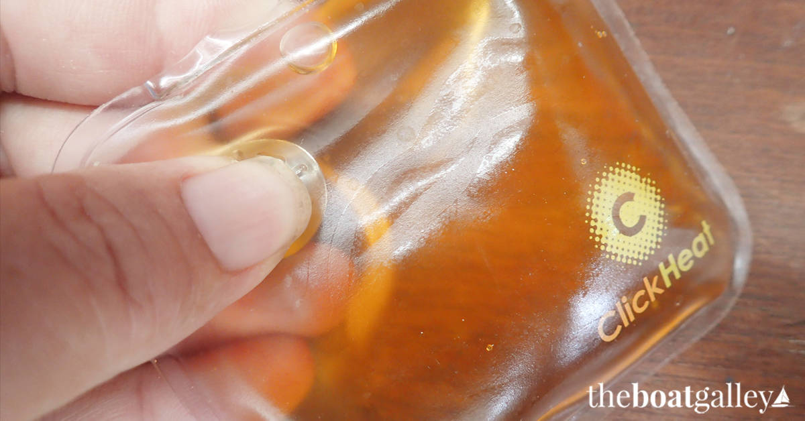
Experience
Hot packs

Slide 9
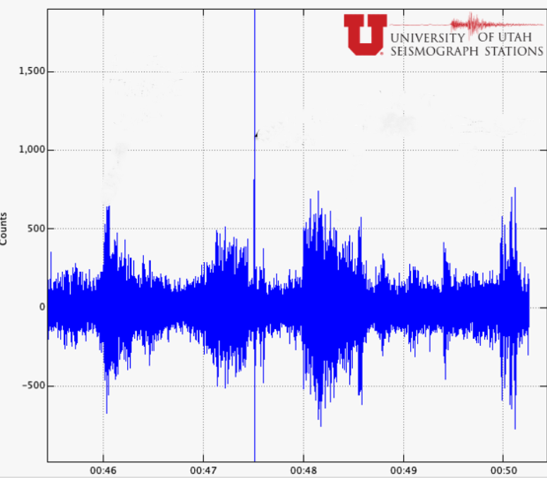
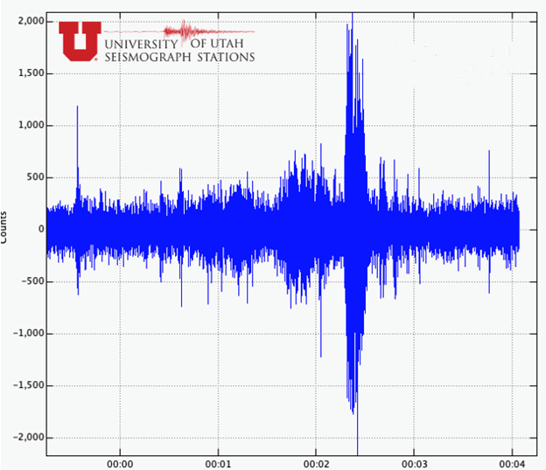
Seismograph Data
Student Questions:
What patterns do you notice on the graph?
Do you notice any changes in the patterns?
Are there any similarities and differences across the time or graphs?
What do you think is causing the spikes in the data?
What is surprising about the data?
What are you wondering about the graphs?

Slide 10
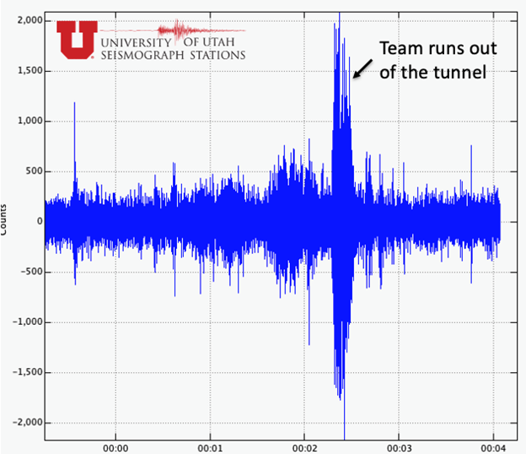
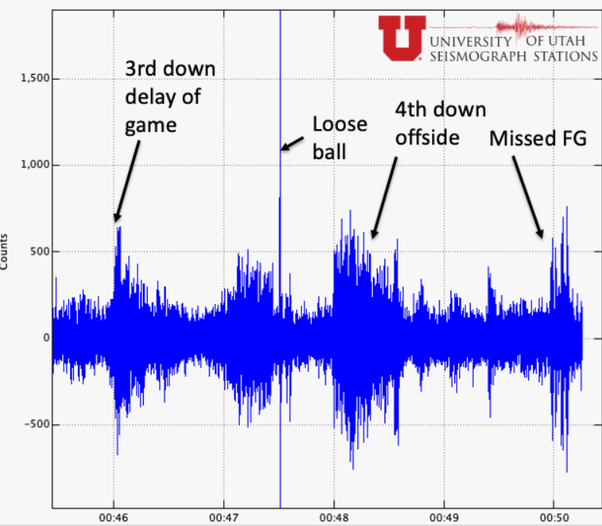
Seismograph Data Actual News article

Slide 11
When to Engage with Phenomenon
Unit
Storyline
Daily
Assessment
Anchoring

Slide 12
Ways to Engage Students in Phenomena
Demonstration
Lab Experiences
Video Clips
Short Readings
Data
Graphs, charts, anecdotes
Pictures
Sorting Activities

Slide 13
Reading

Slide 14
Salt affecting Freezing Point
What are the different parts of the system?
What do you think caused the difference in freezing temperature for the different salts?
Students participate in a lab where they dissolve the same molality of different salts in ice water and record the temperature change.

Slide 15
Radium Girls (Anchoring Phenomenon)
Watching the clip of Radium from the Poisoners Handbook.
Students write based on the following questions:
What do you see happening here? ​
What might be going on inside the women’s bodies that we can’t see? ​
What other matter or energy might be involved that we can’t see? ​
What do we think we know about this phenomenon? Why? What are we unsure of? ​
Topics mentioned that are touched on throughout the year:
Radium as element – elemental identity
Radium is radioactive
Half-lives
Radiation exposure
Radium masks itself as calcium – same number of valence electrons

Slide 16
Phenomenon Experiences:
Student questions:
Write 3 observations about the video.
What happens when 2 rocks hit?
What patterns do you notice when the rocks hit?
What are you wondering about?
Student questions:
What is the difference between the takeoff on land and ice?
What questions do you have after watching the videos?
Why would they use rocket boosters on ice?

Slide 17
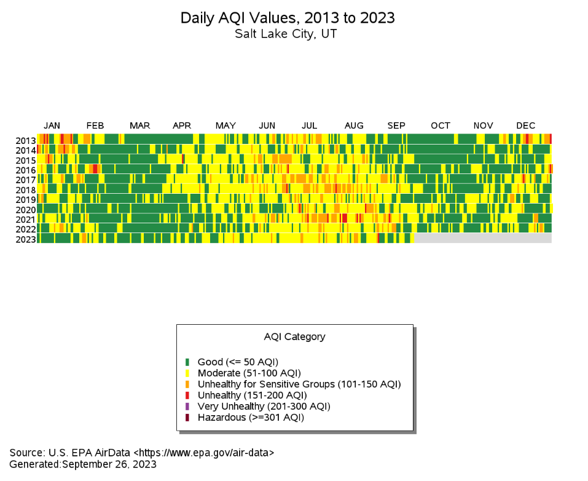
Air Quality Data
What patterns do you see in the data?
What about the data is surprising to you?
What are you wondering after observing this data?
What do you think causes the difference in air quality?

Slide 18
Bohr Models of Period Table
What patterns do you see in the Bohr Models of the first five periods on the periodic table? (Record as many patterns as possible!) Be sure to observe rows and columns.

Slide 19
Rock Pocket Mice Virtual Simulation
Link to Simulation
Engagement Questions Simulation:
What's happening with the predators (larger circles)?
How does reproduction affect the population?
What do you notice about the diversity of organisms within the population?
What is the effect of changing the background color on the population?
What questions do you have?

Slide 20
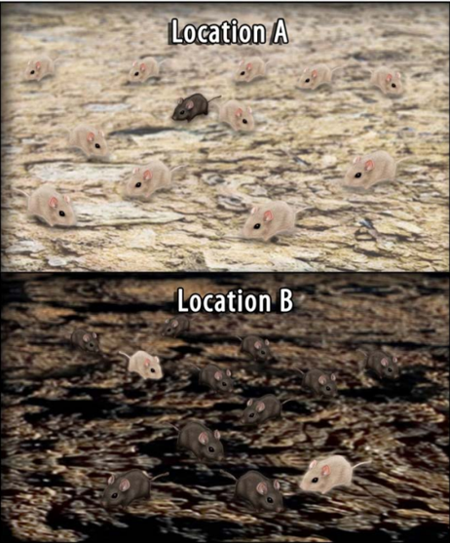
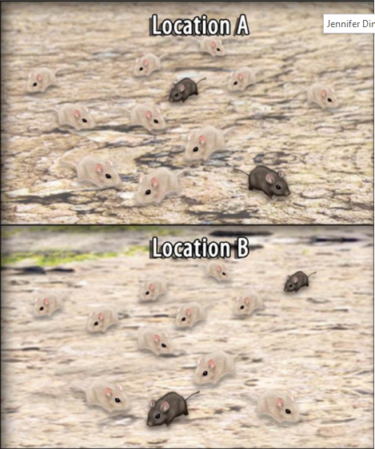
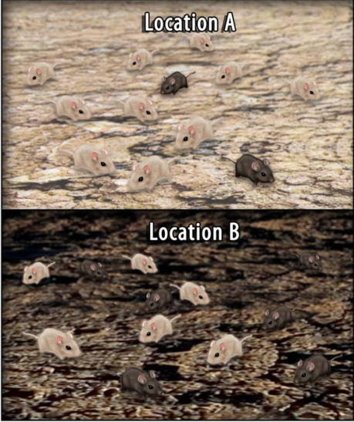
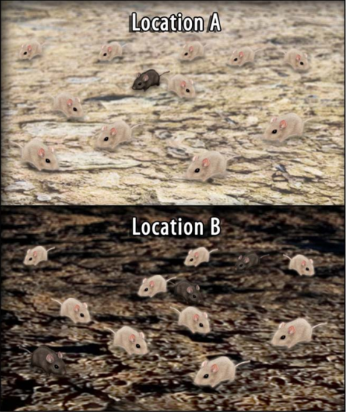
Rock Pocket Mice Pictures
Engagement Questions Pictures:
This can be used as a formative assessment to check the simulation. (Can you put the pictures in order?)
As phenomena
What patterns do you see?
What can't we see?
How does this explain our observation?
What order would you put the pictures in? Why?
What patterns do you notice about the diversity of the population?

Slide 21
Energy Skate Park PhET Simulation
Energy Skate Park Link
What are the different pushes and pulls acting on the skateboarder?
What is the system? What are the components of the system?
How is energy coming into this system?
How is energy coming out of this system?
What energy transformations are taking place?

Slide 22
Windy.com
Link to windy.com
What do you see?
What patterns do you observe?
What causes the patterns you observe?
What interactions of energy and matter might be occurring?

Slide 23
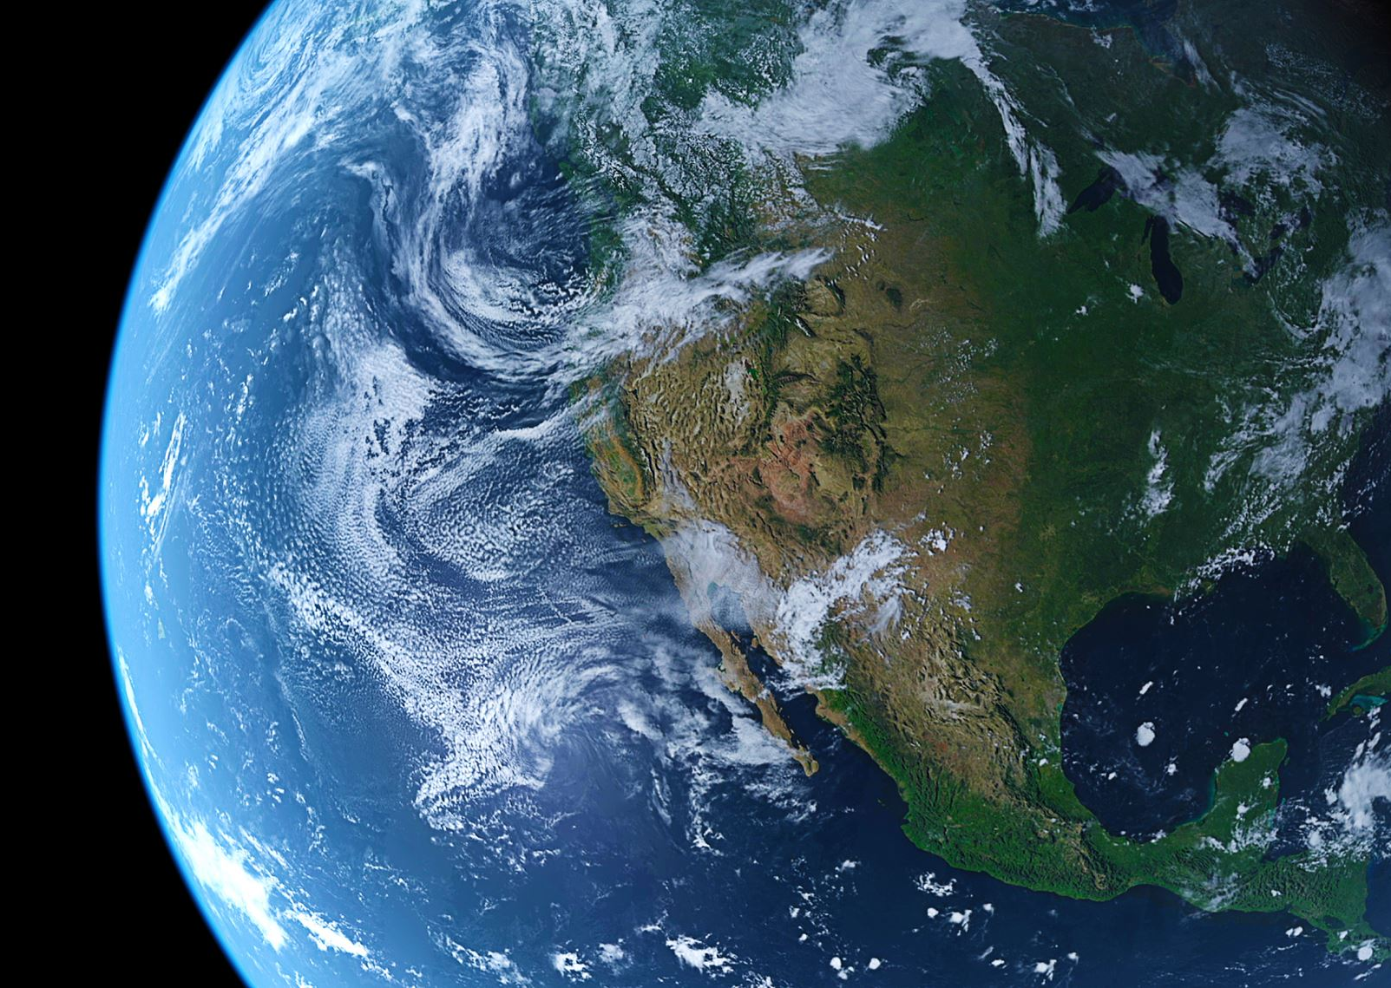
Google Earth
Google earth
Students open google earth link. This can be used to look at different climates and what the earth looks like at different latitudes and longitudes.
Students can look for landforms both in water and on land.
Students can look at the shapes of the continents.

Slide 24
Debrief Whole Group
Where do put phenomena?
What do we, as teacher, have to think about in order for these to be successful?
What questions do you ask to fuel student thinking?

Slide 25
PLC Work
Separate into PLC by grade level/content area.
Establish norms for work.
Identify upcoming standards & phenomenon.
Start to build Classroom Samples! Pair up or group how you'd like within the PLC – the more groups, the more classroom samples can be built to share out!

Slide 26
Next Meeting
Reflection Meeting – Wednesday, November 8 on content/grade level Teams channel.
To Do:
Finish phenomenon classroom sample write up
Implement classroom sample
3 TeachFX recordings (1 of classroom sample, 2 of other lessons)
Complete reflection of TeachFX data

