Slide 1
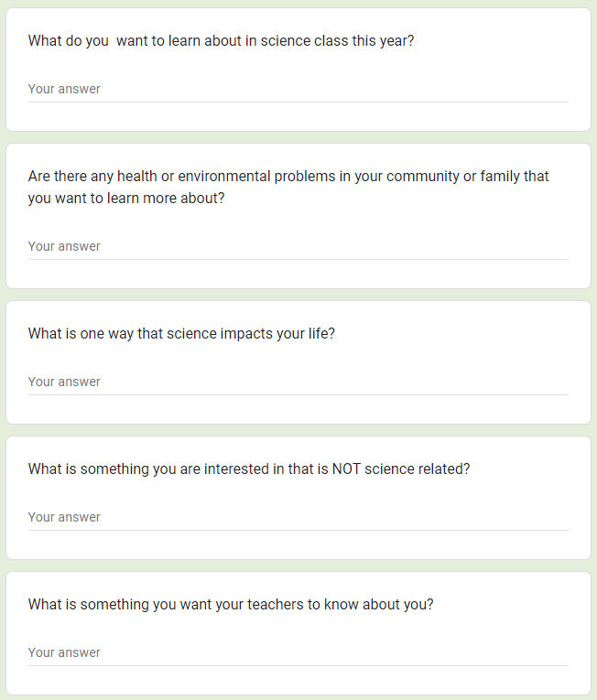
Science in my Life Survey:
This survey is meant to be given to students at the beginning of the year in part to help the teacher identify phenomena that are relevant to their students. I take my students responses and in a separate document identify which student ideas match the DCI’s of each unit. Make this survey available in the home language for ELL students.
This question will help you see what immediate scientific curiosities are in the room. Match these ideas to units whose DCI’s they may be connected to.
This question will help to hone in on issues with societal and/or justice-centered implications. Get student consent before sharing personal or family details with the class.
This question will give you insight on students’ concept of the nature and reach of science, as well as its application to them as individuals.
Many students will identify something that IS related to science- but they might not know it!
An important question to help you get to know your students as individuals so that you can be responsive to their needs.

