Slide 1
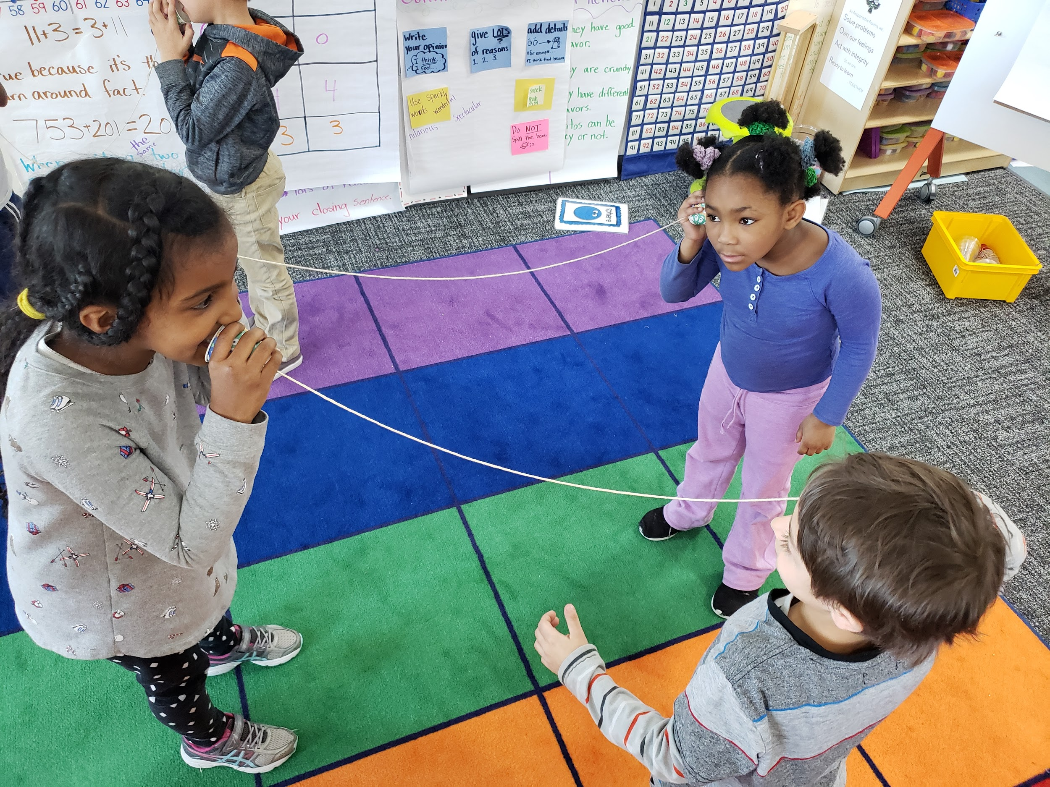
Introduction to Ambitious Science Teaching
Welcome!
Plot Your Dot
Science experience bar graph
Sign-in & Name tag

Slide 2
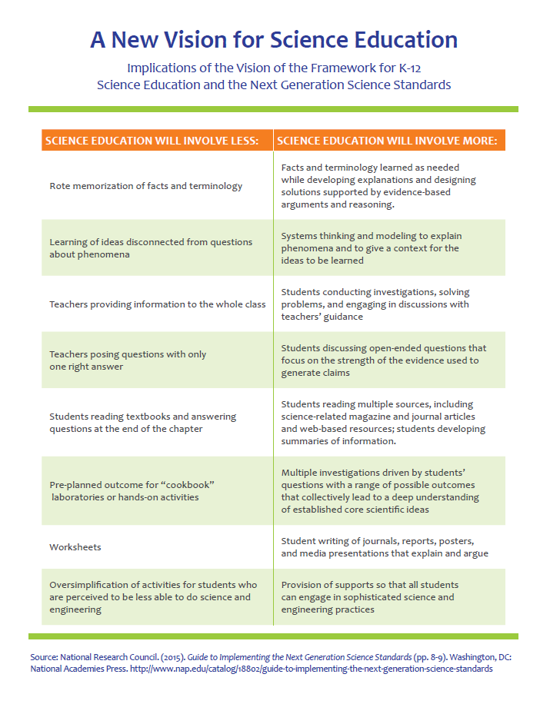
Less of… More of…
A New Vision
for Science Education

Slide 3
Session Outcomes
From this 3-hour session, you will leave with a/an:
Awareness of how ambitious science teaching practices support students’ revising ideas with evidence over time
Shared understanding of models and modeling as a scientific practice
Ideas to support student talk and/or scientific modeling at the start of the school year
Notes:
Estimated time: <1 min

Slide 4
Agenda
Entry Task: Mix, mingle, and Q&A around the room
What is Ambitious Science Teaching?
Architecture of a science unit
Experience a science lesson
Break
What do we mean by modeling? NGSS Connections
Starting the year: Developing a culture of student talk
Exit Task: Index Cards

Slide 5
Ambitious Science Teaching:
Supporting Student Thinking Over Time
Notes:
Estimated time for this section: 45 mins

Slide 6
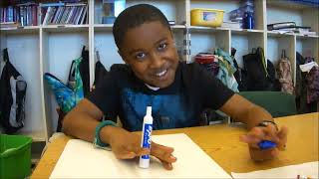
Meet Geovanni: How did his ideas change over time?
Watch video:
What do you hear? see? Notice about Geovanni’s thinking?
What kinds of opportunities did you observe (or can infer) that helped Geovanni shape his thinking?
Notes:
Estimated Time: 15 mins
(Video part one 3 mins + T&T 2 mins + Video part two, 2 mins + T&T 3 mins + 5 min whole group discuss)
Let’s hear Geovanni at the beginning and near the end of a science unit taught using Ambitious Science Teaching practices.

Slide 7
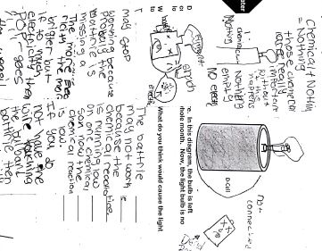
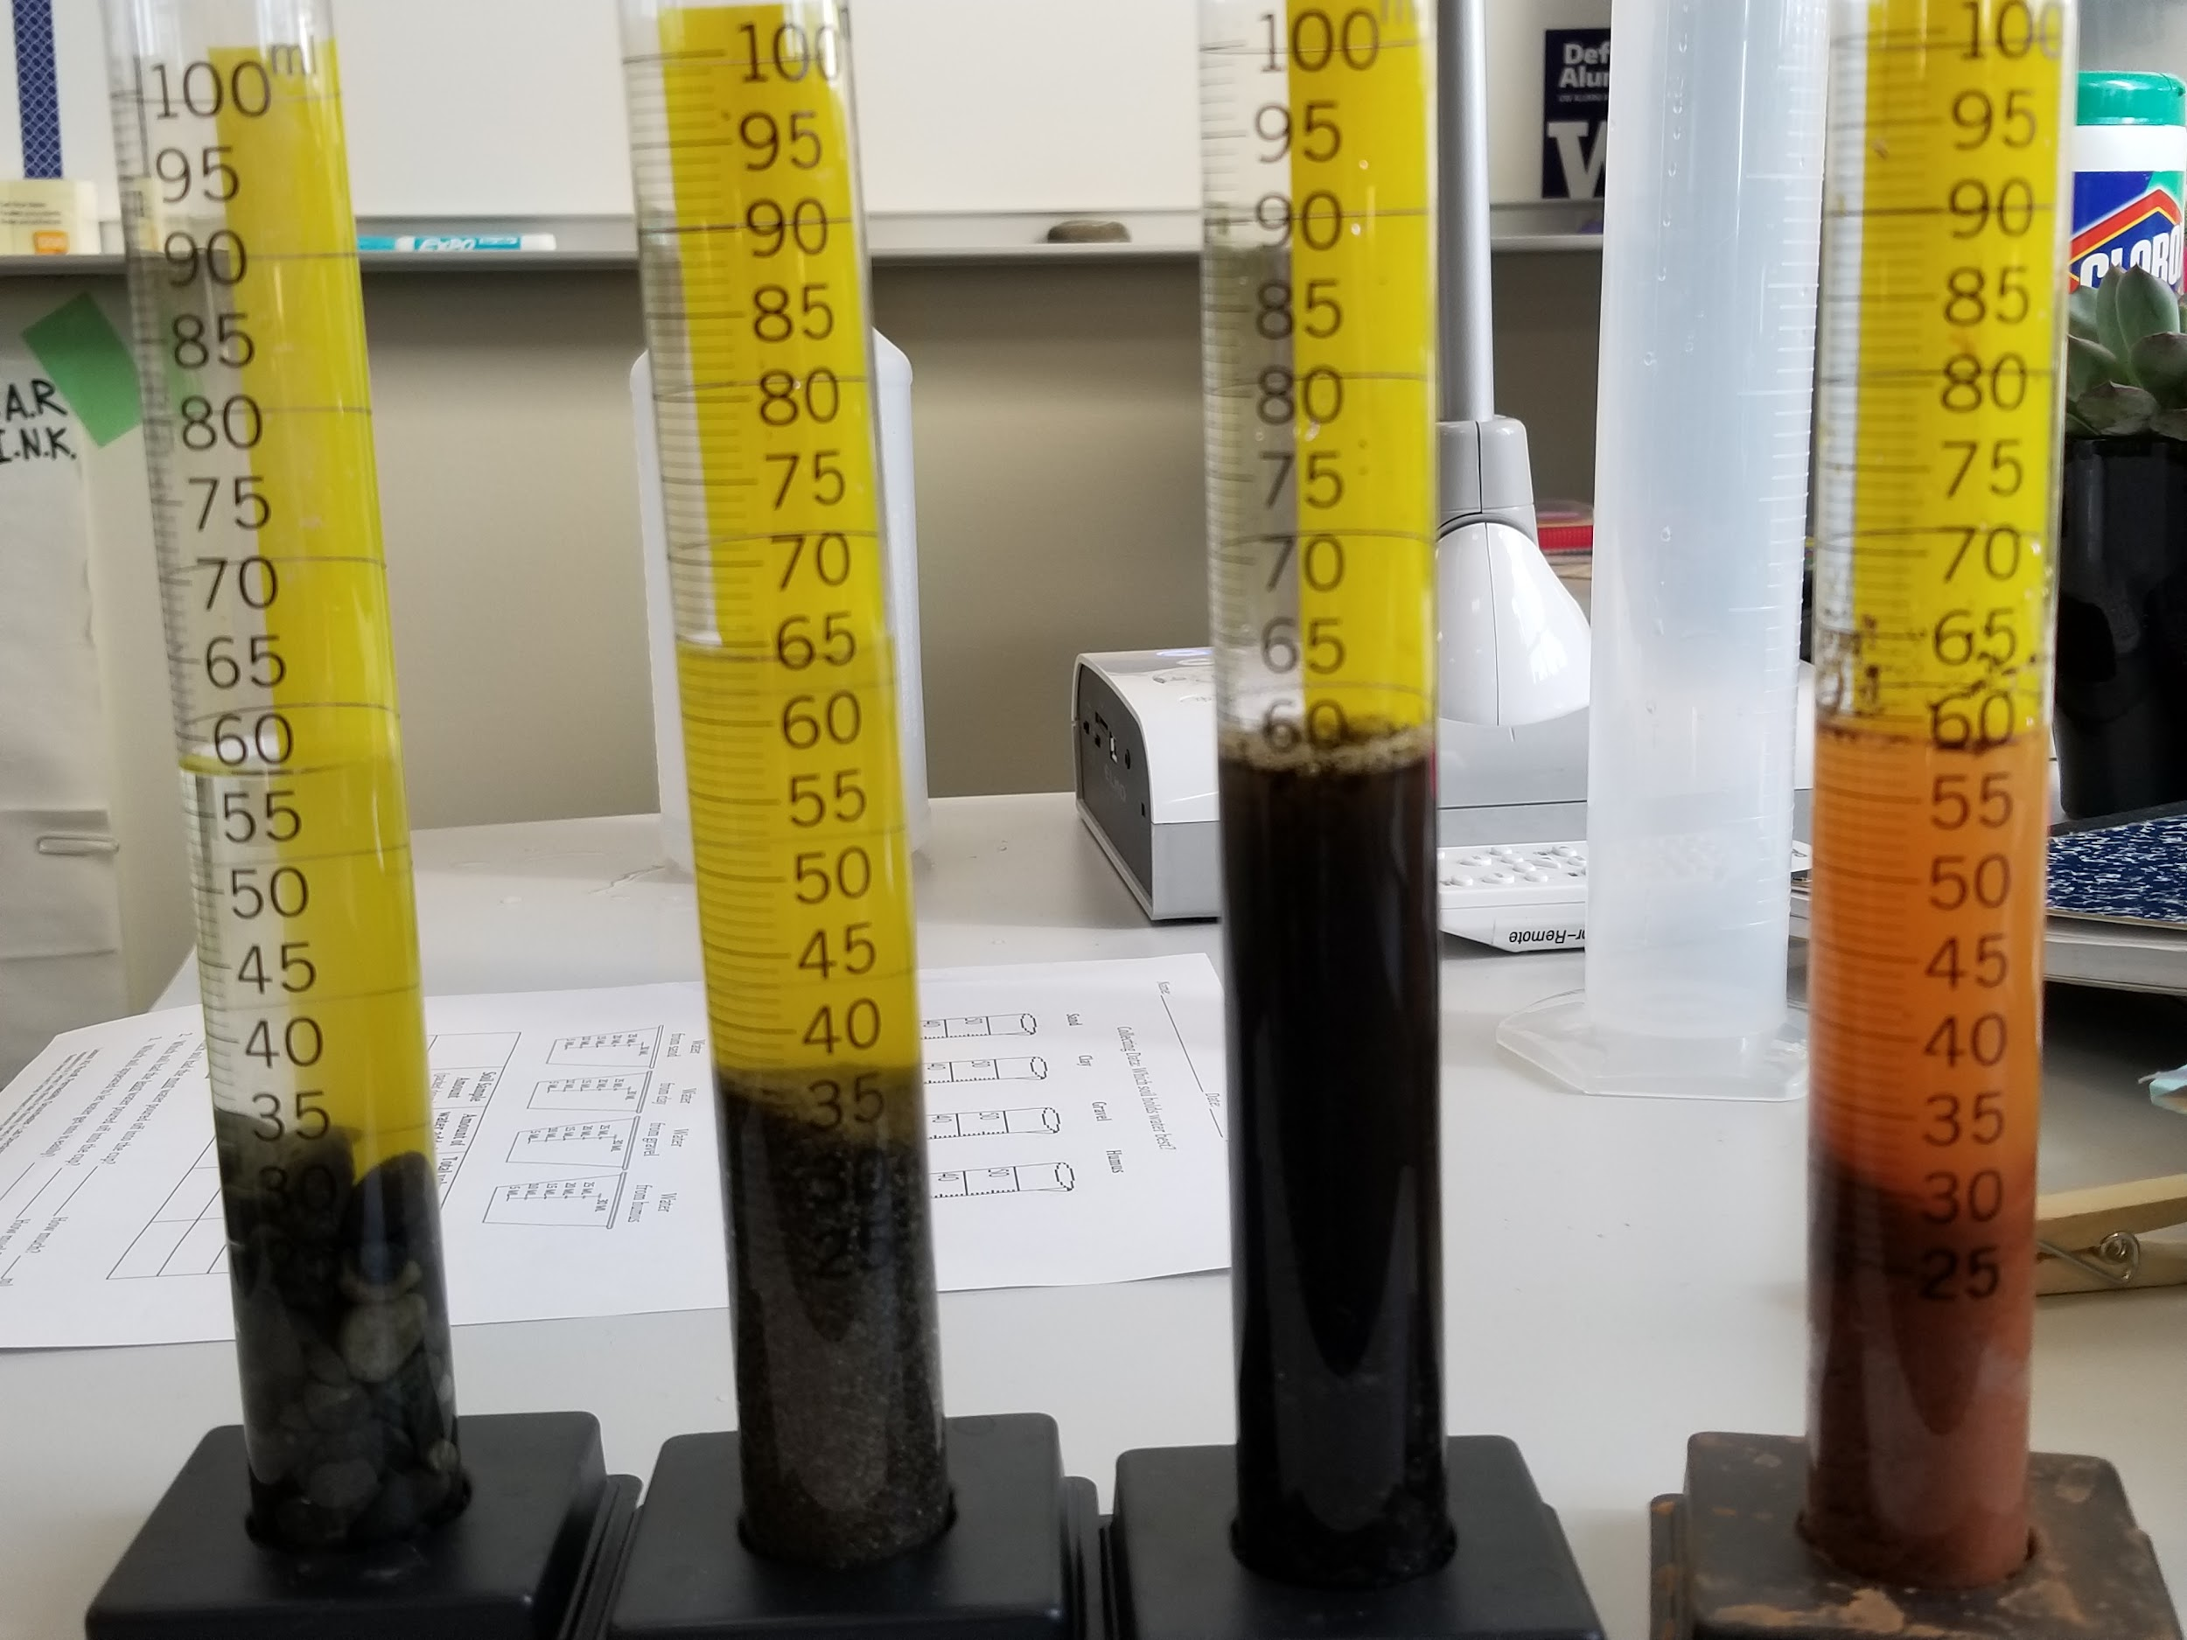
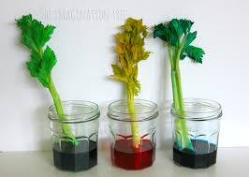
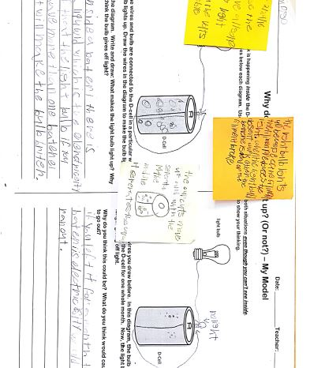
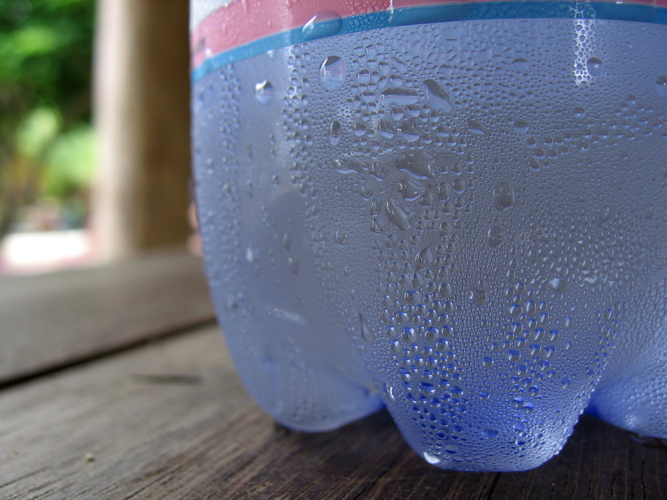
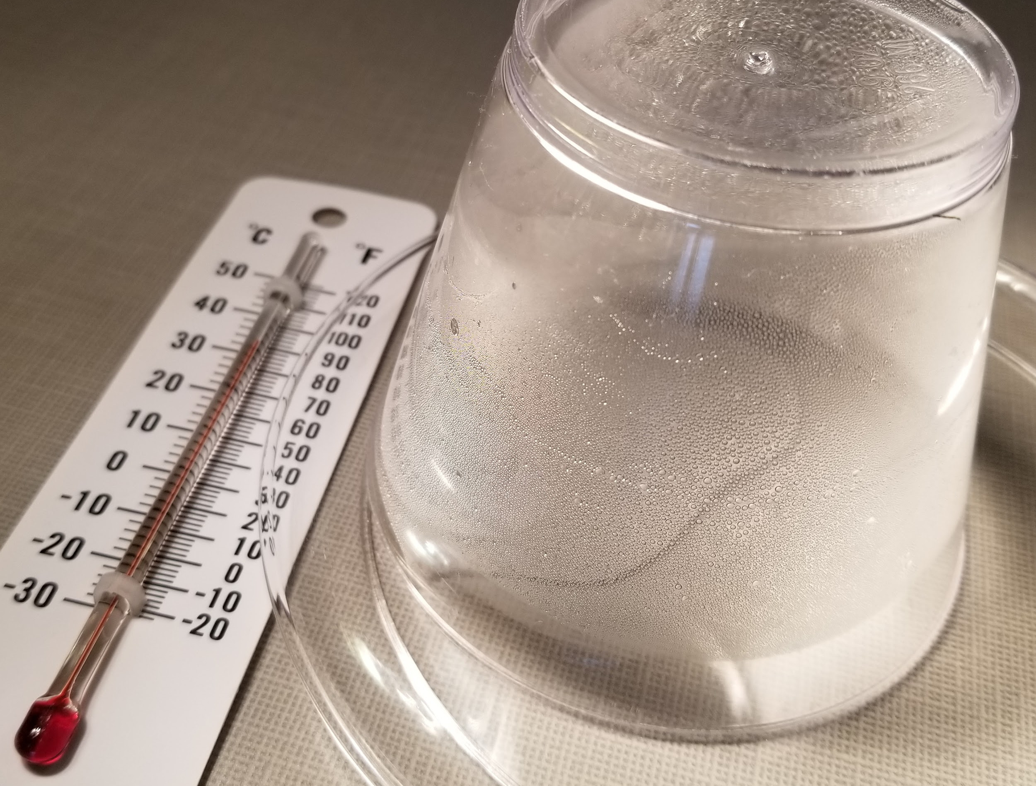
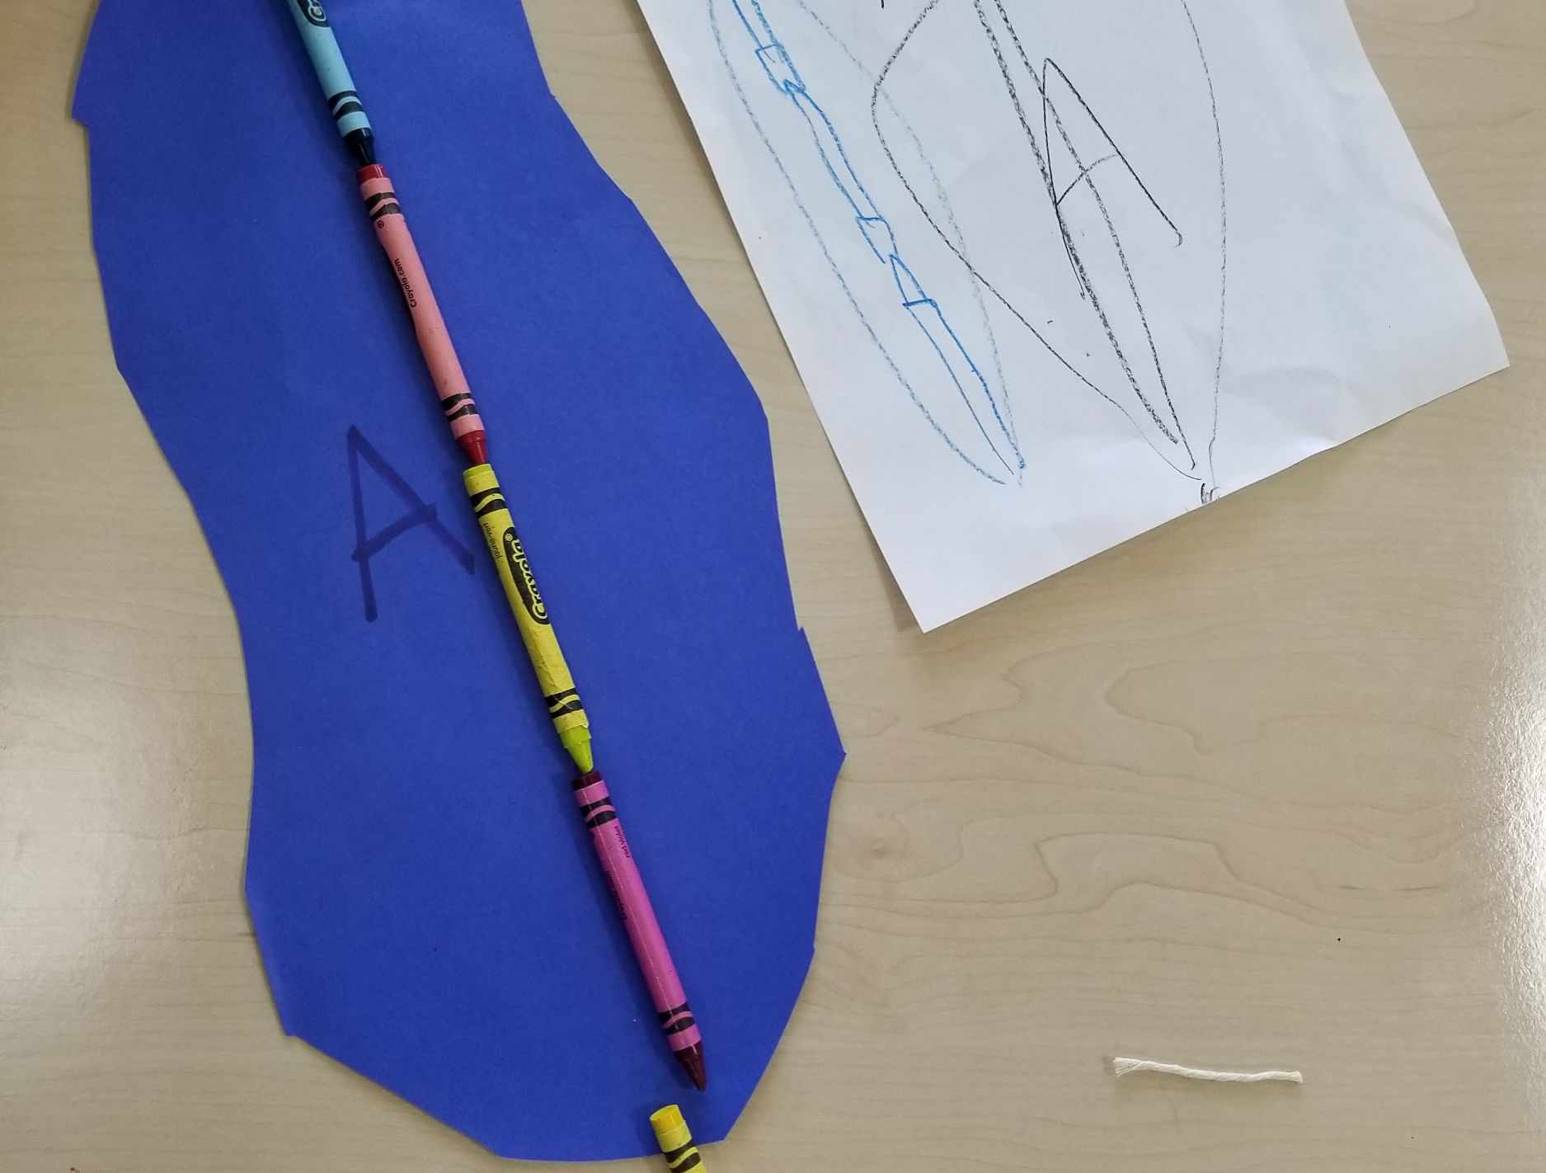
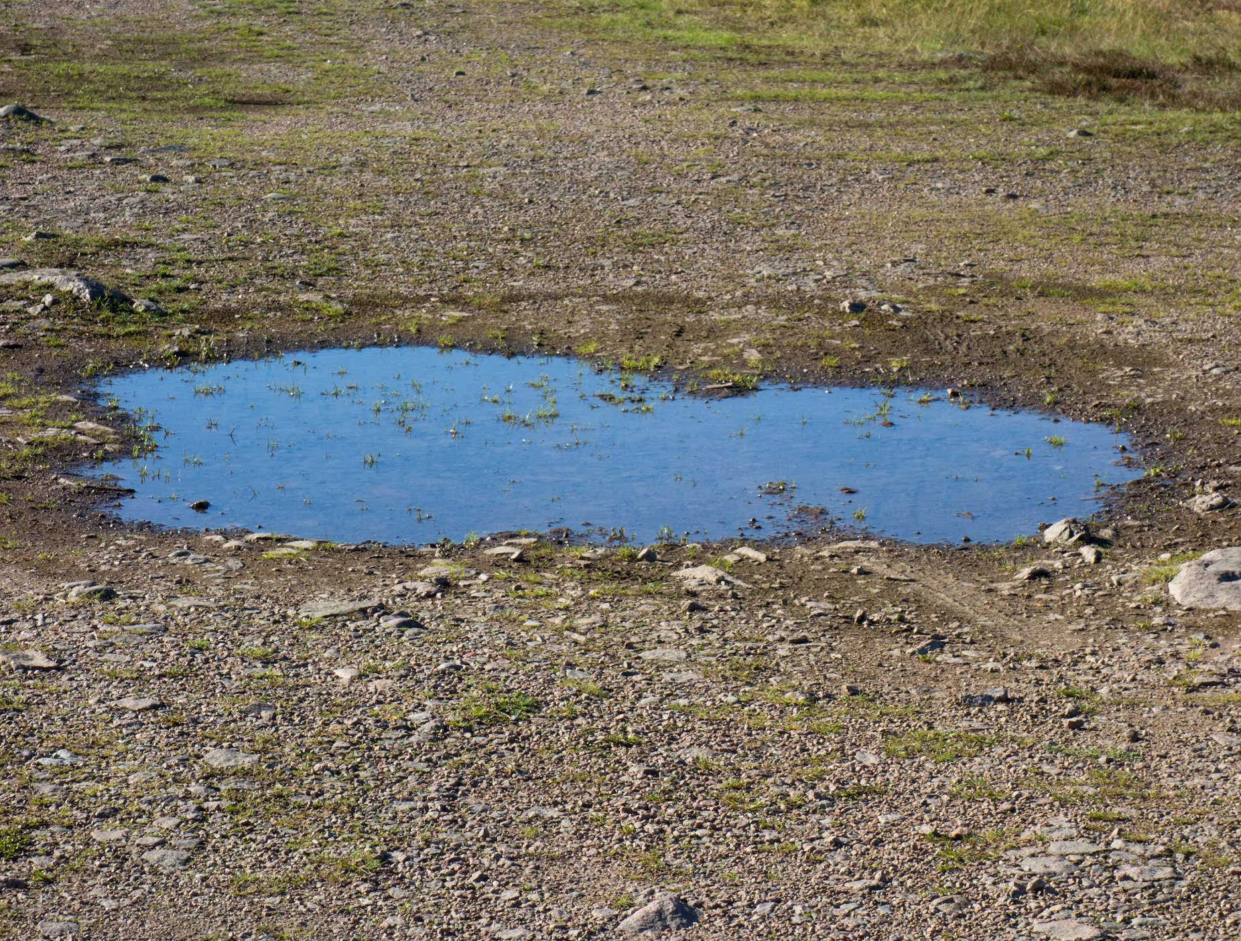
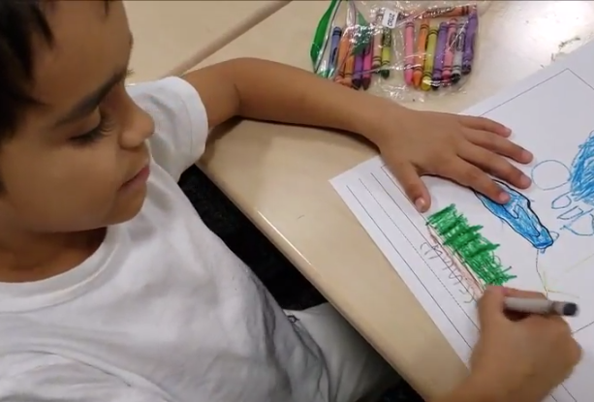
Puddles Unit: Tracing Cruz’s Learning
Water moves in soil
Water goes in plants
Press for evidence-based explanations
Update and revise models
Water Cycle in a Bottle
Covered vs uncovered puddle
Describing puddles
Introduce phenomenon and
elicit Ideas
What experiences did Cruz likely draw upon to create his updated explanation of where the puddle went?
Notes:
Use as reference during think, stop, jot about Cruz’s final thinking about puddles.

Slide 8
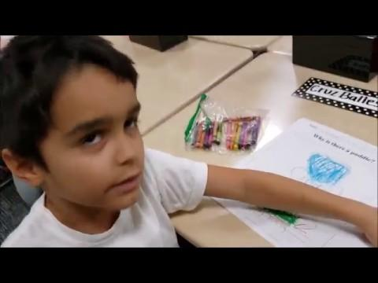
Puddles Unit Example: Ideas change over time
Notes:
Cruz’s final ideas -- also referenced public records on the wall when prompted to keep his thinking going

Slide 9
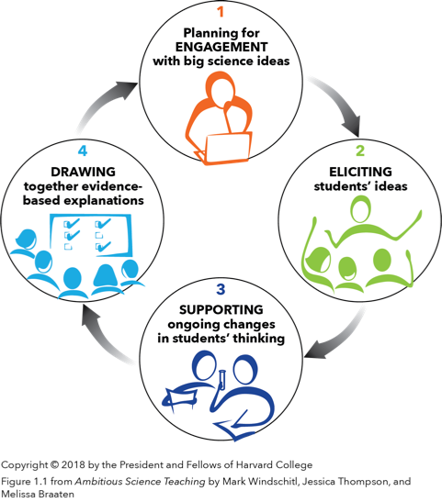
Ambitious Science Teaching Practices
www.AmbitiousScienceTeaching.org
4 sets of productive teaching practices that support all students in learning science based in real-world phenomena
Focused on changes in understanding over time based on evidence (developing and using models with explanations)
Responsive to students current thinking, experiences, and questions
Notes:
Estimated time: 1 minute
Information delivery
Orient to brief history from UW

Slide 10
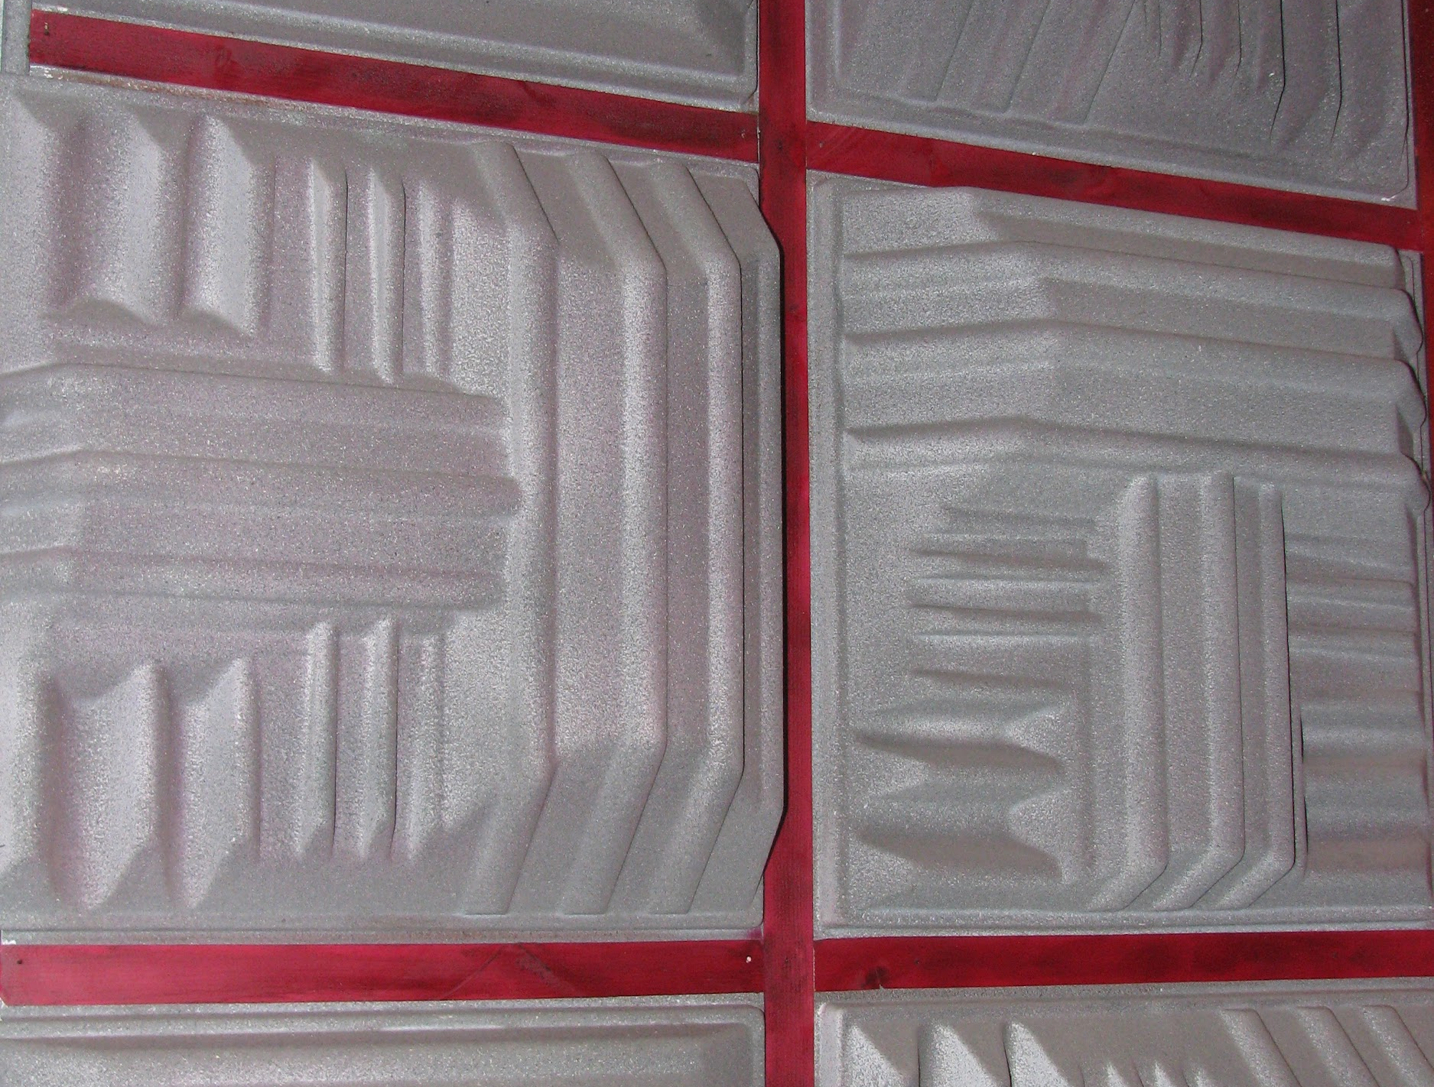
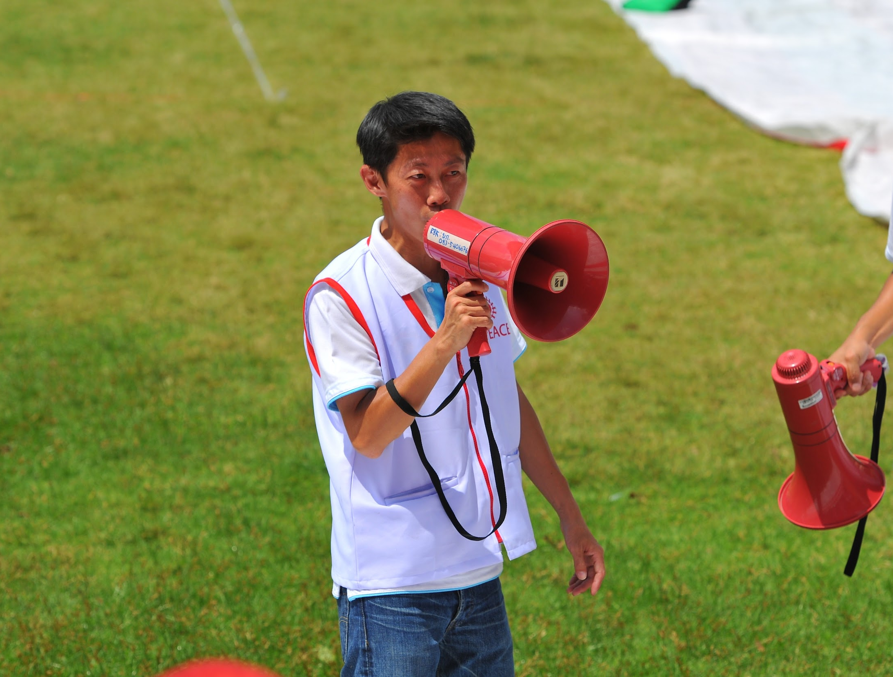
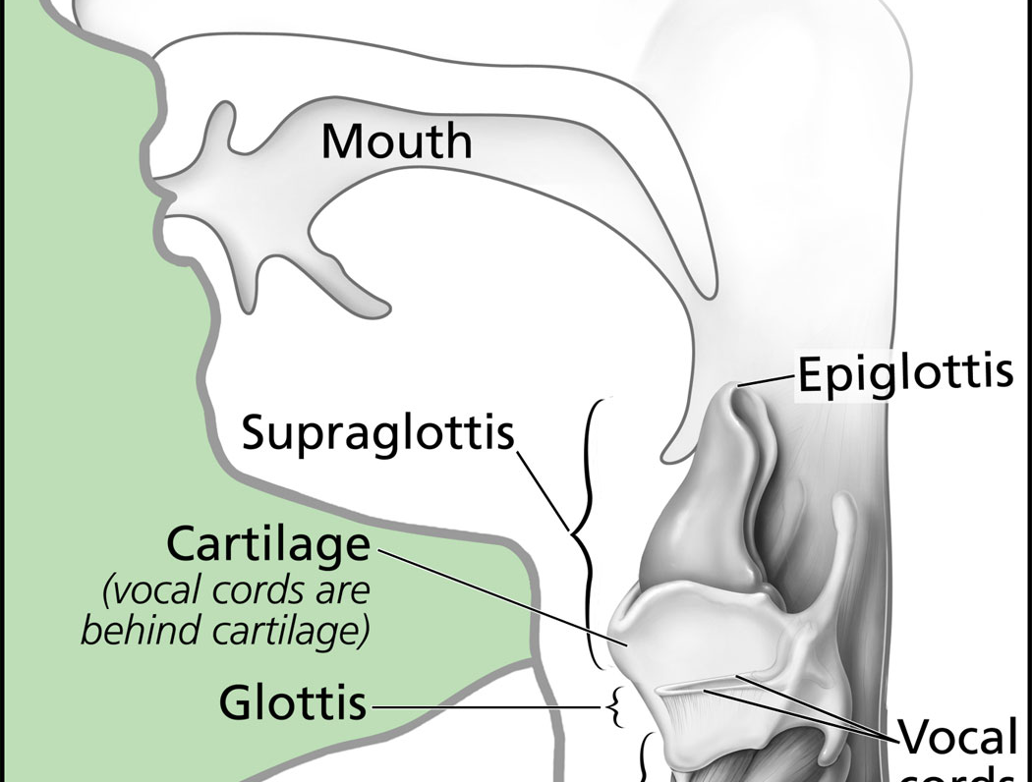
Grade 4 Sound Unit Trajectory
Student Learning
Press for evidence-based explanations
Update and revise models
Matter & Energy: Knock, Knock!
Insulation: Stop that sound!
Seeing sound waves
Decibels at a Distance
Noisy Places Engineering Design Project
Human Systems
Introduce phenomenon and
elicit Ideas
Big Ideas:
Vibrations make sound
Representing qualities of sound
Relationships between:
Force, vibrations, energy, and volume
Force, volume, distance
Big Ideas:
Energy transfers through matter
Matter is made of particles
How can we manipulate energy to solve problems
This is a very broad overview of this unit. There are more specific lessons and experiences than what is represented here in the teacher guide.
Notes:
2 mins

Slide 11
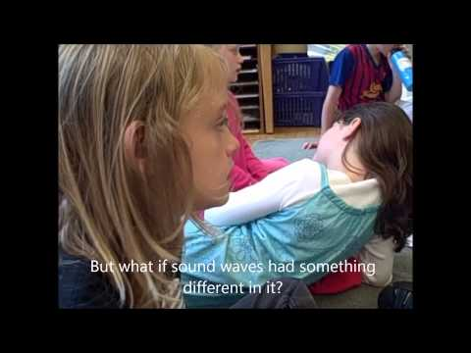
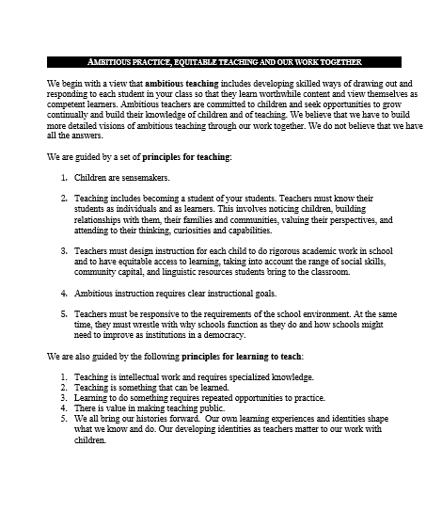
Ambitious Science Teaching: Sound Unit Overview
Where do you see our Ambitious Practices in this unit?
Notes:
20 mins - watch and discuss unit overview using 7 elements and opportunities to learn over time to shape thinking.

Slide 12
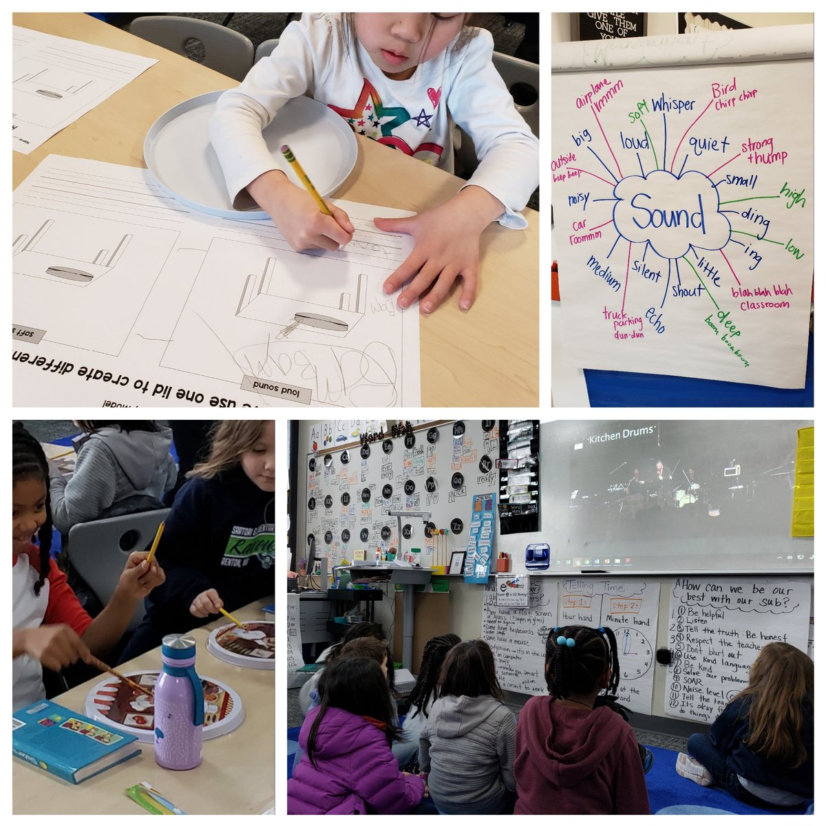
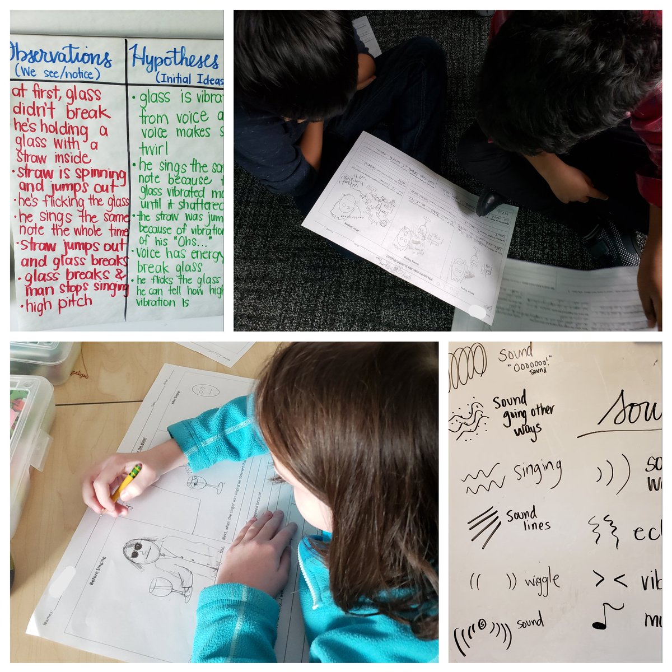
Experience a Lesson:
Let’s drop into the Sound Unit!
Notes:
Estimated time: 50 mins

Slide 13
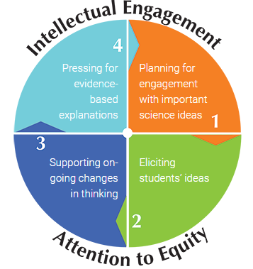
Unit Trajectory: Grade 4 Sound
Student Learning
Press for evidence-based explanations
Update and revise models
Matter & Energy: Knock, Knock!
Insulation: Stop that sound!
Seeing sound waves
Decibels at a Distance
Human Systems
Introduce phenomenon and
elicit Ideas
Big Ideas:
Vibrations make sound
Representing qualities of sound
Relationships between:
Force, vibrations, energy, and volume
Force, volume, distance
Energy transfers through matter
Matter is made of particles
How can we manipulate energy to solve problems
https://AmbitiousScienceTeaching.org
Notes:
2 mins

Slide 14
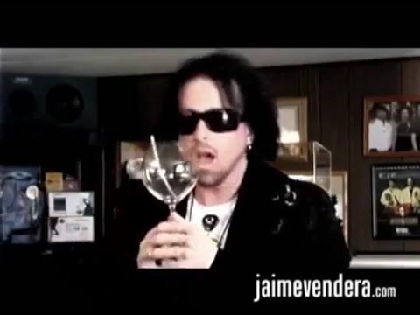
4th

Slide 15
Debrief: L1 Eliciting Ideas
Silent reflection time:
What did we do?
As a student, how did this feel?
As a teacher, what are you thinking about now?
Partner share.

Slide 16
Explore the Unit Guide
What do you notice? What stands out to you?
What kinds of opportunities do you see that will help students build and revise their thinking about sound?
Locate online unit guide (downloadable PDF w/links):
https://AmbitiousScienceTeaching.org/tools/
Skim:
Opening pages
Unit overview table outlining each lesson
Next 2-3 lesson guides after L1 eliciting ideas lesson

Slide 17
Stretch your legs.
Notes:
Start at Noon. This break should be 1:30-1:40

Slide 18
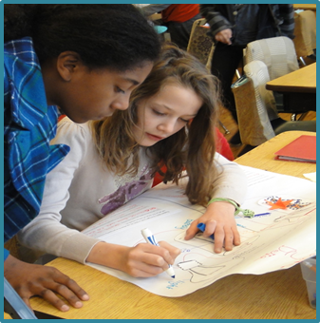
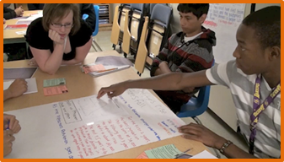
NGSS Connections:
What are Models? What is modeling?
Notes:
Estimated time: 20 mins
Information Delivery + NGSS K-12 Matrix w/student samples

Slide 19
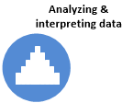
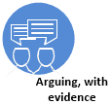
NGSS Science & Engineering Practices inform and motivate each other
Ambitious Science Teaching centralizes modeling and explanation
motivates
motivates
informs
motivates
informs
informs
informs
Notes:
To orient us with Ambitious Science Teaching and the NGSS, one place is in how we use and orient to the science and engineering practices. These lessons I’ve designed in the curriculum guides are designed with centralizing modeling and explanation and using the other science and engineering practices in service of them. Sometimes these are teacher-decisions but there should be space for student driven investigations in each unit around the big ideas in the units.

Slide 20
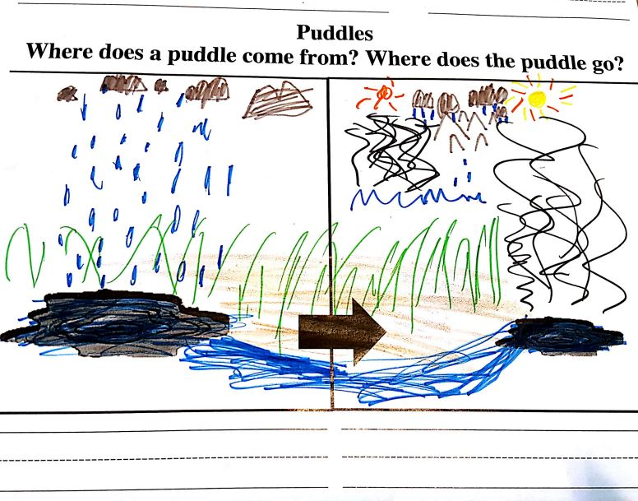
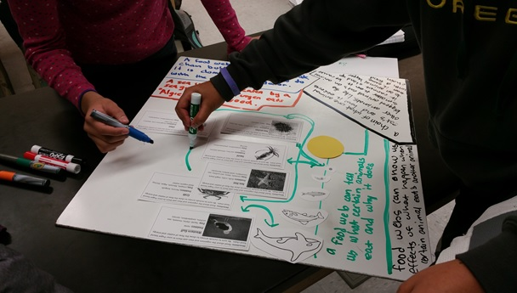
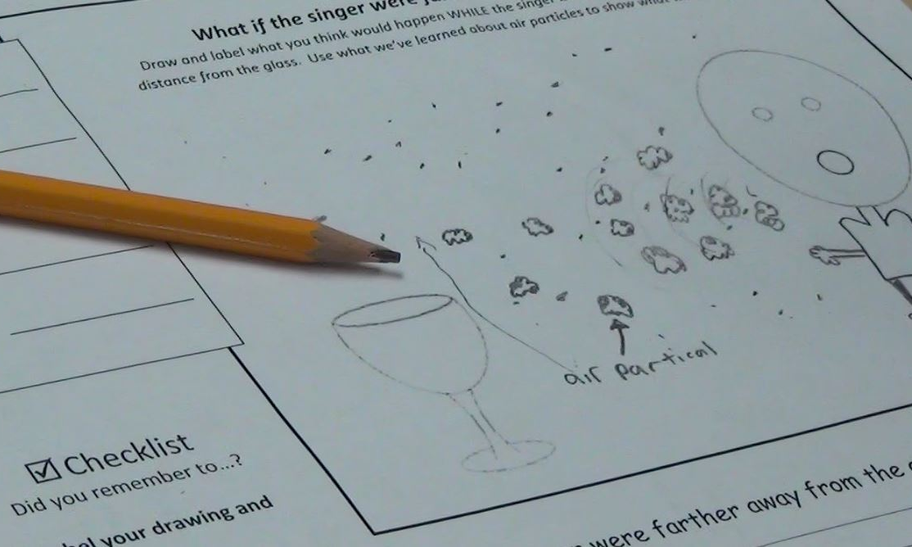
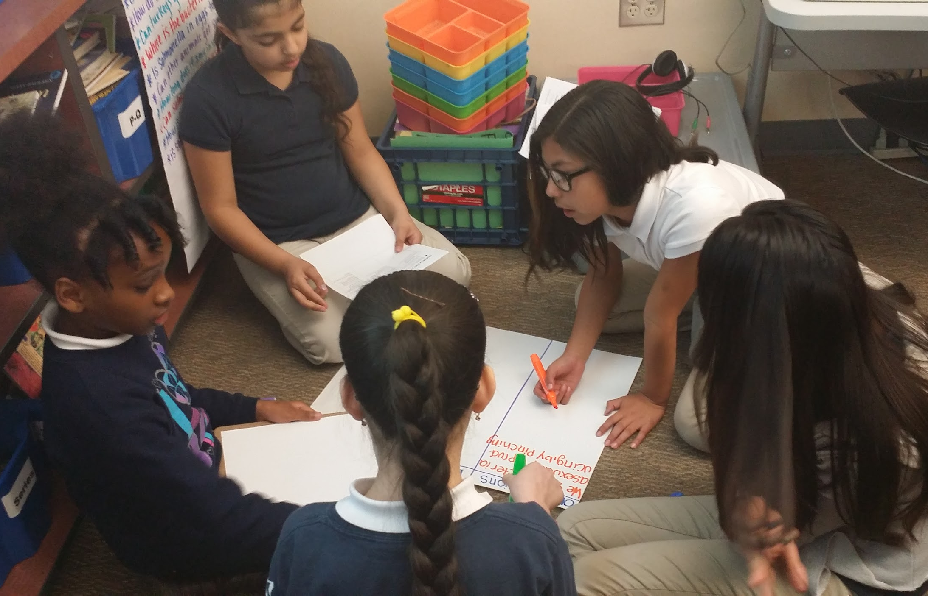
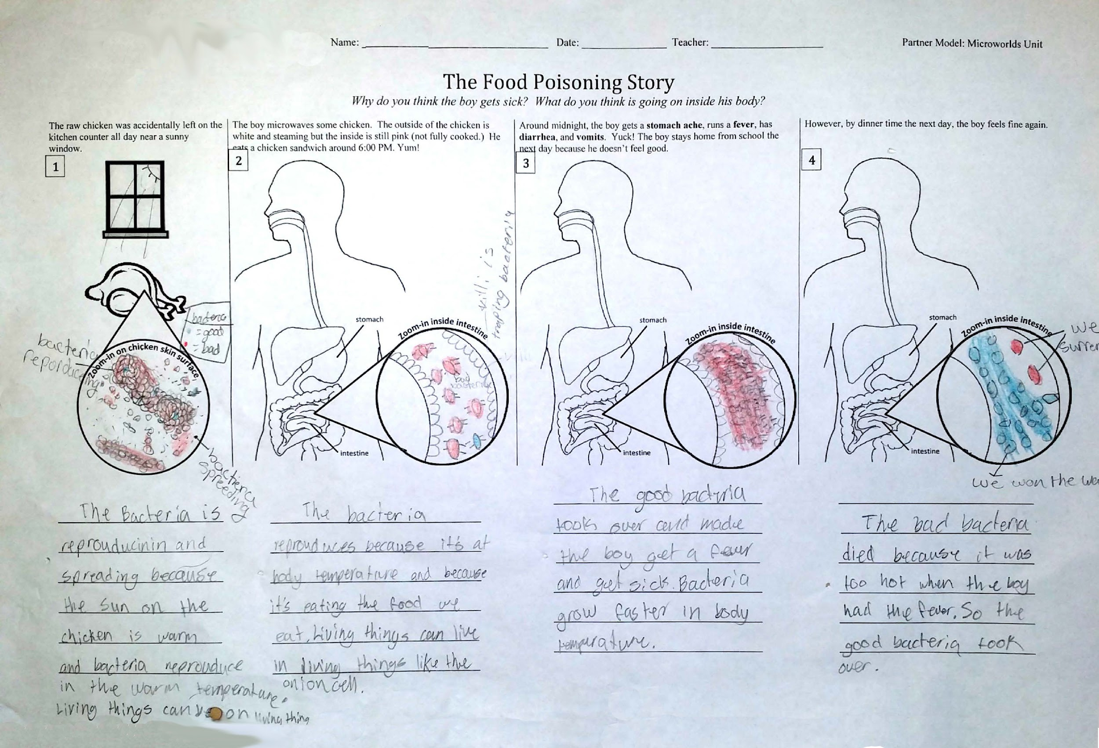
In Ambitious Science Teaching, what do we mean by modeling?

Slide 21
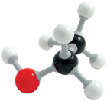
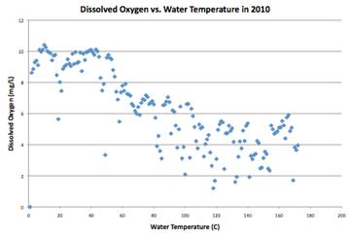
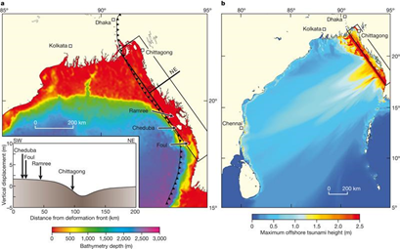
What are scientific models?
Representations of things, ideas, events, or processes
Physical models: ball and stick molecule
Graphs: dissolved oxygen in creek locations of different temperatures
Computer simulations: tsunami wave heights in West Bengal 1762

Slide 22
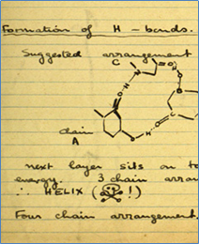
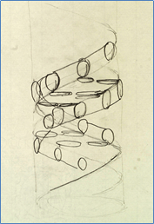
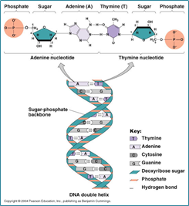
What is modeling?
A scientific practice, in which representations of phenomena are created, tested, and revised over time in light of new evidence and information.
Evolution of DNA double helix model
Starts with images from Rosalind Franklin’s notebook

Slide 23
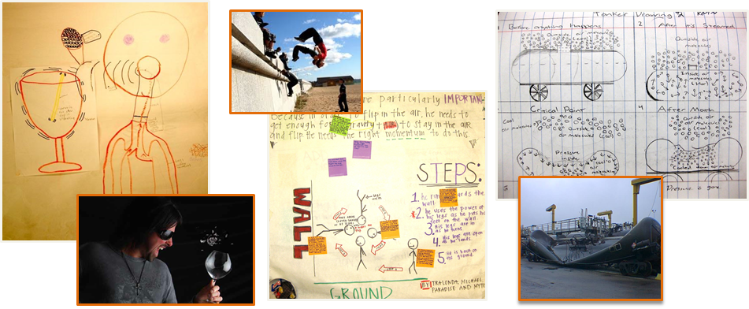
Students produce models that are pictorial, and of events that can have more than one way of expressing an explanation...
4th grade Sound energy
11th grade Force & motion
8th grade Gas laws

Slide 24
Focus on Explaining Phenomena
Puzzling phenomena whose full explanation requires a wide range of science ideas to be coordinated with one another
Sustained intellectual work on challenging problem

Slide 25
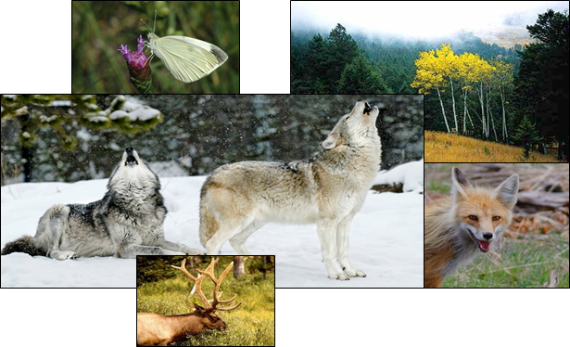
Puzzling Question for Yellowstone ecosystem change phenomenon:
How could the re-introduction of so few wolves to Yellowstone, cause such dramatic changes in the ecosystem?
Carrying capacity
Population dynamics
Niches
Competition for resources
Trophic levels and energy
Interdependence of organisms

Slide 26
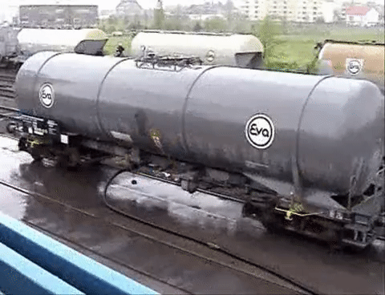
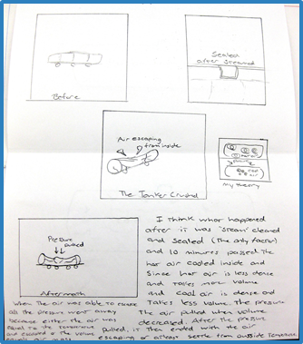
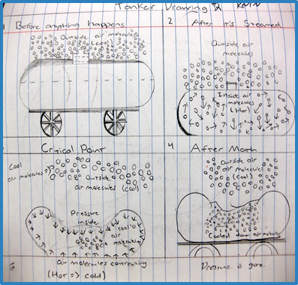
Modeling means revising
in response to new evidence, ideas
Evidence from unit activities, readings, videos, data...
Kevin’s initial model
Kevin’s model later

Slide 27
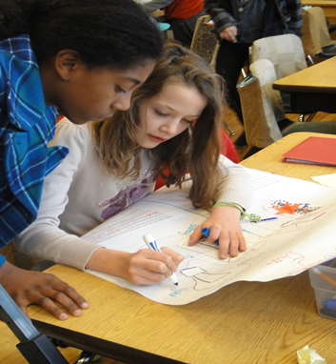
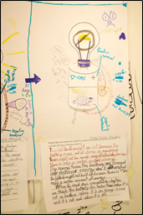
Why is modeling a valued practice?
It’s not so kids to act like “little scientists”
It makes students’ thinking visible to you and makes their reasoning available to their peers
Allows students to show more of what they currently know in variety of ways
Helps students see value in changing their thinking in response to new evidence/ideas

Slide 28
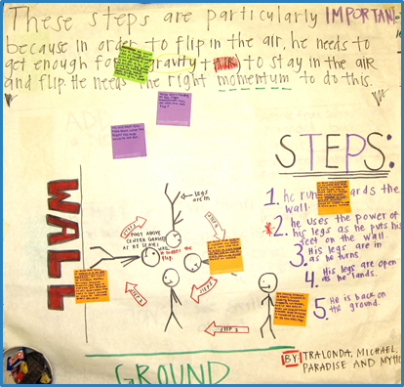
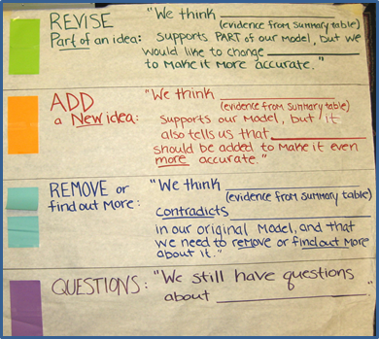
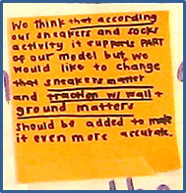
Revising models in principled ways
“We think according to our sneakers and socks activity it supports part of our model, but we would like to change that sneakers matter and traction with the wall and ground matters should be added to make it even more accurate.”

Slide 29
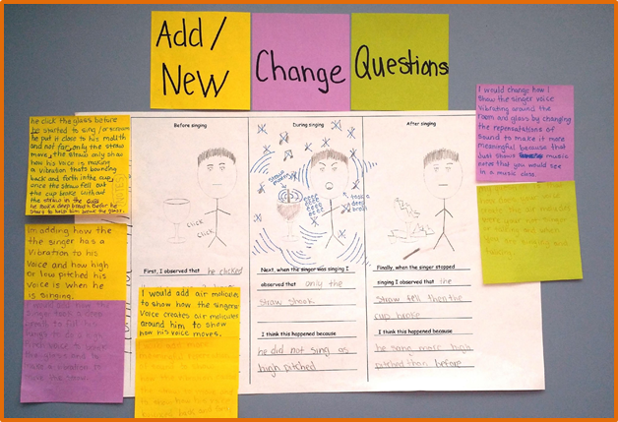
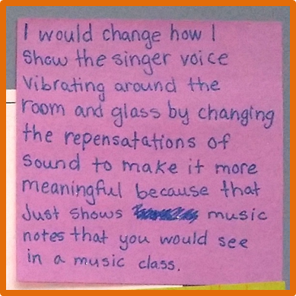
Upper elementary sound energy unit model revision

Slide 30
Initial model:
Sound lines crescents growing up and squiggle
What happened “I use my pencil” and speech bubbles
Near end of unit:
Sound lines crescents growing our plus air
Key added highlighting volume (loud) and medium (air) for sound to travel

Slide 31
NGSS SEP: Developing & Using Models
Pushing beyond the “What happened?” to “How/why did it happen?”
Not just about the unit phenomenon, but about the hands-on labs, too! Modeling can be added to many different kinds of tasks! Can also be theatrical/gestural models with narration!
Curriculum guides have suggestions, but design/share/add your own!

Slide 32
NGSS SEP: Developing & Using Models
Read the K-2 and 3-5 columns.
Did we do any of these today?

Slide 33
Grade 1 Example: Teacher Talk Moves
What is the function of the teacher’s talk moves?

Slide 34
Vision of Learning
To make this kind of learning happen, what do we need to begin to establish in our classrooms?
Brainstorm.
Choose one and get specific.
Notes:
10 mins = some kind of reflection/closing next step type thing

Slide 35
What’s next?
Name, grade, school
What are the big ideas you want to hold onto from today?
What are questions you have moving forward?
Notes:
10 mins = some kind of reflection/closing next step type thing

