Slide 1
Building on students’ Funds of Knowledge
Toward Justice-Centered Ambitious Science Teaching (AST) © 2023
Notes:
This PL is designed for 3 hours and was designed by Dr. Heena Lakhani, Dr. Jessica Thompson and the C2AST and PASTEL teams.

Slide 2
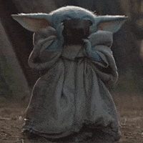
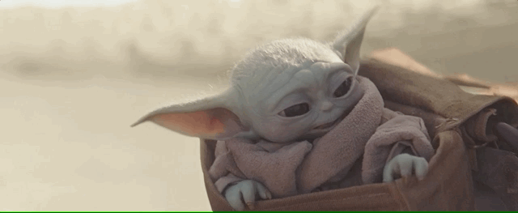
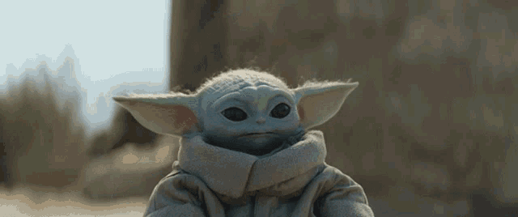
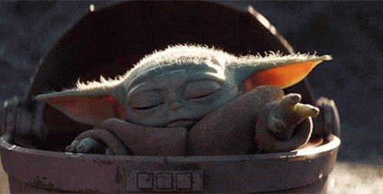
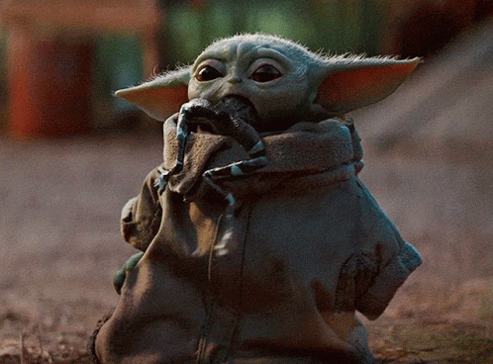
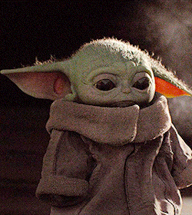
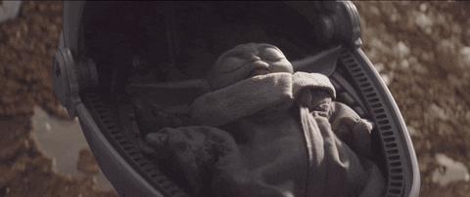
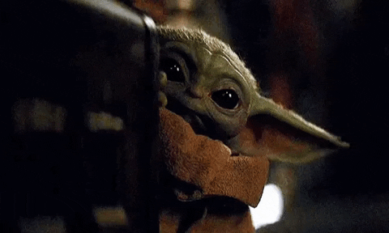
1
6
Chat Check-in
On a scale of Baby Yoda
Please share how you are feeling coming into this learning session using the numbers attached to the Yoda gif.
Feel free to add a brief explanation.
2
7
4
5
3
8

Slide 4
Part 1: FOK and our own critical reflection
Notes:
Part 1 60-90 minutes

Slide 5
Funds of Knowledge: Incorporating knowledge, language, lived experiences, and different ways of knowing science to position students as valuable contributors.
Students’ Cultural Expertise
Students have many ways they engage in meaning-making that. These may be narrative, non-linear, divergent, multi-scale and more.
Students diverse ways of thinking, cultures, and languages are strong assets and can enrich the science community in the classroom.
Teachers’ Critical Reflection
Whose perspectives are reflected in this work? Whose are absent?
What assumptions are being made?
Whose interests are served? Whose are not?
Whose values are being transmitted?
Who has power in this situation and where does it come from?

Slide 6
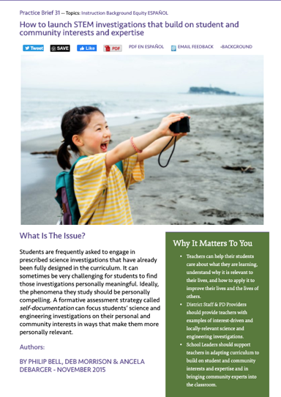
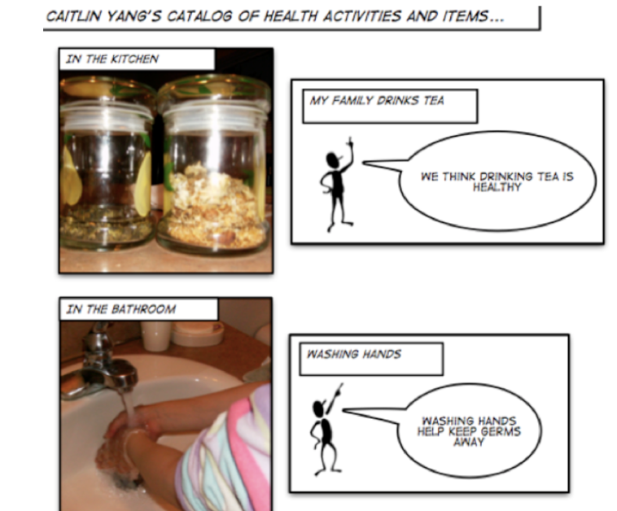
http://stemteachingtools.org/brief/31

Slide 7
Activities like this involve many intersecting identities and require critical reflection
Students’ Cultural Expertise
Students have many ways they engage in meaning-making that. These may be narrative, non-linear, divergent, multi-scale and more.
Students diverse ways of thinking, cultures, and languages are strong assets and can enrich the science community in the classroom.
Teachers’ Critical Reflection
Whose perspectives are reflected in this work? Whose are absent?
What assumptions are being made?
Whose interests are served? Whose are not?
Whose values are being transmitted?
Who has power in this situation and where does it come from?

Slide 8
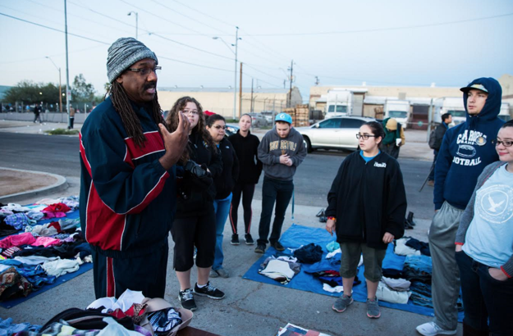
“Critical consciousness is the ability to identify, critique, and challenge the social forces that produce inequality and oppression.”
Questions teachers can use to develop a language of critique:
Whose perspectives are reflected in this work? Whose are absent?
What assumptions are being made?
Whose interests are served? Whose are not?
Whose values are being transmitted?
Who has power in this situation and where does it come from?
Notes:
Retrieved from https://medium.com/sanford-inspire-program/rejecting-face-value-critical-consciousness-in-the-classroom-ae7eb551e1e4 on 7/30/20

Slide 9
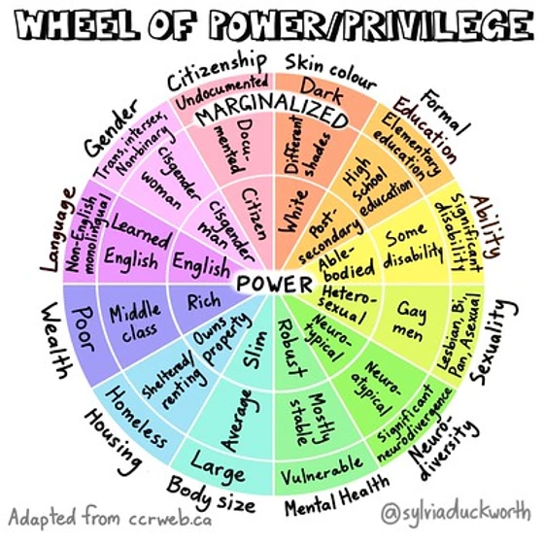
How can we use this wheel to reflect on Funds of Knowledge and Funds of Identities in our classrooms?
Notes:
https://www.thisishowyoucan.com/post/__wheel_of_power_and_privilege

Slide 10
Science Learning is Cultural: “Human beings, no matter who we are, where we live, or what language we speak at home, develop our ways of knowing, talking, valuing, and acting as we live our day-to-day lives inside family and community. These ways of living are what is now understood as culture. Indeed, across communities, human beings make sense of the world in ways that are both similar and different.”
—Bang, Brown, Calabrese Barton, Rosebery & Warren (2017, p. 36)

Slide 11
Science Learning is Cultural, So...
Students’ lived experiences matter | Students’ ways of communicating about the world matter, including their linguistic, gestural, and symbolic ways of representing ideas
How students experience and make sense of power, race, and justice matter | Students’ life histories, interests, possible futures & identities matter
NSTA publication
Notes:
This framework will help us attend to different dimensions of culture and provide an opportunity for us to take a critical stance toward our own identities and positionality. Read more about this tool in the NSTA publication. (Tool adapted from Patterson Williams, Higgs & Athanases, 2019)

Slide 12
Let’s broaden how we conceptualize science and challenge our own perspectives/ education. What dimensions of this table resonate with you? Challenge you?
Reflective Dimensions of Critical Consciousness & Cultural Awareness | Western Science can be about…. | Other Perspectives of Science Invites…
Who? | Scientists, people with degrees in science, white identities. | Youth, multi-generational relations, community members, multispecies
What? | Experimental investigations | Nature walks, stories
Where? | Laboratory, field | Home, neighborhoods, communities spaces
Why? | Economic output, competitive progress, advancements | Collective well-being, living in harmony with the universe
Resources? | Textbooks, talks, academia | Family members, communities, cultural knowledge, everyday experiences, ecosystems
Notes:
DeepDive into CC

Slide 14
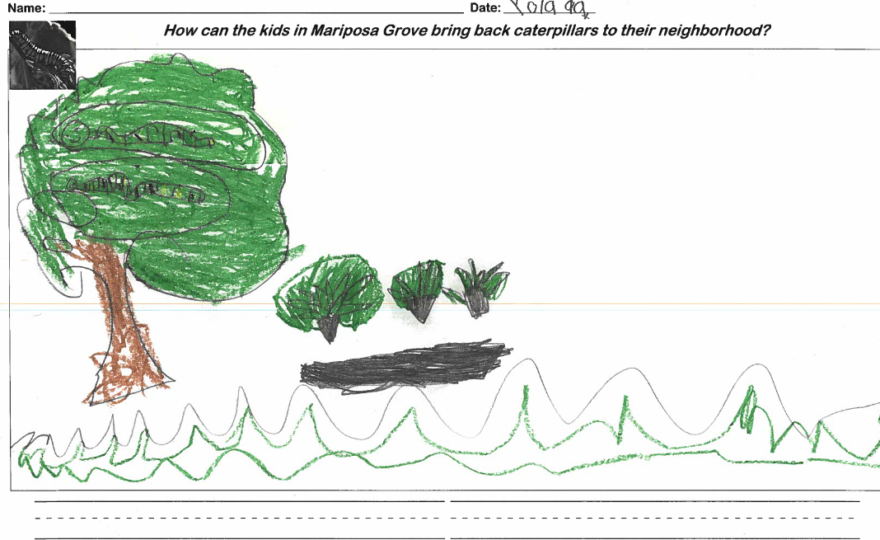
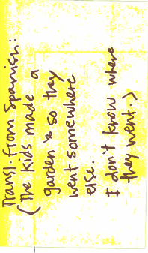
From Kindergarten Unit: Plants & Animals
Notes:
SHARE THIS STORY: The student is Marisol, who came to the US from Guatemala this summer. She speaks Mam and a little Spanish and is learning Spanish and English in school! She loves school and her family says when she gets home she talks about science as one of her favorite parts.
When I told the kids the story of Mariposa Grove and posed the question of why weren’t there any caterpillars after the field was turned into a garden, I made sure to tell the story in English and Spanish, and using the pictures from the ppt as visuals. It was amazing because Marisol spent most of her childhood in a rural farming community in Guatemala. She is a super talented artist and was able to explain to me that because the kids made a garden, the caterpillars went somewhere else to find food.
In thinking about Marisol’s modeling, her background knowledge was key to her puzzling through the phenomenon. The modality of drawing and orally communicating her ideas in Spanish helped the class access these ideas. And the storytelling in multiple languages with visual scaffolding helped her to enter into investigating the problem in the first place.

Slide 15
Let’s consider…
Cultural perspective: How does this example show that race matters and that language matters?
Critical perspective: How did the teacher leverage Marisol’s scientific ideas and experiences?
What additional actions might you take to do further attend to a critical and cultural approach.

Slide 16
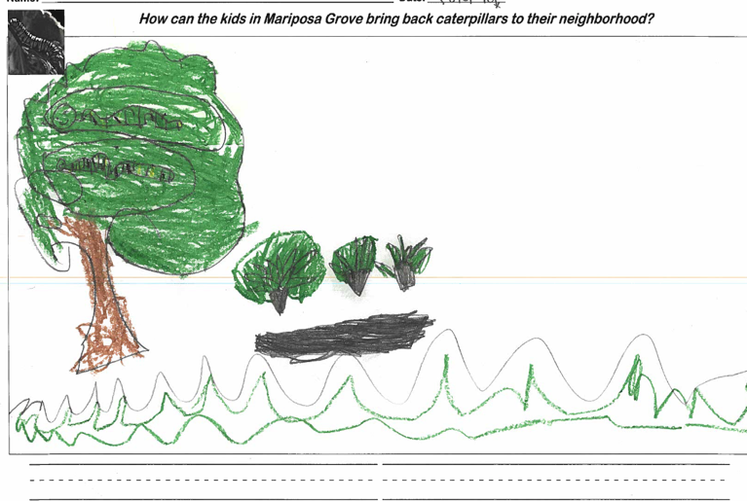
Activity 1
Please find your group number
Write the names of group members in the speaker notes
Read through the vignette
Discuss the questions with your group
Write any notes that capture your conversation
Notes:
TEACHER SLIDES FOR SMALL GROUP WORK

Slide 17
Vignette: Kindergarten, Unit: Plants & Animals
1
SPS Teacher: “The student is Marisol, who came to the US from Guatemala this summer. She speaks Mam and a little Spanish and is learning Spanish and English in school! She loves school and her family says when she gets home she talks about science as one of her favorite parts.
When I told the kids the story of Mariposa Grove and posed the question of why weren’t there any caterpillars after the field was turned into a garden, I made sure to tell the story in English and Spanish, and using the pictures from the ppt as visuals. It was amazing because Marisol spent most of her childhood in a rural farming community in Guatemala. She is a super talented artist and was able to explain to me that because the kids made a garden, the caterpillars went somewhere else to find food.
In thinking about Marisol’s modeling, her background knowledge was key to her puzzling through the phenomenon. The modality of drawing and orally communicating her ideas in Spanish helped the class access these ideas. And the storytelling in multiple languages with visual scaffolding helped her to enter into investigating the problem in the first place.”
Notes:
TEACHER SLIDES FOR SMALL GROUP WORK

Slide 18
Critical & Cultural Perspectives
1
Teacher Reflection Questions Cultural perspective: How does this example show that race matters and that language matters? Critical perspective: How did the teacher leverage Marisol’s scientific ideas and experiences? What additional actions might you take to do further attend to a critical and cultural approach.
Notes from Group Conversation
Notes:
TEACHER SLIDES FOR SMALL GROUP WORK
Names of Group Members:

Slide 19
Let’s end today by thinking about your students and taking a critical look at who is participating along these dimensions…
 | Racial | Language | Relationship | Gender
Who are the students whose FOK are incorporated into class?
Whose are not?

Slide 20
Reflect
What am I learning?
What prompted my learning?
Specifically, how might what I am learning generalize to my teaching practice? That is, how will my work as a teacher be different because of my learning today?

Slide 21
Part 2: What do we mean by FOK and what dimensions can we see in our teaching?
Notes:
Part 2, 2-3 hours

Slide 22
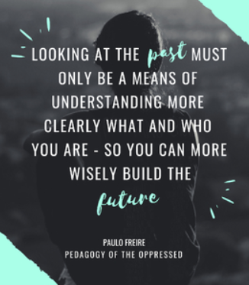
Let’s consider…
What do we really mean when we say FOK?
What do we think we are attending to but may not be because of collapsing and flattening of terms?
Notes:
Acknowledgement of who we are as a group and ready for next level, vulnerability is powerful
FOK- what are we really talking about? This is getting dropped a lot, what do we really mean? Do we know what we mean? Habits of practice- district equity moves & approaches collapsing, flattening or simply not naming what we are hoping to attend to. How do we name what is and isn’t being named while holding onto critical hope-Paulo Freire
What do we mean by saying culture, FOK, CRT, not naming race and attending to Black and Brown students.
Are we avoiding an opportunity to have a conversation that opens up vs. closes down conversations? Are we making claims of addressing race and centering students’ cultural expertise when perhaps we aren’t or we are actually just doing best practices?
How do we avoid collapsing culture and race with FOK? When does FOK serve racial justice and cultural assets in science?
What is the damage and harm done when we don’t name the racism- flattening
How does the conflation result in us not seeing (black, brown, some linguistically diverse students)students?

Slide 23
Unpacking Funds of Knowledge:Navigating & Naming Tensions as Opportunities
Flattening Funds of Knowledge
Expanding Funds of Knowledge
Notes:
30 minutes with discussion
Please share out a jamboard comment from a colleague that resonated with you and/or our conversation

Slide 24
Notes:
EXAMPLE FROM PRIOR PL

Slide 25
Introducing a new teacher reflection tool to examine students’ FOK
Read more: NSTA publication

Slide 26
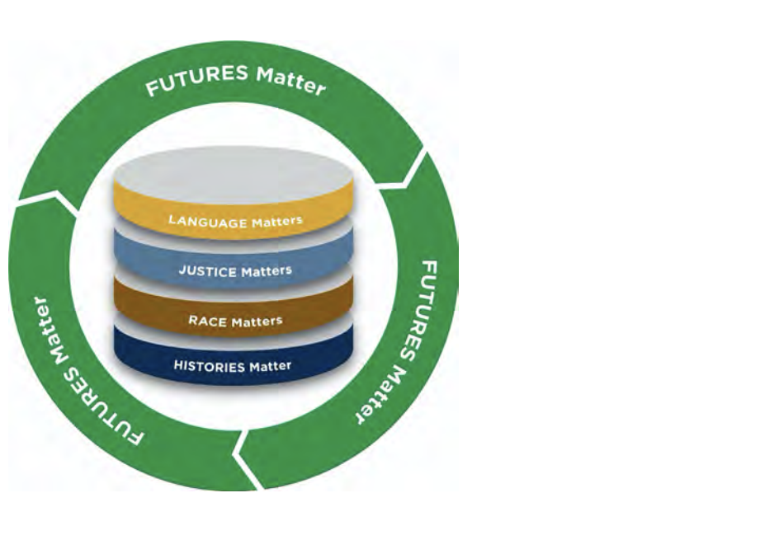
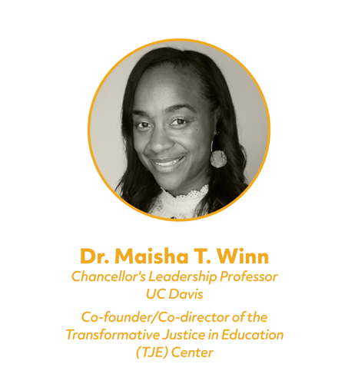
Based on Winn’s 5 Pedagogical Stances, which are “steps toward equity and justice that belong in education-focused conversations about pathways to tangible outcomes.”
Read more
Notes:
https://diversity.ucdavis.edu/sites/g/files/dgvnsk731/files/inline-files/Imagining-Equity-5%2BPedagogical%2BStances-Whitepaper-WEB.pdf
History Matters, Race Matters, Justice Matter, Language Matters, and Futures Matter

Slide 27
A critical and cultural framework for examining funds of knowledge
Science Knowledge Matters. Students’ ideas are scientific. What do students already understand about the phenomenon? Students’ critiquing & questioning science based on their experiences is valid. | Language & Expression of Ideas Matters. What everyday language did students use? How were they representing key ideas without words? How are students engaging in story-telling, for example?
Race, Power and Justice Matter. How are students showing/writing about race, power and justice (including justice for animals and the environment)? How does/can/should justice connect to learning? How did students talk about their own agency, such as how they can/will take action in the world? How is power shared in the classroom? | Histories, Realities and Futures matter. What lived experiences did students draw on? What did you learn about their possible interests and identities (now or in the future)? How are their ideas and identities connected to cultural sustainability?
Notes:
Reflection tool. This framework will help us attend to different dimensions of culture and provide an opportunity for us to take a critical stance toward our own identities and positionality. (Tool adapted from Patterson Williams, Higgs & Athanases, 2019 and informed by the work of Dr. Maisha Winn)

Slide 28
Activity 3
Reflect on students’ FOK using this framework and as a whole group, look at a few 4th grade examples of student work

Slide 29
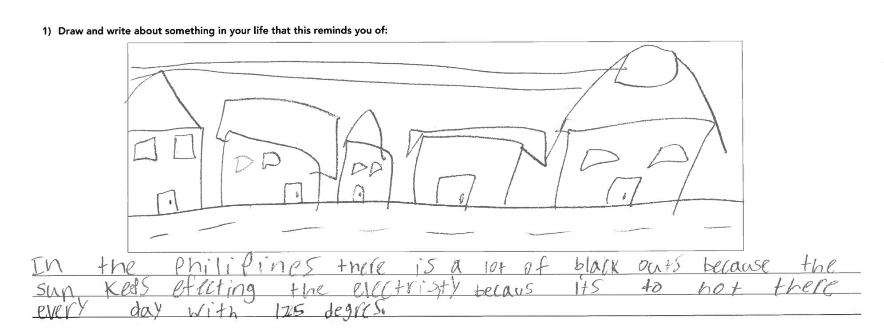
Example from models (4th grade Energy unit SPS)
“In the Philippines there is a lot of black outs because the sun keeps effecting the electricity because its too hot there every day with 125 degrees.”
Notes:
Taking inventory of students initial questions provides insights into their critical and cultural connections to the unit. Each of these comments hold sociopolitical and ecological weight. They also connect to parts of the unit that should the teacher leverage the question in class would position the student as scientist, critical contributor of science learning...

Slide 30
“Why don’t they have more solar panels in Ergstown?”
“Why do they need all that light?”
Notes:
Using the SCAN Noticing Tool: Taking inventory of students initial questions provides insights into their critical and cultural connections to the unit. Each of these comments hold sociopolitical and ecological weight. They also connect to parts of the unit that should the teacher leverage the question in class would position the student as scientist, critical contributor of science learning...

Slide 31
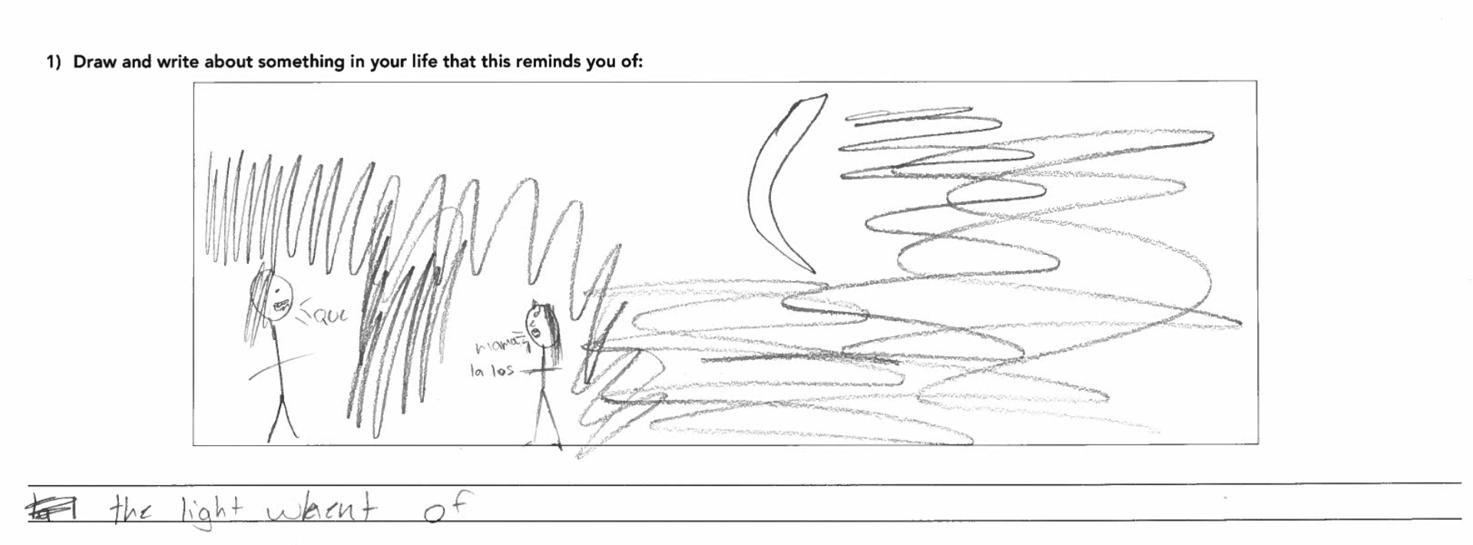
Notes:
Taking inventory of students initial questions provides insights into their critical and cultural connections to the unit. Each of these comments hold sociopolitical and ecological weight. They also connect to parts of the unit that should the teacher leverage the question in class would position the student as scientist, critical contributor of science learning...

Slide 32
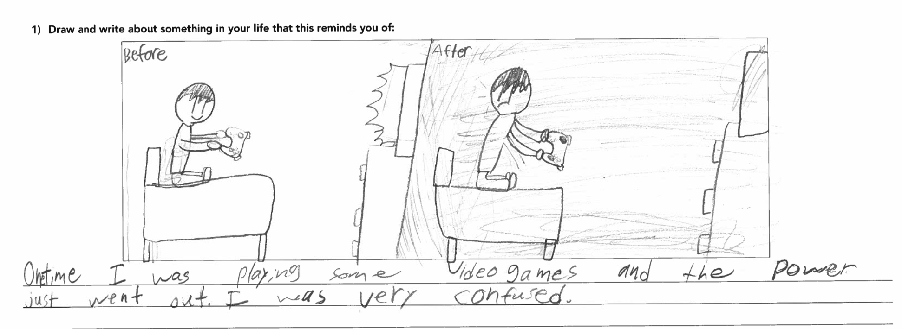
Notes:
Taking inventory of students initial questions provides insights into their critical and cultural connections to the unit. Each of these comments hold sociopolitical and ecological weight. They also connect to parts of the unit that should the teacher leverage the question in class would position the student as scientist, critical contributor of science learning...

Slide 33
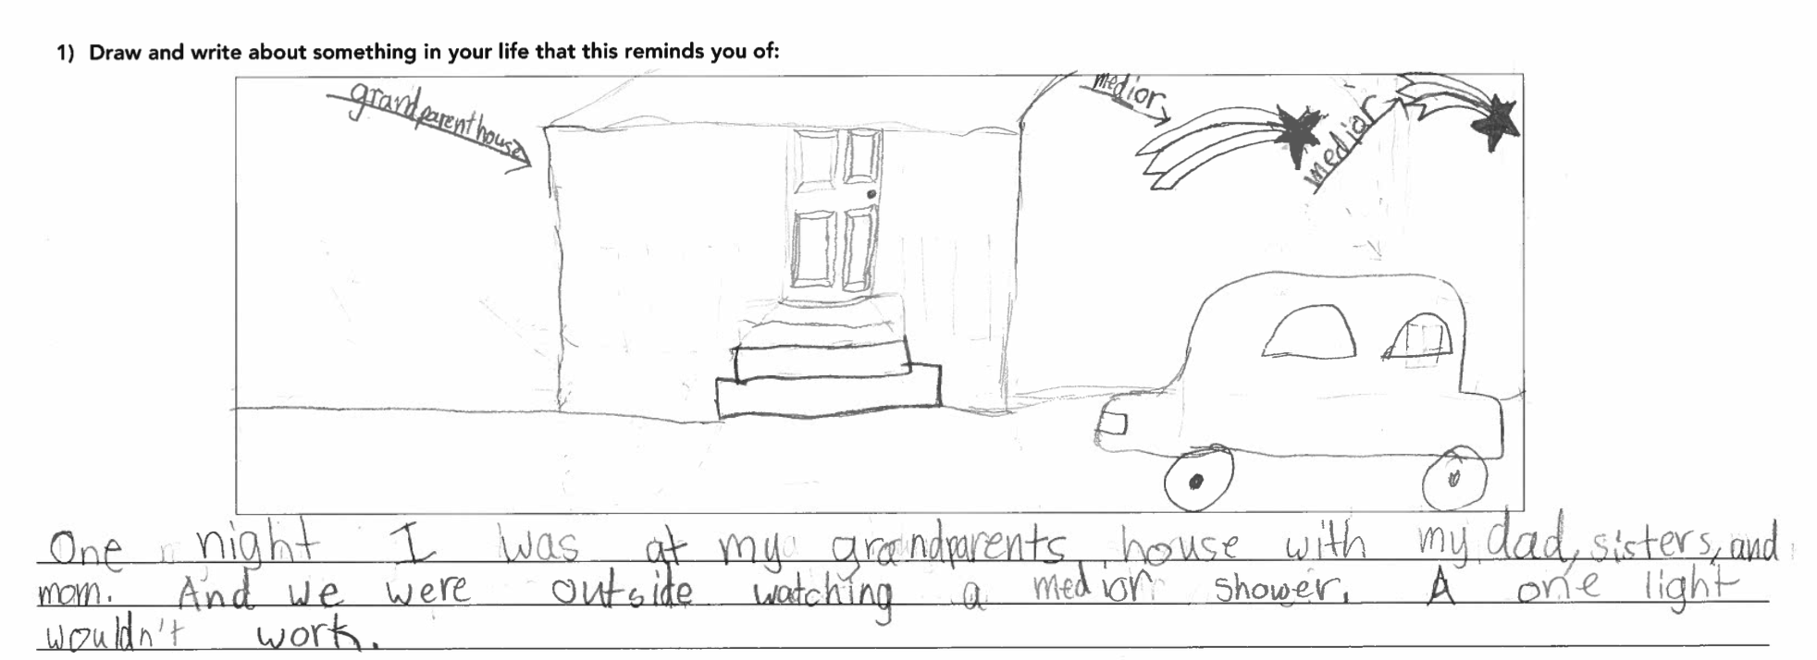
“One night I was at my grandparents house with my dad, sisters, and mom. And we were outside watching a meteor shower. A one light wouldn’t work.”
Notes:
Taking inventory of students initial questions provides insights into their critical and cultural connections to the unit. Each of these comments hold sociopolitical and ecological weight. They also connect to parts of the unit that should the teacher leverage the question in class would position the student as scientist, critical contributor of science learning...

Slide 34
A critical and cultural framework for examining funds of knowledge
What did you notice in the student responses?
Science Knowledge Matters. Students’ ideas are scientific. What do students already understand about the phenomenon? Students’ critiquing & questioning science based on their experiences is valid. | Language & Expression of Ideas Matters. What everyday language did students use? How were they representing key ideas without words? How are students engaging in story-telling, for example?
Race, Power and Justice Matter. How are students showing/writing about race, power and justice (including justice for animals and the environment)? How does/can/should justice connect to learning? How did students talk about their own agency, such as how they can/will take action in the world? How is power shared in the classroom? | Histories, Realities and Futures matter. What lived experiences did students draw on? What did you learn about their possible interests and identities (now or in the future)? How are their ideas and identities connected to cultural sustainability?
Notes:
Reflection tool. This framework will help us attend to different dimensions of culture and provide an opportunity for us to take a critical stance toward our own identities and positionality.

Slide 35
Activity 4
Now use the framework to analyze a video of a student discussion from 2nd grade

Slide 36
Now, let’s watch a video that draws on students’ Funds of Knowledge while Co-Constructing a Summary Table
Context: 2nd grade Landforms, After students have done some activities
Puzzling phenomenon: Should the community center build a structure on a beachfront cliff? (Amplify curriculum)
In this video, you will see a SPS teacher introducing the KLEWS chart to 2nd graders for the first time. Notice how she frames the lesson. The teacher moves beyond the key concept of “landforms are made of rock” and asks students to critically examine this concept and develop a set of questions they can return to overtime. The teacher plans to have students return to the KLEWS chart about 5 times for this unit.
Notes:
https://www.youtube.com/watch?v=_nTIFNHGucQ&feature=youtu.be min 17-22

Slide 37
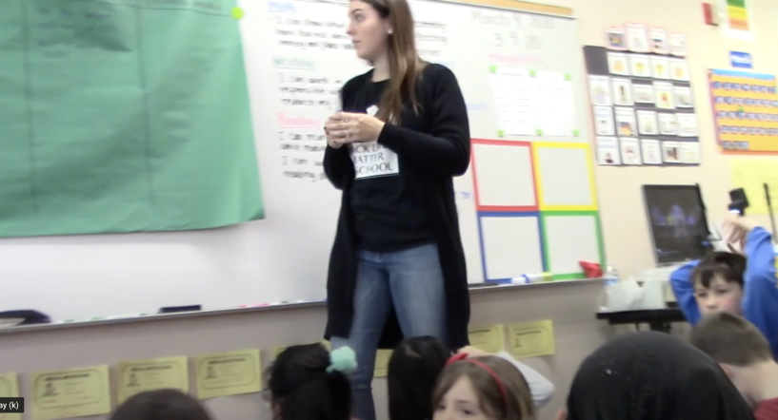
Co-constructing KLEWS Charts & Summary Tables: Building Evidence- based Explanations Over Time
Why is this important?
For Students: Students are asked to do the intellectual heavy-lifting and engage in reasoning with evidence.
For Science: Justifying explanations with evidence is how scientists make progress on ideas.
For Equity: Discussing evidence helps break-down the notion that science is about right and wrong answers and allow multiple entry points for students.

Slide 38
A critical and cultural framework for examining funds of knowledge
What did you notice in the student responses?
Science Knowledge Matters. Students’ ideas are scientific. What do students already understand about the phenomenon? Students’ critiquing & questioning science based on their experiences is valid. | Language & Expression of Ideas Matters. What everyday language did students use? How were they representing key ideas without words? How are students engaging in story-telling, for example?
Race, Power and Justice Matter. How are students showing/writing about race, power and justice (including justice for animals and the environment)? How does/can/should justice connect to learning? How did students talk about their own agency, such as how they can/will take action in the world? How is power shared in the classroom? | Histories, Realities and Futures matter. What lived experiences did students draw on? What did you learn about their possible interests and identities (now or in the future)? How are their ideas and identities connected to cultural sustainability?
Notes:
Reflection tool. This framework will help us attend to different dimensions of culture and provide an opportunity for us to take a critical stance toward our own identities and positionality. (Tool adapted from Patterson Williams, Higgs & Athanases, 2019)

Slide 39
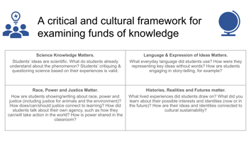
Activity 5
Now let’s break into Grade-level groups (K, 1, 3, 4) and look at student models: In grade-level groups, reflect on: a) the tool and what funds of knowledge have you see/have seen students bring to the unit/or any unit related to this topic at your grade level, b) how can you build on students’ scientific stories in the unit?
Whole group: What is been a noticing that you have had with the students’ funds of knowledge, and would like ideas for how to build on it?

Slide 40
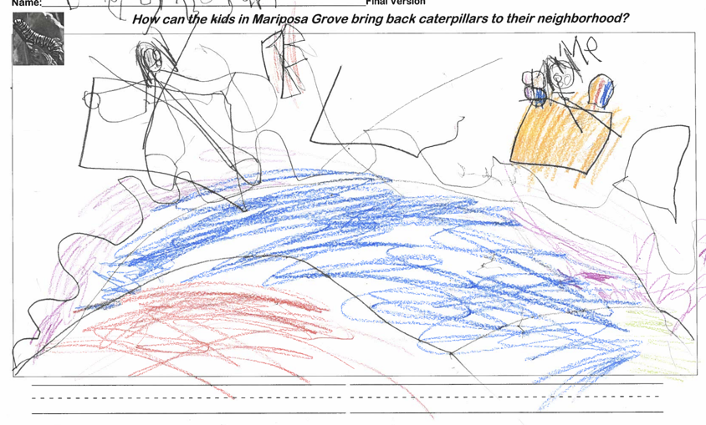
Kindergarten Needs of Plants and Animals
How can the kids bring the caterpillars back to Mariposa grove?

Slide 41
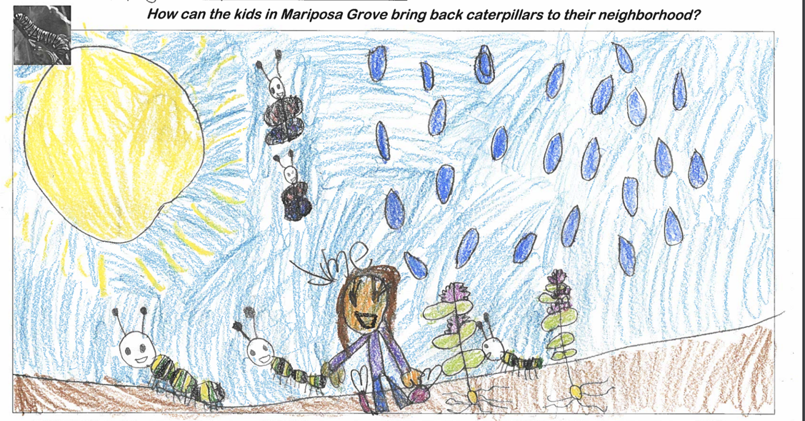
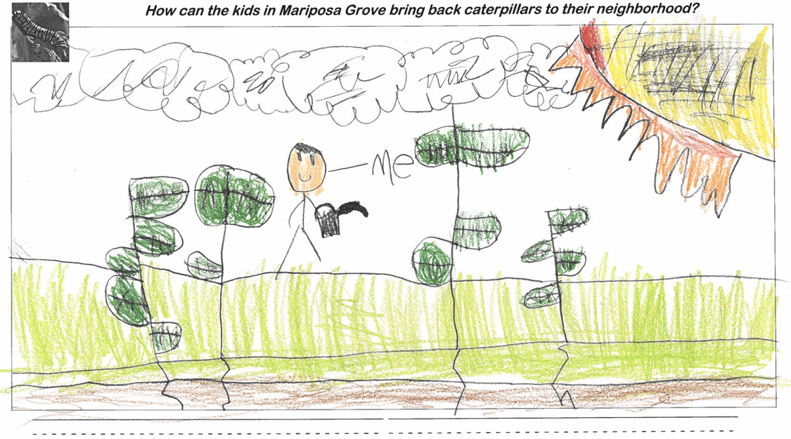

Slide 42
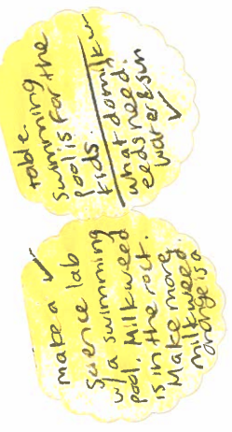

Slide 43
A critical and cultural framework for examining funds of knowledge
What did you notice in the student responses?
Science Knowledge Matters. Students’ ideas are scientific. What do students already understand about the phenomenon? Students’ critiquing & questioning science based on their experiences is valid. | Language & Expression of Ideas Matters. What everyday language did students use? How were they representing key ideas without words? How are students engaging in story-telling, for example?
Race, Power and Justice Matter. How are students showing/writing about race, power and justice (including justice for animals and the environment)? How does/can/should justice connect to learning? How did students talk about their own agency, such as how they can/will take action in the world? How is power shared in the classroom? | Histories, Realities and Futures matter. What lived experiences did students draw on? What did you learn about their possible interests and identities (now or in the future)? How are their ideas and identities connected to cultural sustainability?
Notes:
Reflection tool. This framework will help us attend to different dimensions of culture and provide an opportunity for us to take a critical stance toward our own identities and positionality. (Tool adapted from Patterson Williams, Higgs & Athanases, 2019)

Slide 44
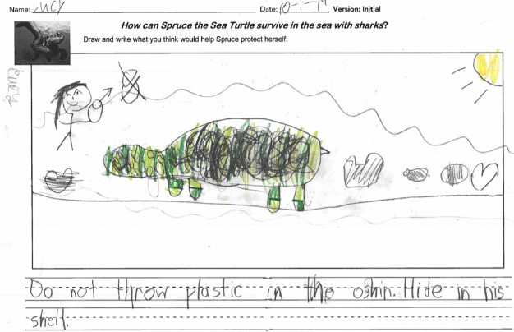
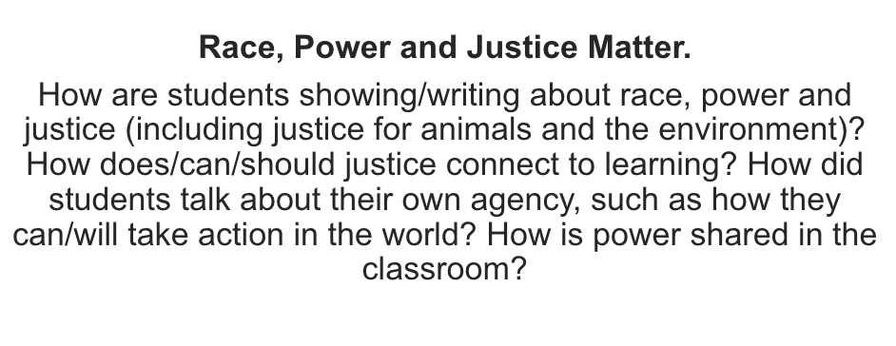
1st grade Animal and Plant Defenses How can Spruce survive?

Slide 46
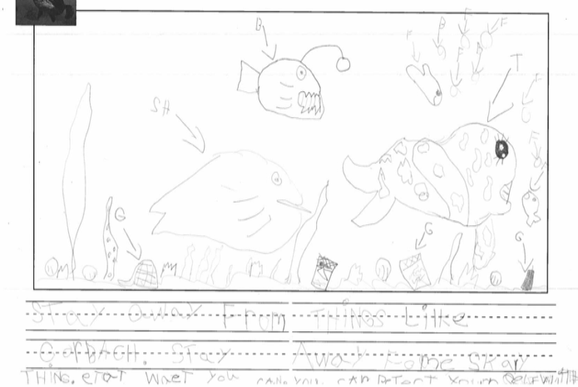

Slide 47
A critical and cultural framework for examining funds of knowledge
What did you notice in the student responses?
Science Knowledge Matters. Students’ ideas are scientific. What do students already understand about the phenomenon? Students’ critiquing & questioning science based on their experiences is valid. | Language & Expression of Ideas Matters. What everyday language did students use? How were they representing key ideas without words? How are students engaging in story-telling, for example?
Race, Power and Justice Matter. How are students showing/writing about race, power and justice (including justice for animals and the environment)? How does/can/should justice connect to learning? How did students talk about their own agency, such as how they can/will take action in the world? How is power shared in the classroom? | Histories, Realities and Futures matter. What lived experiences did students draw on? What did you learn about their possible interests and identities (now or in the future)? How are their ideas and identities connected to cultural sustainability?
Notes:
Reflection tool. This framework will help us attend to different dimensions of culture and provide an opportunity for us to take a critical stance toward our own identities and positionality. (Tool adapted from Patterson Williams, Higgs & Athanases, 2019)

Slide 48
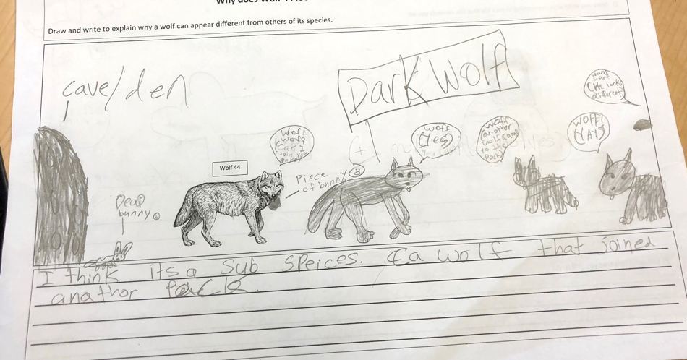
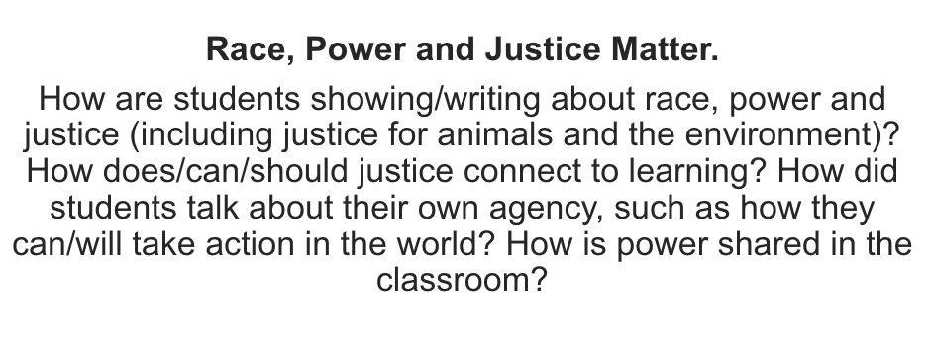
3rd grade Inheritance and Traits Why can a wolf appear different from others of its species?
Notes:
Be prepared for these conversations.

Slide 50
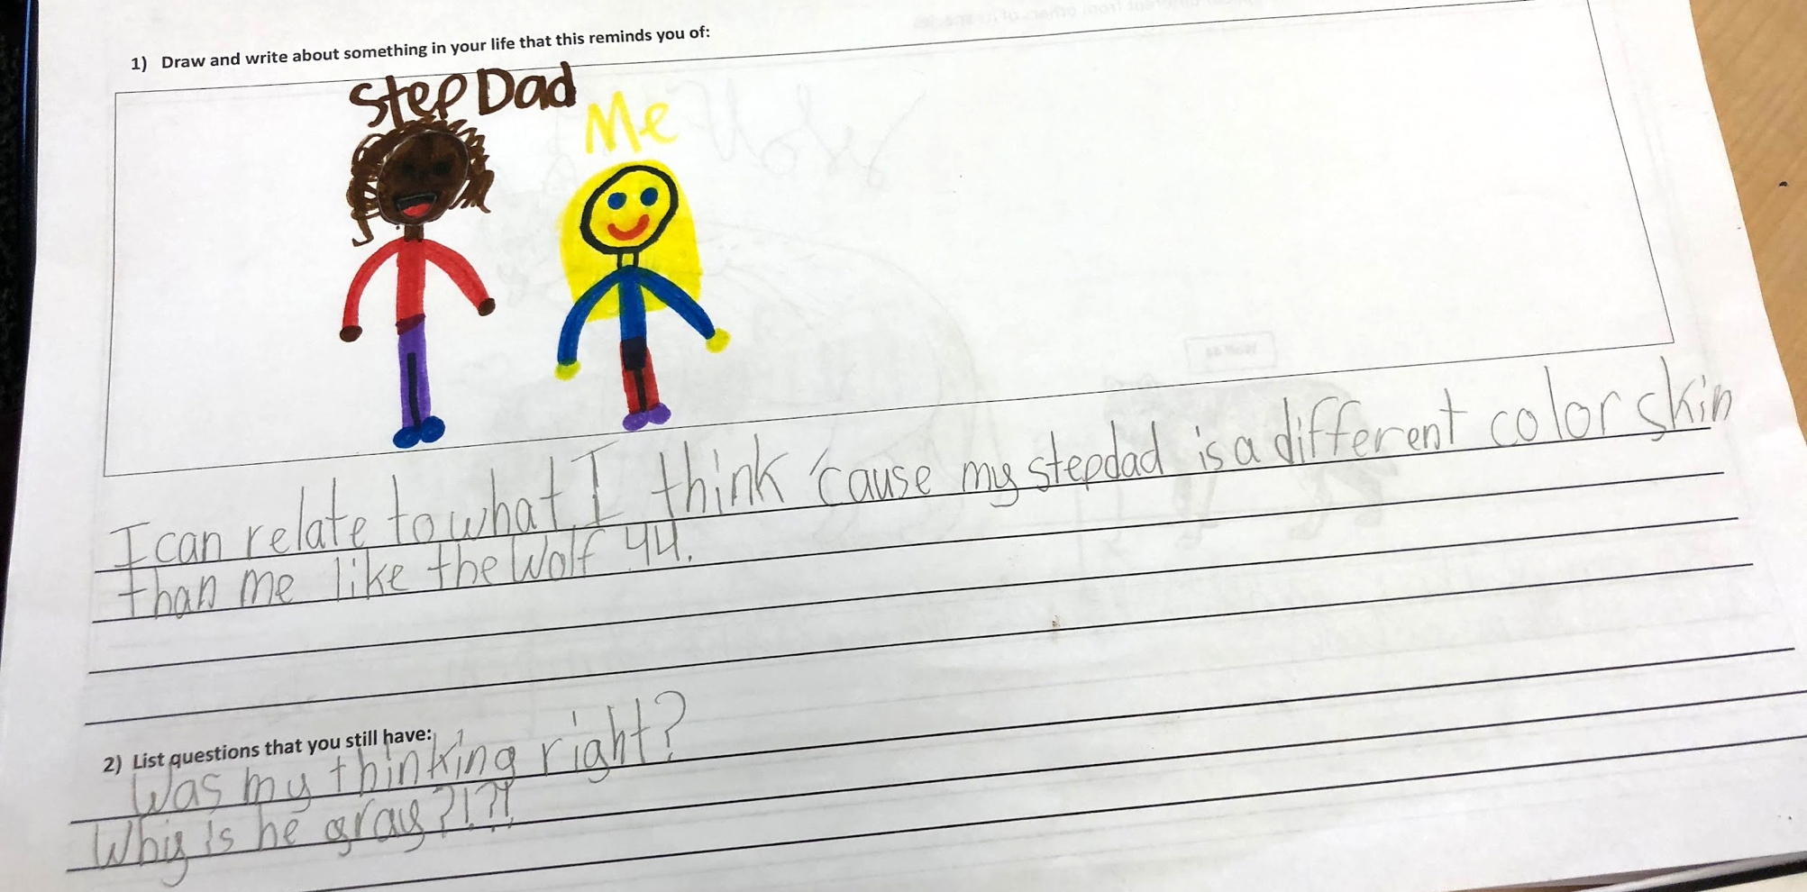

Slide 51
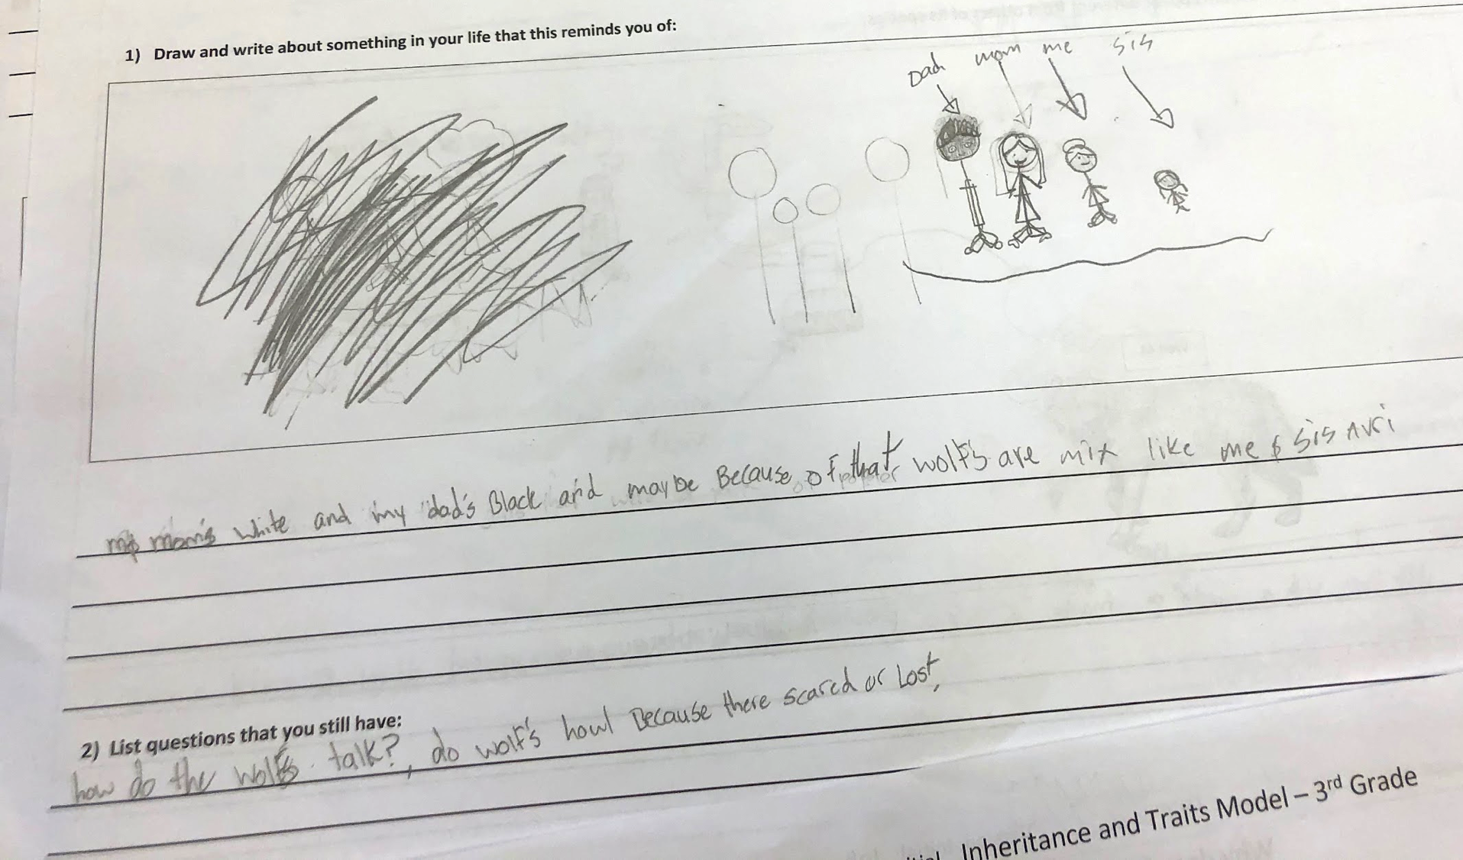
Notes:
What is the risk if we don’t talk about race and honor what students put forward =)

Slide 52
A critical and cultural framework for examining funds of knowledge
What did you notice in the student responses?
Science Knowledge Matters. Students’ ideas are scientific. What do students already understand about the phenomenon? Students’ critiquing & questioning science based on their experiences is valid. | Language & Expression of Ideas Matters. What everyday language did students use? How were they representing key ideas without words? How are students engaging in story-telling, for example?
Race, Power and Justice Matter. How are students showing/writing about race, power and justice (including justice for animals and the environment)? How does/can/should justice connect to learning? How did students talk about their own agency, such as how they can/will take action in the world? How is power shared in the classroom? | Histories, Realities and Futures matter. What lived experiences did students draw on? What did you learn about their possible interests and identities (now or in the future)? How are their ideas and identities connected to cultural sustainability?
Notes:
Reflection tool. This framework will help us attend to different dimensions of culture and provide an opportunity for us to take a critical stance toward our own identities and positionality. (Tool adapted from Patterson Williams, Higgs & Athanases, 2019)

Slide 53
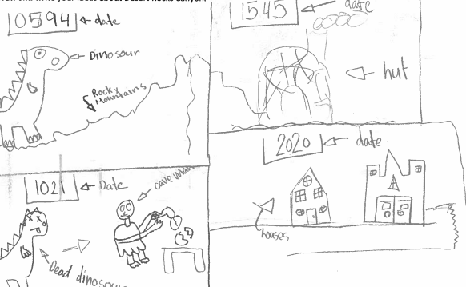
4th grade Earth Features
How do rocks and fossils tell us about how Earth has changed over time?

Slide 54
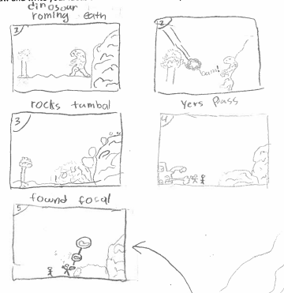
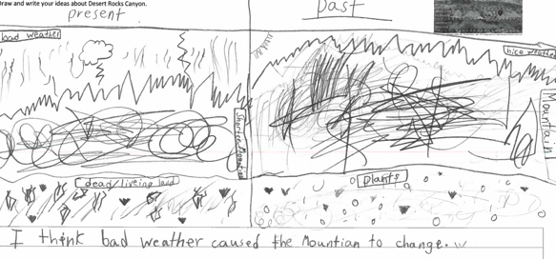
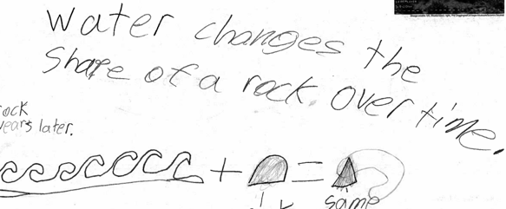
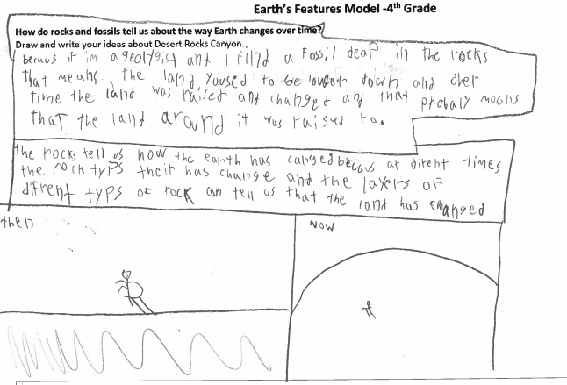
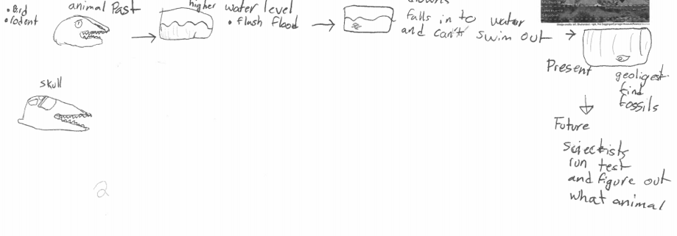
STUDENTS’ REPERTOIRES: MULTIPLE VISUAL MODALITIES FOR IDEA SHARING
Conventions:
Comic:
Timeline:
Before/After:
Sections:
Symbolic:

Slide 55
Notes:
“Like creation stories everywhere, cosmologies are a source of identity and orientation to the world. They tell us who we are. We are inevitably shaped by them no matter how distant they may be from our consciousness. One story leads to building understanding, relationship, place and richness. We are all building story in the classrooms we occupy we should consider how are we protagonists or antagonists, what stories are we weaving into the lives of our students, how can we center students’ stories within science learning.”

Slide 56
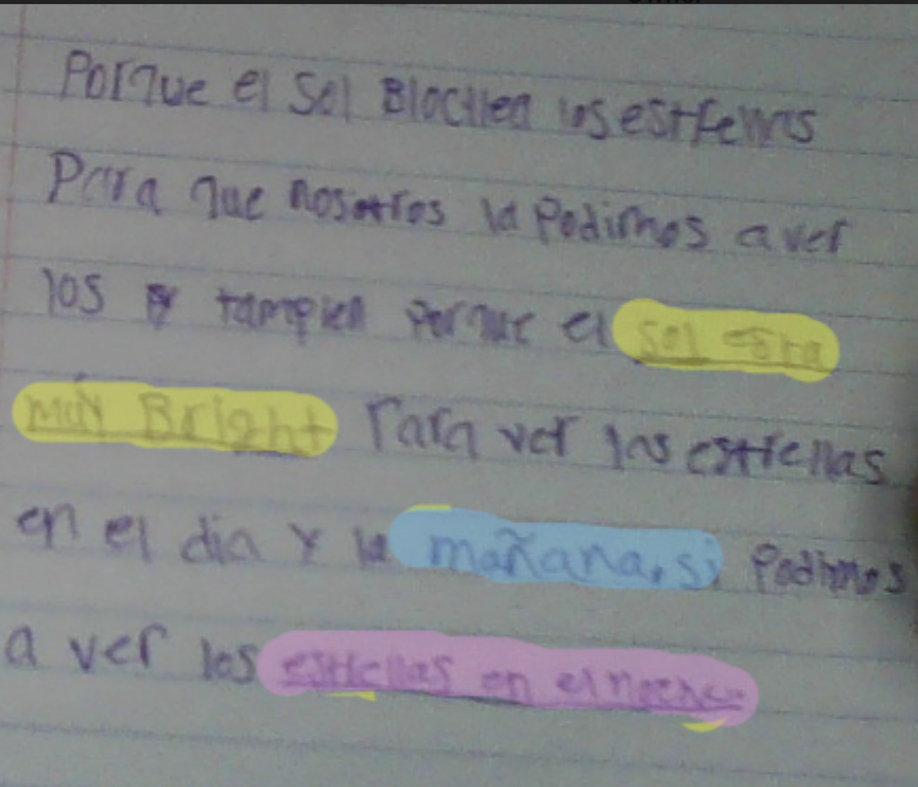

Slide 57
A critical and cultural framework for examining funds of knowledge
What did you notice in the student responses?
Science Knowledge Matters. Students’ ideas are scientific. What do students already understand about the phenomenon? Students’ critiquing & questioning science based on their experiences is valid. | Language & Expression of Ideas Matters. What everyday language did students use? How were they representing key ideas without words? How are students engaging in story-telling, for example?
Race, Power and Justice Matter. How are students showing/writing about race, power and justice (including justice for animals and the environment)? How does/can/should justice connect to learning? How did students talk about their own agency, such as how they can/will take action in the world? How is power shared in the classroom? | Histories, Realities and Futures matter. What lived experiences did students draw on? What did you learn about their possible interests and identities (now or in the future)? How are their ideas and identities connected to cultural sustainability?
Notes:
Reflection tool. This framework will help us attend to different dimensions of culture and provide an opportunity for us to take a critical stance toward our own identities and positionality. (Tool adapted from Patterson Williams, Higgs & Athanases, 2019)

Slide 58
Next Steps
What can you try in your classroom?

Slide 59
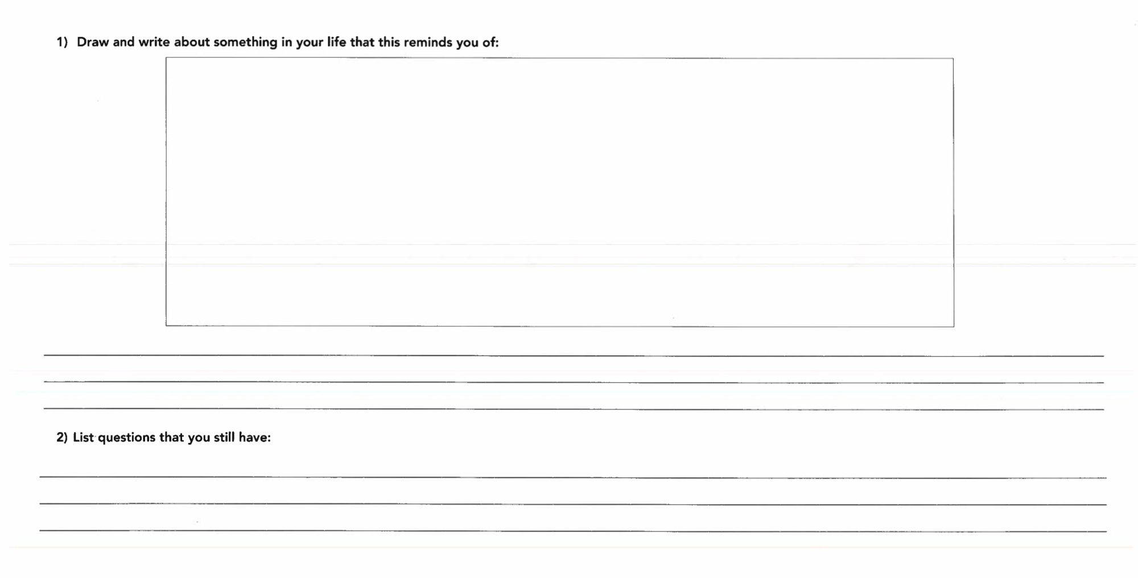
Try eliciting students’ ideas by asking this prompt. Then Look the backside of your students’ models or reflect on student conversations...

Slide 60
Building Scientific Stories Using Students’ Funds of Knowledge
Try using these sentence stems
Sentence Stems (Intermediate grades):
“____’s ideas makes me think of __________.”
“ I would like to build off of what __________ said and share______________”
“ I would like to revisit what ______ said because it makes me wonder about __________”
“I’m still trying to understand what _________ said, I would appreciate it if they could explain their idea again/more.”
“I like _______’s idea and I am wondering how it connects to (human impact, the environment, communities, our future…)
Sentence Stems:(Primary grades)
“_______’s idea makes me think of_______”
“I like _________ idea because it________”
“I would like ________ to share their idea again”
“_______’s idea connects to my idea because______”
“ I wonder how ______’s idea affects ______ (plants, animals, humans, families, nature….)
Notes:
Need teacher input on wording. How are these different than other share-out norms/sentence stems?

Slide 61
Tracking Students’ Ideas
Try tracking students’ ideas in the moment or after a lesson
 | Science Knowledge Matters | Language & Expression of Ideas Matters | Race, Power and Justice Matter | Histories, Realities and Futures matter
Students’ divergent ideas that push my thinking
How might I revisit these ideas in the unit?

Slide 62
Teacher Stories

Slide 63
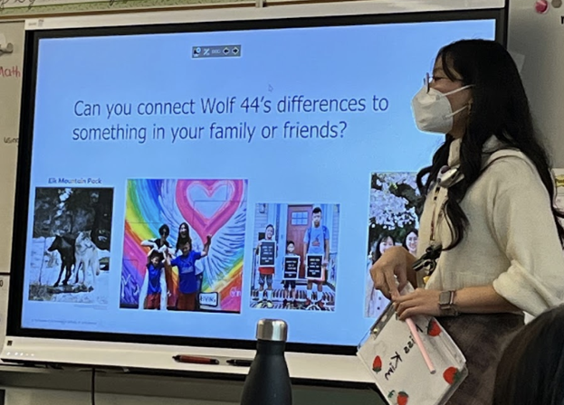
Sharing teacher FOK
In this video clip you will see a first-year teacher eliciting students’ ideas about a phenomenon about inheritance. She models sharing her own experiences, languages and identities to open up the conversation for students. In so doing she normalizes talking about race and family structures as a part of science learning.
https://youtu.be/VKL6zGFk6NA (12:16-22:45, about 10 minutes)
Notes:
This 3rd grade teacher shares how she incorporated her own family stories to support students in talking about their experiences, as a way to elicit ideas about inheritance and encourage students to think about how race matters in science.

Slide 64
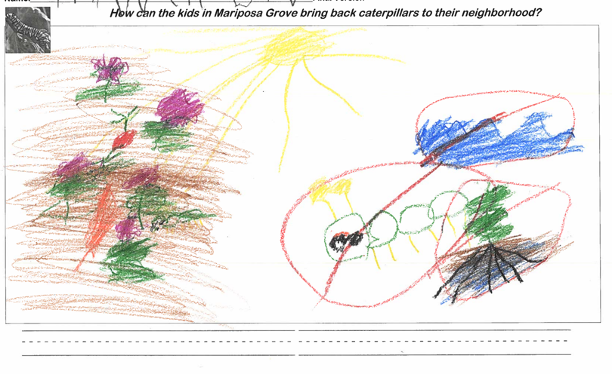
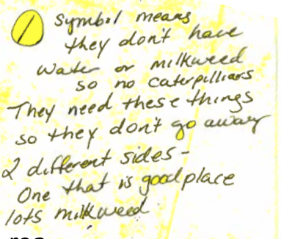
Challenging Assumptions
K teacher: “You see deeper into what they're really thinking and sometimes a student that you think that is really at a really low level can surprise you by the picture and by what they're trying to say in the picture. I have this one kid, he hated writing, writing time for him was the worst time ever. But when it came to science. Wow. It was like, I saw a different child just because of what he produced for those models. So again, with different perspective, it made me realize that he had more potential that I was giving him credit for. Because sometimes we create our own biases.” (05/20/20)
Notes:
This K teacher shares how she has developed a broader lens for looking at students’ ideas and is learning to challenge the assumptions of school labels about students’ capabilities.

Slide 65
Reflect
What am I learning?
What prompted my learning?
Specifically, how might what I am learning generalize to my teaching practice? That is, how will my work as a teacher be different because of my learning today?

Slide 66
Inquiry Cycles: Next time we meet we will share what we learned!
C2AST Workshop
Try out ideas in your classroom
C2AST Workshop
Discuss & share ideas with colleagues
Discuss & share ideas with colleagues
Notes:
What is an inquiry Cycle? How does it benefit students, teachers and families. How do researchers hope to learn from it.

Slide 67
We are excited to be in this work with you! Please reach out with questions, feedback, and ideas!

Slide 68
Resources & Readings
Adriana Alvarez, Leah Peña Teeters, William R. Penuel, Moisès Esteban-Guitart, (2023). Considerations to engage a funds of identity approach as a vehicle toward epistemic justice in educational settings, Learning, Culture and Social Interaction, Volume 40, 100718, ISSN 2210-6561, https://doi.org/10.1016/j.lcsi.2023.100718.
Thompson, J. Mawyer, K., Johnson, H., Scipio, D. & Luehmann, A. (September/October 2021). From responsive teaching to culturally and linguistically science teaching. The Science Teacher, 89 (1). NSTA publication

