Slide 1
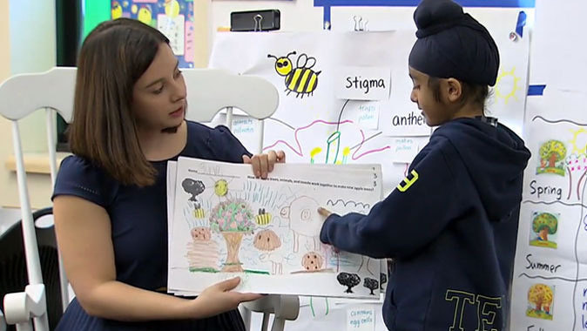
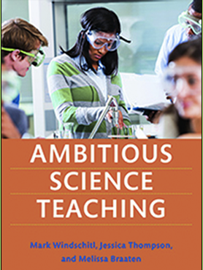
Model How To & Optional Slides
UW C2AST (Critical and Cultural Approaches to Ambitious Science Teaching)
Seattle Public Schools & Edmonds Partnerships 2019-2023
Notes:
C2AST is a partnership between the UW Ambitious Science Teaching group and K-6 teachers. We would like to learn with you about how to take a critical and cultural approach to teaching elementary science. These slides are intended to help teachers start examining your own critical consciousness, students’ joyful and divergent ideas and consider connections to justice work and how to take action.

Slide 2
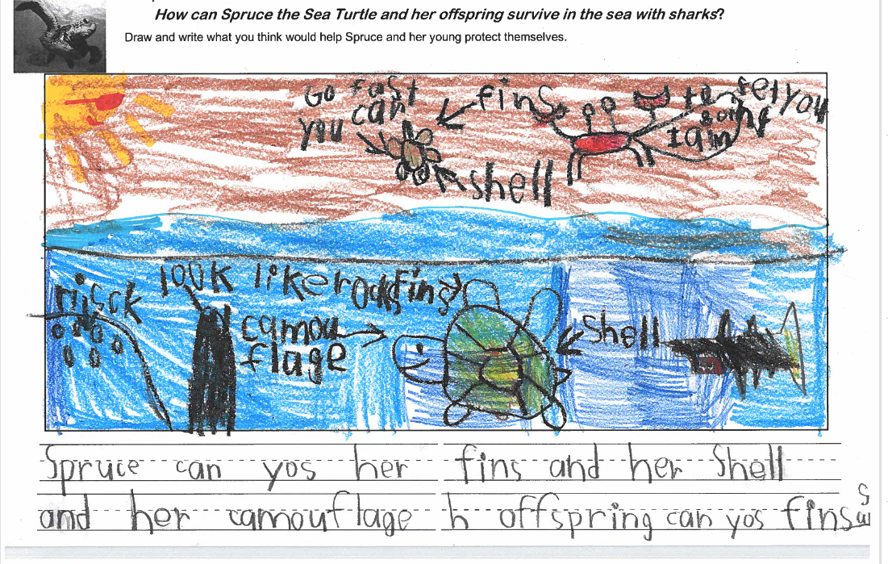
Scientific Modeling
Why is this important?
For Students: Students are asked to share their thinking and do the intellectual heavy-lifting of engaging in reasoning with evidence and prior experiences. Centering and authentically leveraging students’ divergent ideas builds students’ confidence and fosters their identity as someone who does science. Centering students’ ideas also creates a safe & inclusive learning community for all learners.
For Science: Justifying explanations with evidence is how scientists make progress on ideas. Furthermore, the diversity of ideas and how these ideas are communicated pushes the field of science to become more expansive and inclusive of diverse identities and ways of understanding the world.
For Equity: Discussing evidence helps break-down the notion that science is about right and wrong answers and allow multiple entry points for students. It also, provides space for students to explore with each other the different ways they are grappling with the phenomenon and the cultural connections they make supports student sensemaking and productive conversations about science and justice.

Slide 3
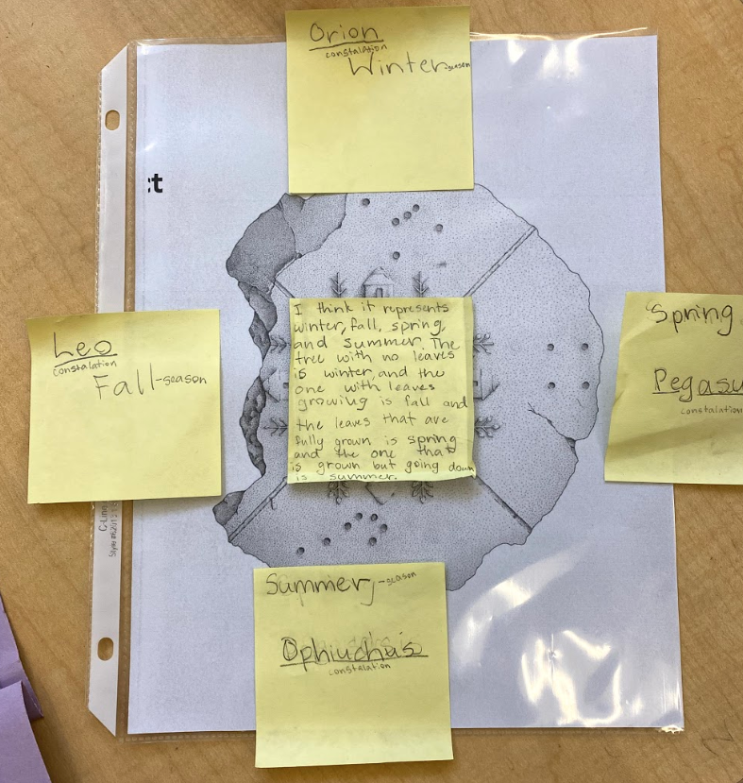
Explanatory Modeling: Revising ideas as evidence is gathered throughout the unit. A safe place to share thinking & learn from each other.
Students Cultural Expertise
A sandbox of idea gathering where students call upon their prior lived experiences to show their thinking and share ideas with peers.
Students can take ownership of their ideas and learning, as they visualize and share ideas and revisit them regularly over time.
All ideas and ways of knowing are valued.
A place to revise ideas as new evidence is gathered.
Teacher Reflection
Am I holding a position of inquiry rather than judgement?
What questions should I ask to understand students’ drawing/writing and explore students’ ideas further?
How can I make a safe environment for students to share and discuss ideas?
How can we help students make connections between their models and their everyday experiences and life?
Modeling provides a way to ground and authentically continue the phenomenon based storyline.

Slide 4
Why initial models?
Provides a way to make ideas visible and public
Makes students know “my ideas matter”
Setting the stage for learning together and collaborative sensemaking
Honors students’ experiences and prior knowledge
This is an important time to see divergent ideas and honor different ways of knowing
​We encourage you to make a list of initial ideas and to revisit these throughout the unit (this is very empowering to students to see that their ideas are attended to).

Slide 5
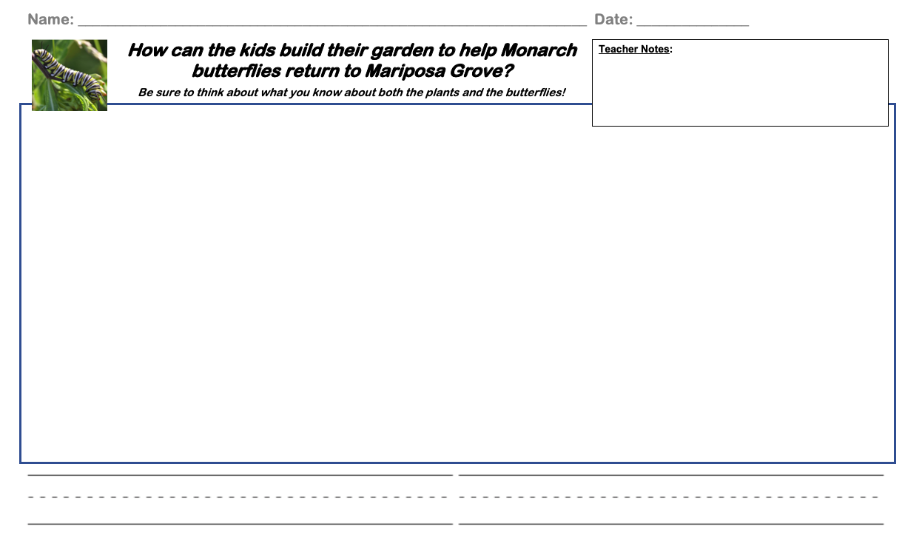
What is on a model?
The unit phenomenon written as a big question.
Lots of space for students to draw, write, label and show their thinking in a variety of ways.

Slide 6
What is on the back of the model?
On the back of the model this simple prompt provides an opportunity for students’ to share their expertise, prior experiences and elevate the connections they think are most important. How teachers use these ideas to support and extend sensemaking are very important.

Slide 7
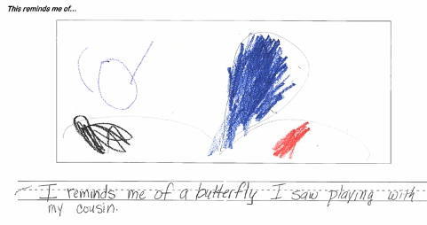
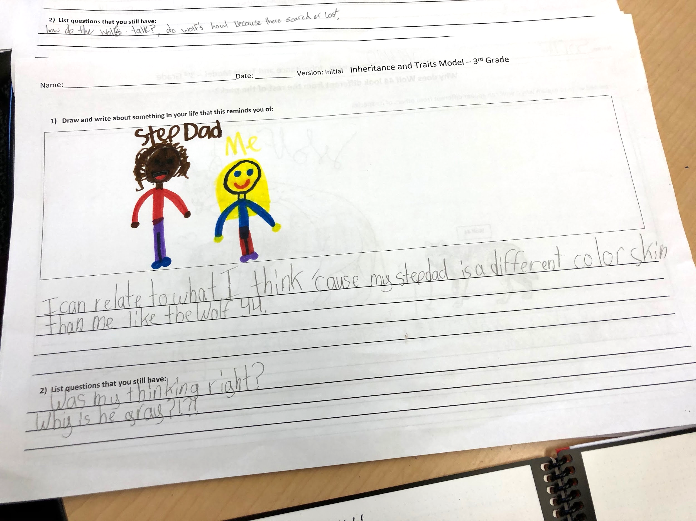
Why is the back important?
To uncover personal connections.
When students can relate to the phenomena emotionally and intellectually, they are more invested and interested.
To provide multiple access points.
Students might use the backside as a different access point, or they might continue to refine their initial claims from the frontside.
To identify how students understand impact.
Students can identify connections and use the content from the unit to take action in the world. (i.e. rewiring light sockets with parents (4), building sustainable garden (K).
To encourage story telling.
Students may use varied narrative forms to tell stories connections to their own lives.

Slide 8
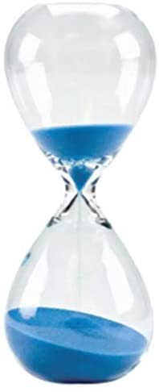
Divergent thinking & critical reflection
As we look at student work we want to look deeply at students’ ideas and challenge what we think we know about science, what counts as science and the idea that science is about seeking right answers.
Instead of looking for “right” or “wrong” answers in students’ initial models, we want to step back and first just notice the ideas students are surfacing.

Slide 9
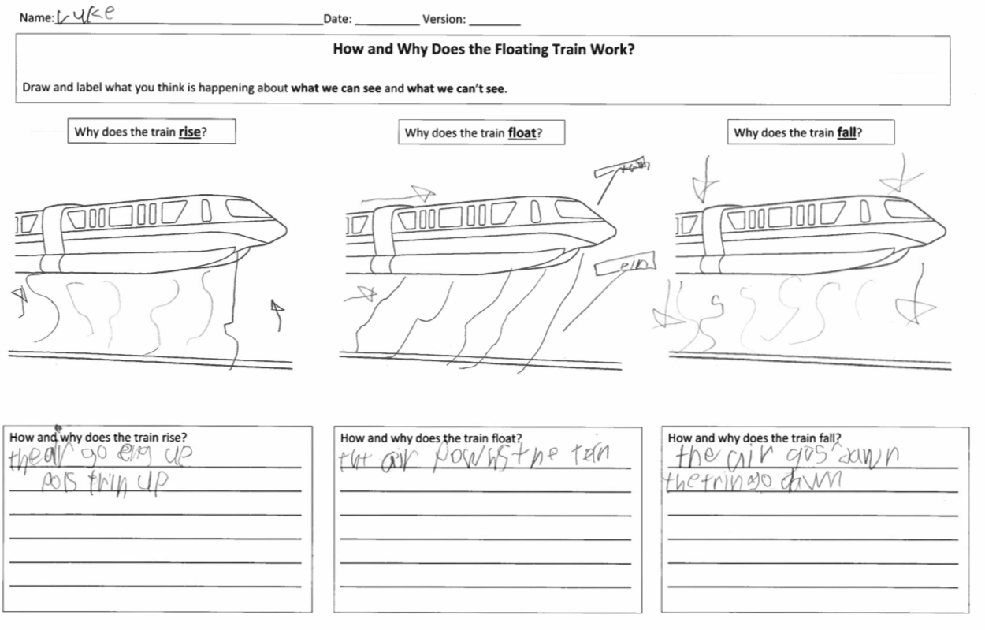
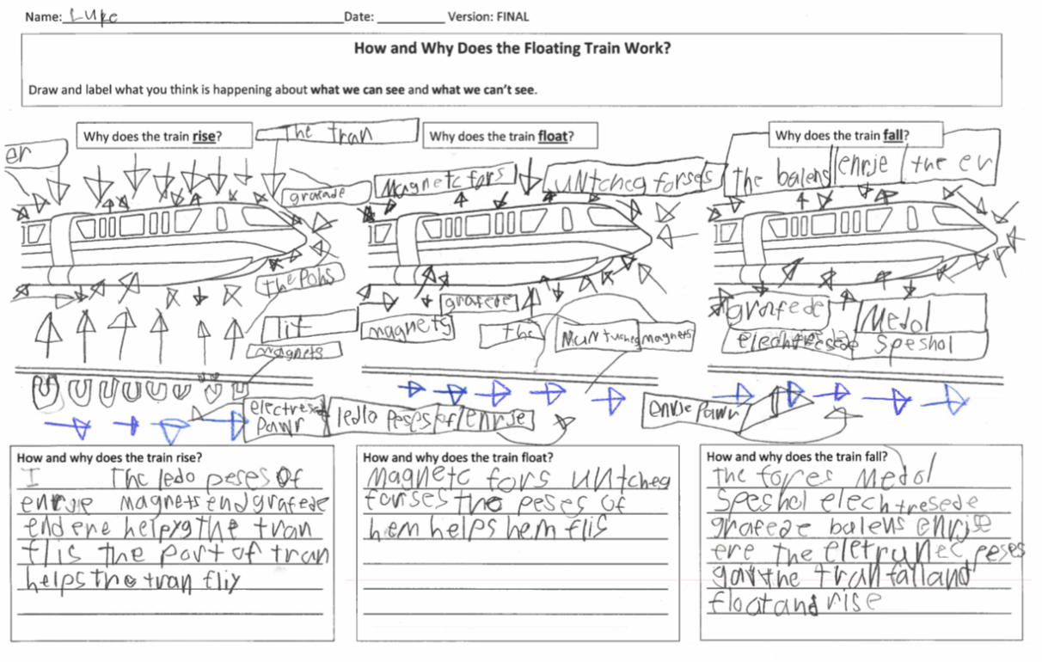
Throughout the unit and at the end, students can go back and revise their models.

Slide 10
Why is it important to revise models?
Helpful Tips and Strategies
Create Back-Pocket-Questions to use to help students more deeply explain their thinking and revise their models.
Visit table but then listens/observes student working on model before asking Back-Pocket-Questions or encouraging them to elaborate on what they have added to model.
Carry pencil or other pointer around so that when they talk about revisions they can point to specific parts of the model.
Identify 1 or 2 ideas from the Gotta-Have-Checklist that are missing from the students’ revised model and asks them to add this idea.
Encourage student to create a key or use other modeling conventions to show how and why levels.
Encourage multilingual and inclusive of other languages.
To support students in weaving together their experiences and new evidence into an explanation.
To provide opportunities for students to show what they have learned and re-engage with the puzzling phenomenon on their own terms.
To help teach students the importance of changing their thinking based on evidence.

Slide 11
When should models be revised?
When students revise their models is best determined by individual teachers based on class discussions and students’ needs.
The best times to revise models are:
After students have collected evidence around several big science ideas
In place of other unit assessments
When students could benefit from revisiting the puzzling phenomenon and tying all of their thinking together

Slide 12
The next set of slides can be copied and/or used when you want to help students discuss models after students do their initial models.

Slide 13
Our Question:
[insert big question from the phenomenon that directly relates to modeling task]

Slide 14
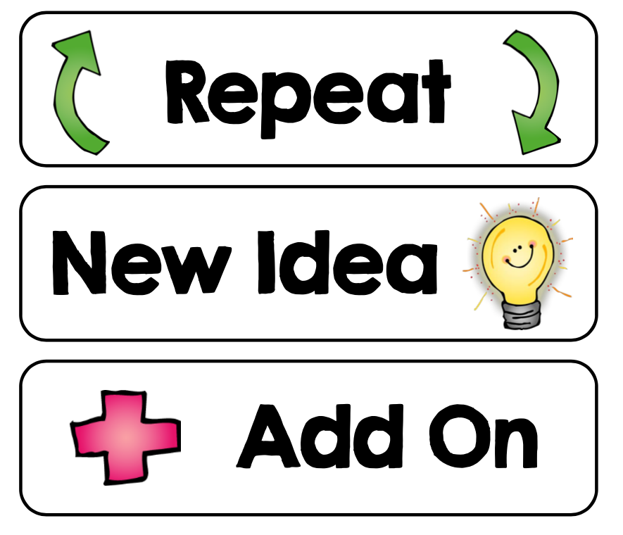
[Add image of your unit model template.]
Let’s share ideas from our models!
Can you say more about…
Can you repeat what you said about…
I have a new idea about…
I have a different idea...
I want to add onto that idea…

Slide 15
The next set of slides can be copied and/or used when you want to help students revise ideas.

Slide 16
Our Question:
[insert big question from the phenomenon that directly relates to modeling task]

Slide 17
Revising our models
What are some new ideas you would like to include in your model?
Why do you want to include those ideas in your model?
Which activity did that idea come from?
Notes:
Suggested teacher framing: “Before we make changes to our models we are going to discuss the new ways we are thinking about our unit question. As we do this remember that it is okay for us to have similar ideas or different ideas! It is norm for people to use evidence in slightly different ways or to even use evidence from different activities than our partners. We are sharing with each other because it can be really helpful to hear how others’ are thinking about the changes they will make.”
Teacher action: Pass out the students’ initial model templates—they will need to look at their old work to think about what they want to change. Give students 5-10 minutes to share ideas with their partners. Be sure to think about pairing for equity. Consider a different partnering combination, fresh eyes on the same experience.
Circulate, listen in to student ideas, and ask back pocket questions as students discuss.

Slide 18
REvising our models (Grades K-2)
Now add new ideas to your initial model by using a different color. This will help us see how your ideas change over time.
Option 1: Revising models on original model in new color (K-2)
[Add image of your unit model template.]
Notes:
Teacher action: Give students 10-15 minutes to add new ideas to their models. Circulate as students work and ask back pocket questions to help probe students to deeper levels of thinking.
Sample back pocket question stems you could use:
What does _____ represent in your drawing?
I see you wrote _____, how might you draw this idea?
I see you drew _______, how does this connect to this other part of your drawing?

Slide 19
Revising our models (grades 3-5)
Using a different color on your initial model please:
Add new ideas
Tweak or change ideas
Cross-out ideas that you don’t think fit anymore
Add questions that you still have.
This process of revising your model will help us see how your ideas change over time.
Option 1: Revising models on original model in new color (3-5)
[Add image of your unit model template.]
Notes:
Teacher action: Give students 10-15 minutes to add new ideas to their models. Circulate as students work and ask back pocket questions to help probe students to deeper levels of thinking.
Sample back pocket question stems you could use:
What does _____ represent in your drawing?
I see you wrote _____, how might you draw this idea?
I see you drew _______, how does this connect to this other part of your drawing?

Slide 20
We are going to use a new piece of paper to help us share how we understand the question we have been exploring. You can use the new ideas from our activities or your conversation and old ideas from your initial models.
Option 2: Revising models new paper
[Add image of your unit model template.]
Notes:
Teacher action: Give students 10-15 minutes to add new ideas to their models. Circulate as students work and ask back pocket questions to help probe students to deeper levels of thinking.
Sample back pocket question stems you could use:
What does _____ represent in your drawing?
I see you wrote _____, how might you draw this idea?

Slide 21
Now add new ideas to sticky notes and place it on your initial model. This will help us see how your ideas change over time.
Option 3: Revising models with sticky notes
Changed idea
New idea
[Add image of your unit model template.]
Remove this idea
Questions I have
Notes:
Teacher action:Give students 10-15 minutes to add new ideas to their models. Circulate as students work and ask back pocket questions to help probe students to deeper levels of thinking.
Sample back pocket question stems you could use:
What does _____ represent in your drawing?
I see you wrote _____, how might you draw this idea?
I see you drew _______, how does this connect to this other part of your drawing?

Slide 22
A critical and cultural framework for examining student ideas in models
Science Knowledge Matters. Students’ ideas are scientific. What do students already understand about the phenomenon? Students’ critiquing & questioning science based on their experiences is valid. | Language & Expression of Ideas Matters. What everyday language did students use? How were they representing key ideas without words? How are students engaging in story-telling, for example?
Race, Power and Justice Matter. How are students showing/writing about race, power and justice (including justice for animals and the environment)? How did students talk about their own agency, such as how they can/will take action in the world? How is power shared in the classroom? | Histories, Realities and Futures matter. What lived experiences did students draw on? What did you learn about their possible interests and identities (now or in the future)? How are their ideas and identities connected to cultural sustainability?
Notes:
Teacher Reflection tool. This framework will help us attend to different dimensions of culture and provide an opportunity for us to take a critical stance toward our own identities and positionality. (Tool adapted from Patterson Williams, Higgs & Athanases, 2019)

Slide 23
Want to learn more about modeling?
Teacher Resources
READ
Chapter 6, Making Thinking Visible Through Models, AST
A Layered Approach to Scientific Models | NSTA
WATCH K-2 Teaching Channel Modeling Series
These provide a glimpse inside kindergarten and 1st/2nd-grade classrooms that are developing scientific models to make sense of and more deeply explain a real-world phenomenon over time. The kindergartners in Ms. Tomokiyo’s class at Southern Heights Elementary School in Seattle, Washington, are seeking to understand how a puddle on the grass appears and disappears over the course of a day.
The overview video describes scientific modeling in elementary classrooms and how to support the revision of students’ ideas over time.
In the first strategy video, we see students using share-outs and discussion spotlights to learn from each other. As you watch, think about how share-outs of models can be more than “show and tell.”
The second strategy video shows students engaging in an interactive read-aloud. As you watch, think about how you can use informational texts to support scientific sense-making. Pay special attention to how students critique science ideas and representations from the books.

