Slide 1
My Water Book
Name__________________________________
Notes:
Invite students to draw a picture of water on the front. Notice what students draw and how they are using water in their picture. Their images can possibly used
All important instructional ideas/prompts in the following slide notes will be bolded.

Slide 2
Where does my water come from?
In this book you will learn, read, and discover more about where your water comes from. You will see pictures, look at maps, make maps, and listen to stories about people that lived a long time ago. You will use all this information to help you answer a question about something that happened over 100 years ago. You may need to ask questions in order to learn and it will help if you can share your ideas. You will need to listen to the ideas that the people in your class share with each other. In order to begin this story, you will need to travel back thousands of years ago, to a time when all the land around your school was covered in ice.
Notes:
Read aloud or with students, using a suspenseful voice!
Teacher information: http://www.wta.org/go-hiking/trip-reports/trip_report.2015-01-31.2532107465
Puget Sound Glacial Activity: https://www.youtube.com/watch?v=Dl2rObdNUFw
I-90 Rocks https://www.youtube.com/watch?v=ip8nTokv_k0
North Bend is at the edge of the puget lobe glacial ice sheet

Slide 3
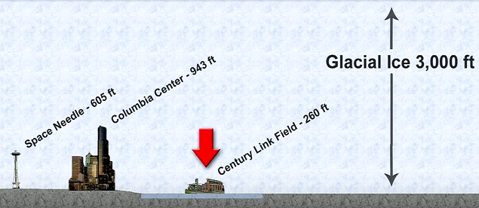
Ice Sheets in Washington State
The land around your school has been covered over by an enormous piece of ice many times in history. Right where you are standing there was a huge ice sheet pushing down on the rocks, the soil, and the hills. These huge ice sheets came back seven different times to cover the land all around your school. What would a huge ice sheet do if it was pushing down on top of your school playground and classroom?
Notes:
Allow students to discuss whole group or in partner groups the question which directly relates to their knowledge/understanding of the impact of ice in shaping the land. Students may describe erosion or talk about places that they have visited, this can be used during the lesson to guide the discussion or to press students for clarifying their ideas.
https://www.youtube.com/watch?v=TzzGPfVx32M Continental Drift Video

Slide 4
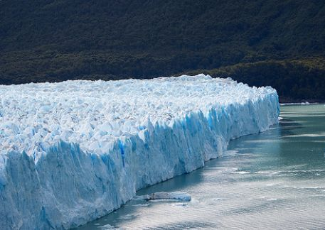
Ice sheets and glaciers are very large pieces of frozen water that are extremely heavy, incredibly strong, and usually move very, very slowly.

Slide 5
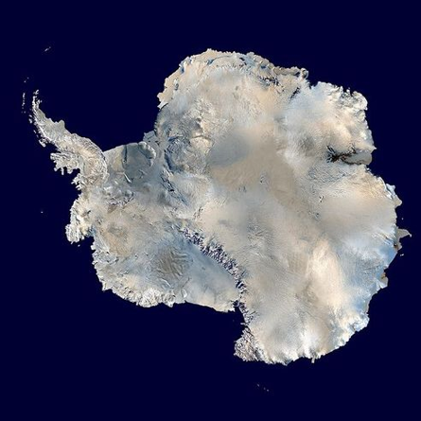
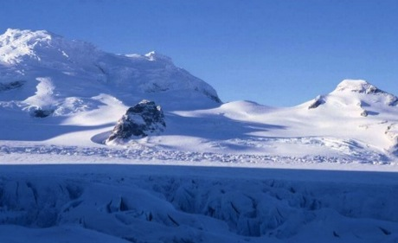
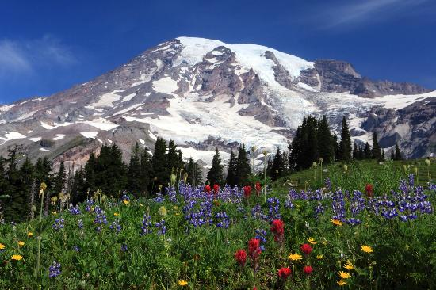
There are two types of glaciers:
Continental glaciers or ice sheets form over large areas of continents close to the North and South Poles.
Alpine Glaciers are mountain glaciers that are smaller than continental glaciers and form at the tops of mountains.
Notes:
Possibly show a globe to identify the North and South poles.
Continental glaciers: Picture of Antarctica from Space and one from the ground.
Alpine Glaciers: Mt. Rainier has 25 different glaciers many of these glaciers produce meltwater that creates rivers and gives hundreds and thousands of people clean, drinking water.
Ice Sheets are also sometimes called Ice Caps

Slide 6
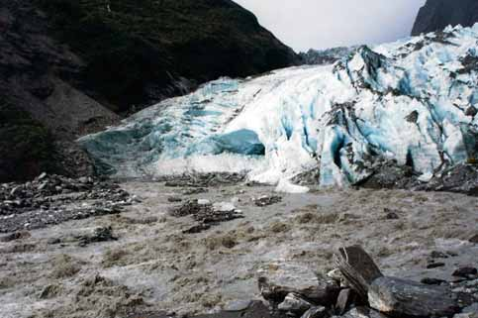
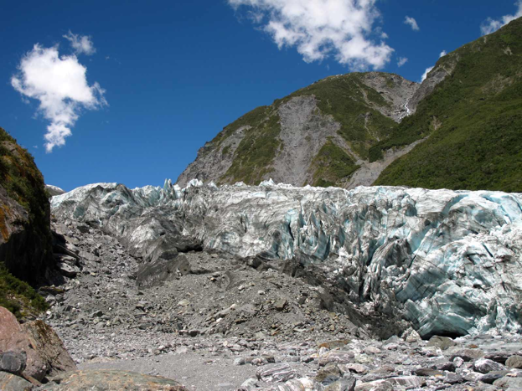
Mountain Glaciers
Most tall mountains have alpine glaciers, such as Mt. Rainier, which has 25 glaciers. Alpine glaciers are much smaller than ice sheets and usually form at the top of tall mountains.
Glaciers and ice sheets are made up of ice, snow, boulders, rocks, sand, and soil. This can sometimes make the ice look dirty. Glaciers and ice sheets move when the heavy ice pushes down causing some of the ice to melt into water. This melt water helps the whole sheet of ice to glide over the land. What do you think happens to the land when the continental glaciers move over the land? What happens when this ice melts?
Notes:
Allow students time to discuss the questions in bold if your schedule allows, even a brief turn and talk can provide students with the time necessary to digest information, share ideas, and possibly gain a new perspective.
Underline words that you don’t understand
Create a class glossary/dictionary with students for them to reference during discussions, consider adding a picture dictionary

Slide 7
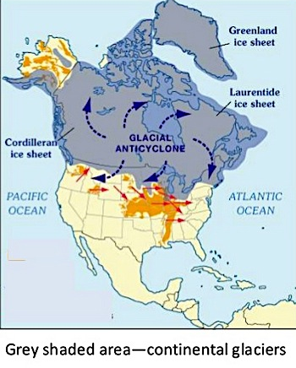
Ice Age
On Earth there are times when the weather has been much colder and other times when the temperature is warmer. When the temperature is colder, huge sheets of ice spread out from the North and South Poles to cover parts of Earth. During this cold time, glaciers on top of mountains also spread out and cover large areas of land.
Notes:
Point to Washington State and try to pinpoint for students where their school is on the map. The grey shaded area was a huge continental glacier.

Slide 8
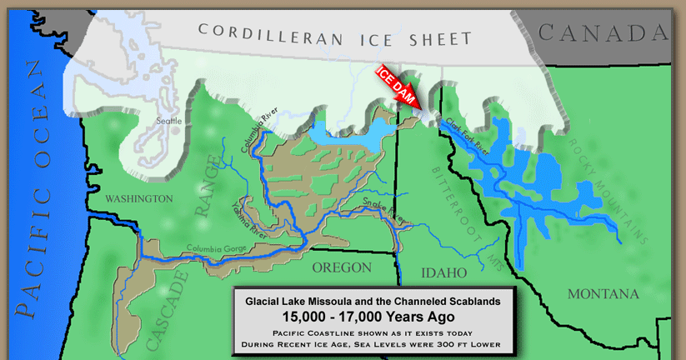
The ice sheets called continental glaciers are much, much larger than mountain glaciers and take thousands of years to form. Ice sheets can start to form when the snow falls during the winter but doesn’t melt during the summertime and then gets more layers of snow added on top every year. Ice sheets can keep getting bigger and taller if the Earth’s temperature is cooler.
Notes:
Look at the Washington State Map with students, have them discuss this ice sheet and how this may have shaped the land.
Links: http://hugefloods.com/LakeMissoula.html

Slide 9
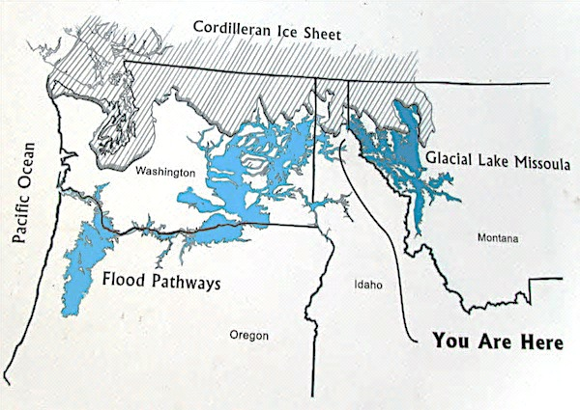
After thousands of years, the Earth slowly starts to warm again and the ice sheets melt. Sometimes they melt slowly, other times if the ice sheet is smaller such as the Cordilleran Ice Sheet, it may only take a 4,000 or 5,000 years to melt. The Cordilleran ice sheet shaped the hills and land around your school.
Notes:
The cordilleran ice sheet shaped the hills and land around your school.
The blue on the map is the meltwater flooding from the retreating ice sheet. The ice sheet is located in grey lines. Flip between this slide and the previous slide #7 to show students that places on maps and events such as our ice age can be represented in many different ways, with different colors or symbols.
Links: https://www.tes.com/lessons/ImUE_bPsI93pWg/glaciers-and-the-ice-age

Slide 10
What can glaciers do to the land?
Glaciers can scratch the land and leave behind clues that the land was once covered in ice.
Glaciers can also carve out the sides of mountains.
Notes:
Draw comparisons between this picture and their hands-on activity with ice and clay, what are the similarities and differences that they observe.

Slide 11
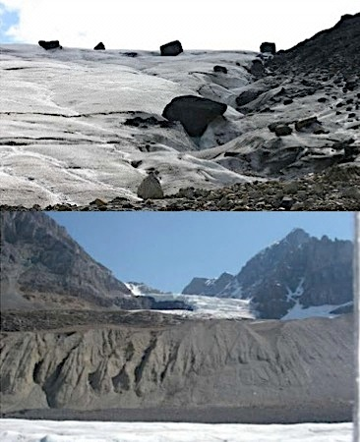
What do glaciers leave behind?
As glaciers melt, the rocks and sand that were stuck inside the ice fall out. Sometimes there are big piles of rocks, sand, and soil that a glacier leaves behind.
Rocks, sand, and soil are left on the sides or at the ends of glaciers. This pile of rocks, sand, and soil are called glacial moraines.
Glacial Moraine
Notes:
Glaciers create landforms, explain that glaciers change the land and sometimes the land can look very different after a glacier has passed through. Students will need to be explicitly told that Glacial moraines are made out of rocks, sand, and soil.

Slide 12
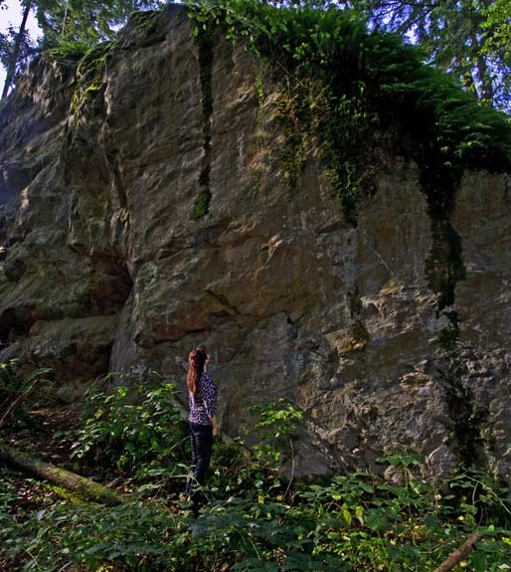
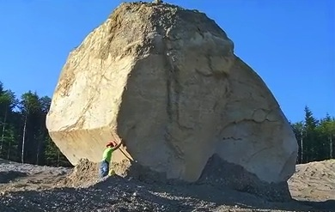
Look at these boulders left behind by a moving glacier. These boulders are much bigger than the rocks that people can pick up with their hands. Think about how big the glaciers were that could move such large boulders. What other kinds of objects could glaciers pick up and move?
Notes:
Sometimes boulders are found when there is new construction or deforestation. These types of boulders are called glacial erratics because there look so strange and stick out from the land. The second picture is a glacial erratic found in a forest. Notice in both pictures the people standing next to the boulders are much smaller than the rocks. This would be a good time to think about how massive in size the ice sheets were that moved these boulders.

Slide 13
Glacial Moraines
Glacial moraines are all over Puget Sound and near your school. Glacial moraines can be made of rocks, sand and soil. Glacial moraines have been left on the ground for so long that sometimes huge trees are growing right on top of them.
Notes:
Short video that demonstrates how Moraines are formed
https://www.youtube.com/watch?v=rkPKCWoPQP4 (start at 13 seconds)

Slide 14
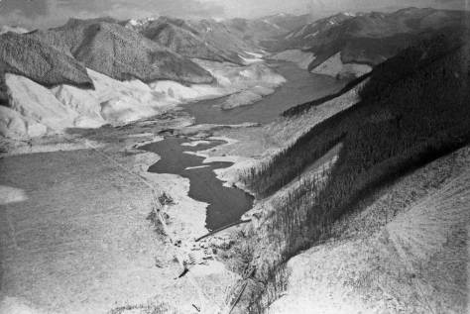
Do you see the flat area in between two mountains? That is a hidden glacial moraine. Look behind the moraine, do you see a lake? That is Chester Morris lake, you drink this water. Your water flows down from some taller mountains into the Cedar River and then into Chester Morris Lake. This water is very, very clean.
Notes:
Who can remember what a glacial moraine is made out of?

Slide 15
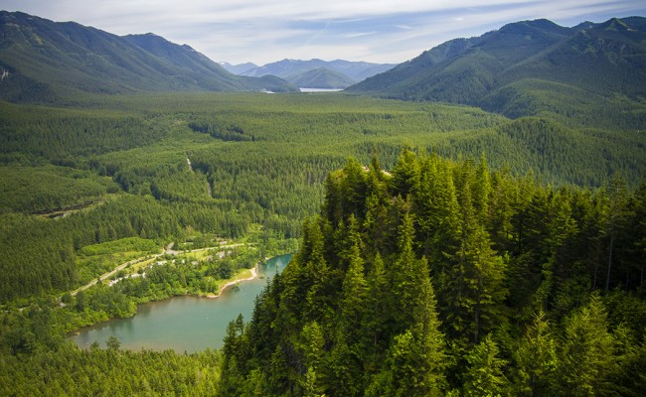
Chester Morris Lake
Dam
Solid Rock
Glacial Moraine
Rattlesnake Lake
Notes:
Here is a similar picture. You can see where the dam is, the hill next to the dam, and the glacial moraine on the other side. What earth materials do you think that the hill next to the dame is made of? Rattlesnake lake’s name comes from the grass that grows in the area, there are no actual rattlesnakes in the area.

Slide 16
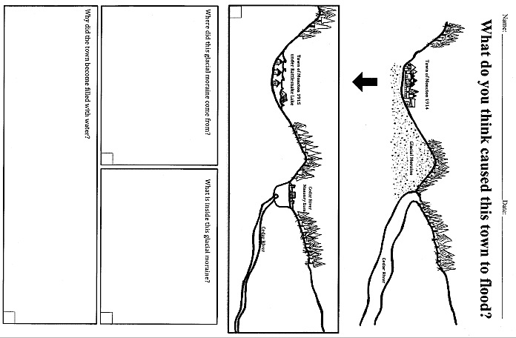
Notes:
Now is the time to add a label into the hillside, glacial moraine or glacial material. Have students add details such as glacial material is made up of small cobbles (small rocks), sand, and soil. They should draw the individual rocks and tiny pieces of sand in the rectangular shape. This may take up to 10 minutes to do.
Short Video about glaciers shaping the land https://www.youtube.com/watch?v=ybq-5RQ0q_A
Short Video about water shaping the land https://www.youtube.com/watch?v=tjjT8LE4x2g

Slide 17
Notes:
This is an example of a model of a watershed. What do you think this drawing/model is trying to tell or teach you?

Slide 18
This is the beginning of your watershed!
This is your watershed, the Cedar River Watershed. All people live in a watershed. A watershed is any area of land that water flows through and collects such as in lake or river. Most of the water in a watershed always flows downhill. It starts from snow and rain which creates small brooks, then the brooks flow into a river or lake, and eventually flowing out into the ocean. Some of the water in a watershed soaks into the ground or is used by plants and animals to survive. You are part of the Cedar River Watershed and everything that you do affects the water in the rivers, lakes, and ocean.
This means that people need to be careful with the kinds of shampoo, laundry soap, and cleaning chemicals that they use at home because it all goes down the drain and ends up in the ocean and then evaporates to the sky where it can turn into rain or snow again. This rain and snow becomes our drinking water. If our water is healthy then we will be healthy and so will the plants, animals, and the land.
Notes:
Show this video after the 2 minute discussion https://www.youtube.com/watch?v=QOrVotzBNto

Slide 19
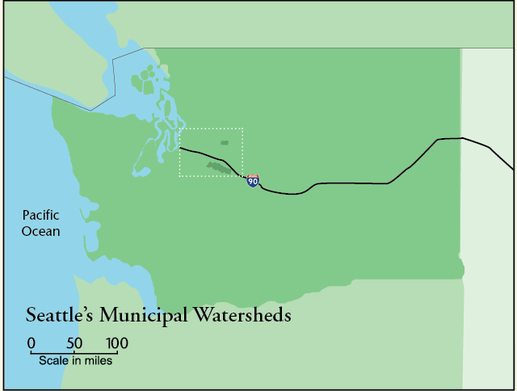
Mapping the Cedar River Watershed
Notes:
This is a map of Washington State. Your school is located in Washington State. You live in Washington State.

Slide 20
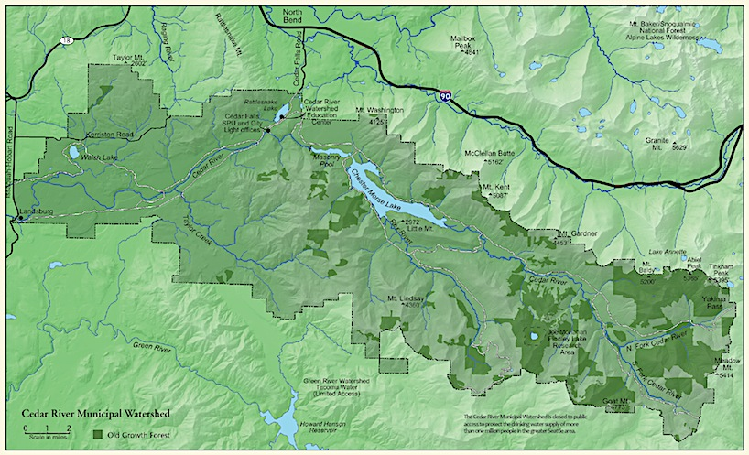
Cedar River Watershed
Notes:
Map Treasure Hunt: Use a highlighter or yellow marker to trace.
Can you find water on this map?
Can you find the North Fork of the Cedar River? The South Fork of the Cedar River?
Can you find Chester Morris Lake?
Can you find Rattlesnake Lake?
What do you notice about the colors of this map? Did you know that the City of Seattle bought all the land around the watershed to protect the quality (cleanliness) of the water you drink. The dark green shows all the area that is protected. Nobody can build houses, stores, or anything in the dark green area. Nobody is allowed to swim or put their boat on the lake, only scientists can visit and travel on the lake. But all 4th grade students in Highline School District will take a field trip to the Cedar River Watershed. When they go on this field trip the students will get the chance to walk on the dam and see exactly where their water lives.

Slide 21
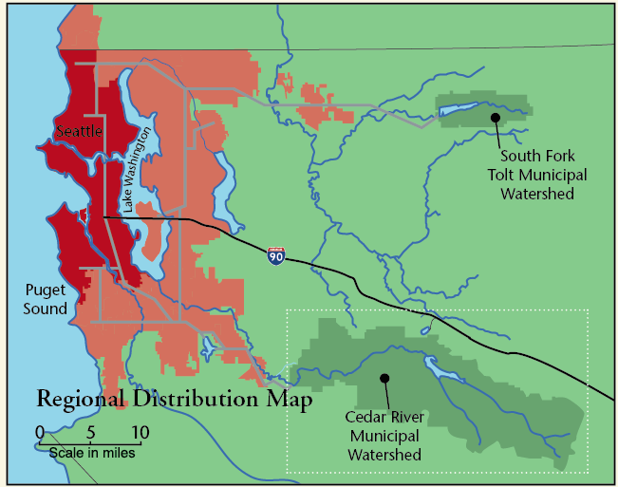
Who drinks the Cedar River water?
Notes:
All the people that live in the red part of the map drink water from the Cedar River Watershed. The Seattle area which includes Burien, Seatac, Des Moines, and all of Highline School District get most of their water from the Cedar River Watershed. But we also get water from the South Fork Tolt River Watershed. Can you find the two watersheds on this map?
http://www.seattle.gov/util/EnvironmentConservation/OurWatersheds/CedarRiverWatershed/SlideShow/index.htm
Show this powerpoint at the end of the lesson or during a short 5-7 minute time.

Slide 22
Porosity & Permeability Experiment
Earth material | Time (seconds) | Observations
No Earth material
Pebbles
Pebbles, Sand, Soil
Clay

Slide 23
Porosity: The amount of space in between the small pieces of rocks, sand, soil, and clay.
Small Rocks
Sand
Clay
Notes:
Can someone come to the board to touch where the space between the pieces of gravel (pebbles), sand, and clay.

Slide 24
Permeability: How fast water can flow through Earth materials such as sand or clay.
Small Rocks
Sand
Clay
Notes:
Who can tell us what the difference is between porosity and permeability? Lets draw the differences and label our work.

Slide 25
Modeling Porosity and Permeability
Earth Materials | Zoom in Box
Pebbles
Pebbles, Sand, Soil
Clay
Notes:
Video (start at 2:54 end at 5:30) https://www.youtube.com/watch?v=8mfBomrw0rs if you have advanced students that would benefit from a more rigorous challenge allow all of your students to watch the entire 6minute video
Tell students that they will be practicing drawing porosity and permeability so that they can think about it when they do it on their model.

Slide 26
Geology of the North Side of the Dam
Notes:
What should I draw here? Draw what is inside this hillside, it is a porous glacial moraine made out to rocks and sand.
Teacher Content Video: https://www.youtube.com/watch?v=vmo0FRAVgkM

Slide 27
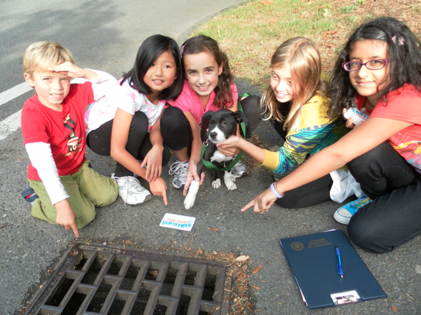
What can I do to help? Save water and electricity.
Turn off the water when you are brushing your teeth
Take shorter showers
Turn off the lights if nobody is in the room
Walk or ride your bike
Pick up trash, especially around storm drains
Notes:
By saving water and electricity you are limiting the amount of water that is needed to get things done such as brushing your teeth or taking a shower.

Slide 28
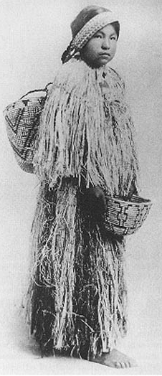
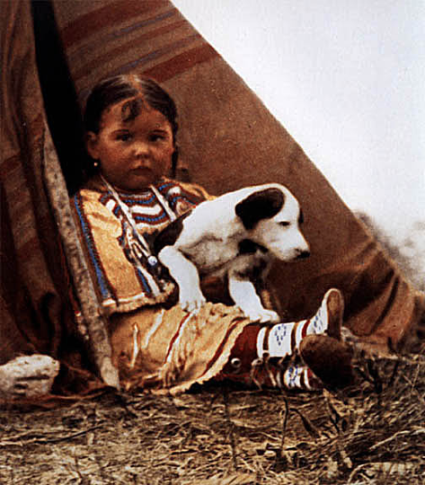
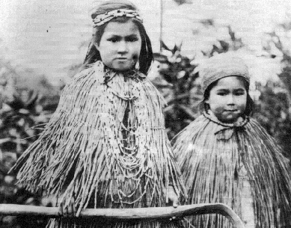
The First People
Notes:
These are pictures of children of the local tribes (Duwamish, Snoqualmie, Muckleshoot) that lived in the Seattle area and near the town of Moncton.
The Muckleshoot girl wears traditional skirt and cape of cedar bark, late 1800s. The first people knew how to take Cedar bark and soak it and make it into clothing, diapers, baskets, hats, and shelter (log houses). The cedar clothing was waterproof and was sustainable, meaning that making it doesn’t harm the environment and the harvesting of the Cedar was done in a very intentional and honorable way so that only certain parts of one side of the Cedar tree would have its’ bark stripped.
Courtesy Smithsonian Institution
Northwest Native American Child with puppy
The Native Americans consider this clothing sacred and only use it for certain occasions. Many Native American tribal members do not like when people use this sacred clothing to dress up for Halloween or for costumes, they consider that very disrespectful to their culture and heritage.

Slide 29
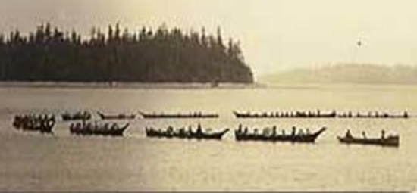
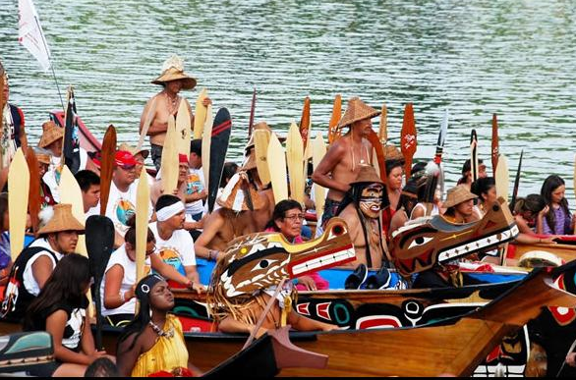
After the last glaciers and ice sheets slowly retreated, about 12,000 years ago the First People came to this area. These first people formed tribes and lived all around the watersheds. This land is was and is still their home. There were many tribes that lived all around the Cedar River Watershed. The Snoqualmie Tribe, the Yakama Tribe, The Muckleshoot Tribe, the Wenatchee Tribe, and the Duwamish tribe would all come to the area around the Cedar River to trade different food, clothing, medicine, and other important items. These meetings of all the tribes were also important to meet people to marry and to share stories and news. The Cedar River is a sacred place for these tribes.

Slide 30
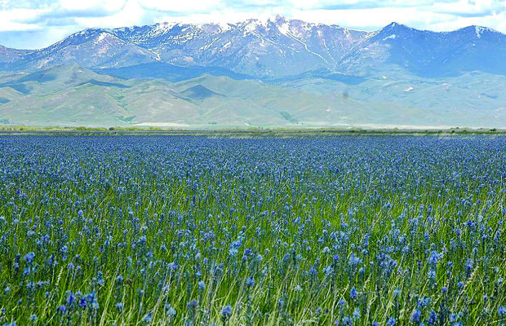
Prairies
Rattlesnake lake was once a beautiful prairie, similar to the one in the picture. The Native American tribes that lived in the area would take care of the land and harvest flower bulbs, such as Camas. They would roast these bulbs in a big, underground fire pit oven. Then they could eat the bulbs or trade them for a different food during the special meetings. At certain times in the year, the Native American people knew that they had to burn the prairie so the ash would make the soil filled with nutrients for the next year’s flower bulbs. This burning also helps keep the prairie clear of big fir trees. Every year this cycle of harvesting and burning would take place. The Native American people still do this practice today and teach others how to take care of the land.
Notes:
Prairies were found all over North America and beyond. The First People had advanced the practice of controlled burning to manage and shape the land. This controlled burning helped to make the land lush and fertile for continued harvesting of edible bulbs.

Slide 31
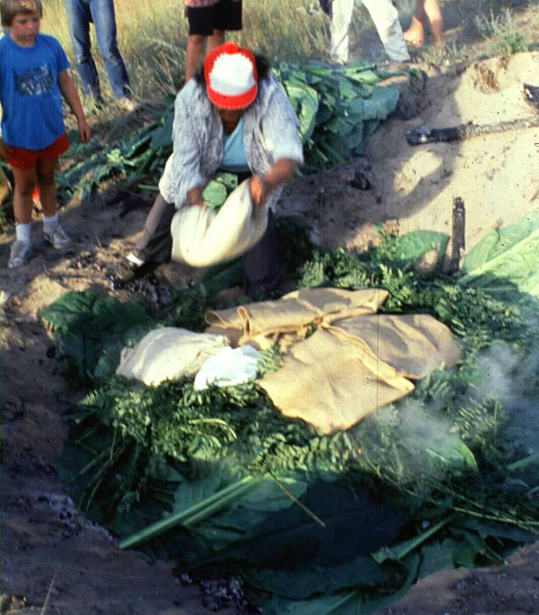
Camas Oven
Notes:
This underground oven is used to cook the Camas bulbs (similar to a tulip bulb). In this photograph they are using Skunk Cabbage Leaves and Ferns above the hot coals and rocks beneath.

Slide 32
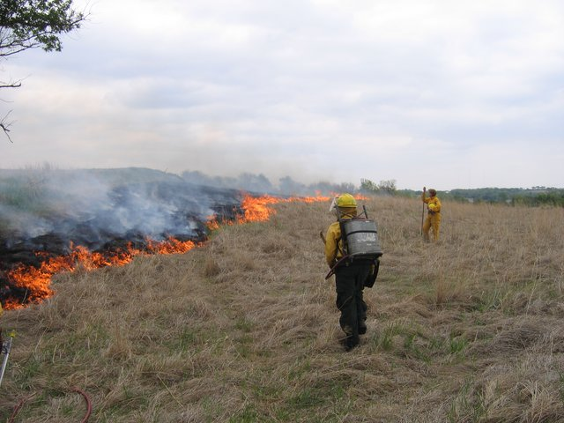
Burning the prairie still happens today. Fires are controlled safely. Burning helps the soil get more nutrients and helps plants grow better the next year. Controlled burns also help prevent future fires from becoming unsafe.

Slide 33
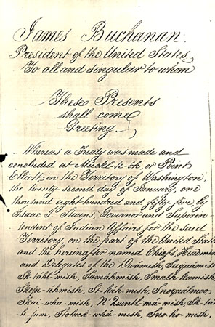
Treaty of Point Elliot
A treaty is a promise to follow rules or ideas. In 1855 the Treaty of Point Elliot was signed by the United States Government and 82 Native American Tribal signers, including Chief Sealth, the Duwamish leader. The Native American signers of the treaty were forced to sign away 64 million acres but they were allowed to keep their right to fish for food. The beautiful, sacred prairie land and the land around the Cedar River was given to the settlers, railroad companies, logging companies, and the local governments.
Notes:
Let students know that treaties in that era were usually handwritten with fancy cursive writing.

Slide 34
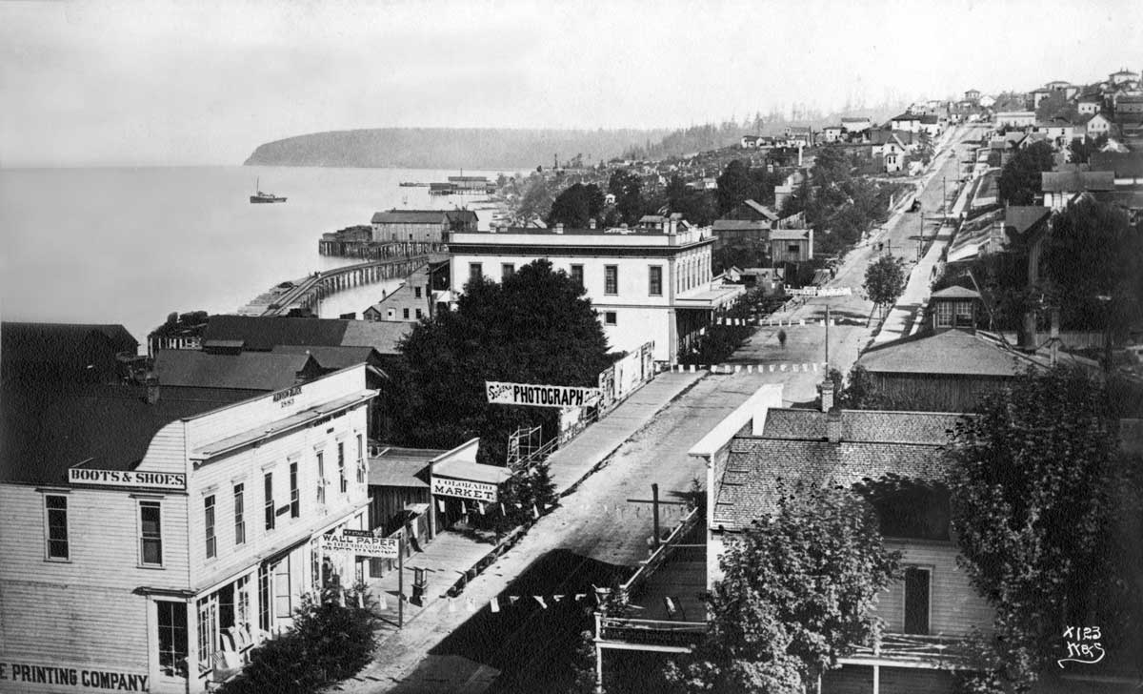
Seattle in 1886
The buildings in Seattle used to be made mostly out of wood, but there were a few brick and stone buildings. Just 3 years after this picture was taken there was a huge fire, that burned through all that wood.

Slide 35
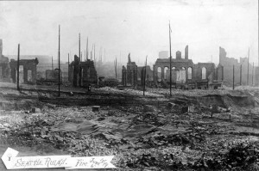
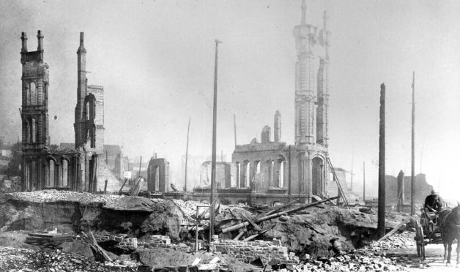
The Great Seattle Fire 1889
The fire burned through most of the buildings in downtown Seattle. Many people lost their jobs and homes.

Slide 36
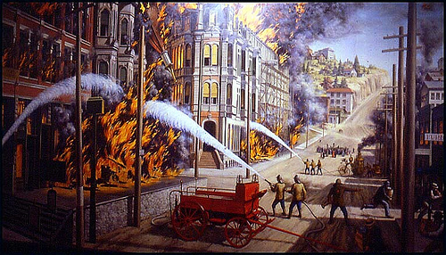
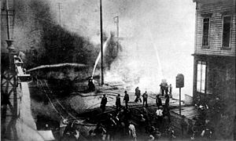
Seattle needs water and power
During the fire, the firefighters had a hard time getting a strong flow of water to stop the fire. One reason for this was because this was a time before Seattle got their water from the Cedar River Watershed. After the fire, the city of Seattle decided to rebuild many buildings but this time using more brick so that it wouldn’t catch on fire so easily. This new construction meant that there were many new jobs. Lots of families moved to Seattle to work on these new jobs. But with all these new people moving to Seattle, the city needed more electricity. So they decided to look more closely at the Cedar River and find a way to bring more water and electricity to Seattle.

Slide 37
The Town of Moncton
The town of Moncton was located near the Cedar River and very close to the place that Seattle wanted to get their water from. In the next few pages you will read about how the town of Moncton was created and how the town disappeared.

Slide 38
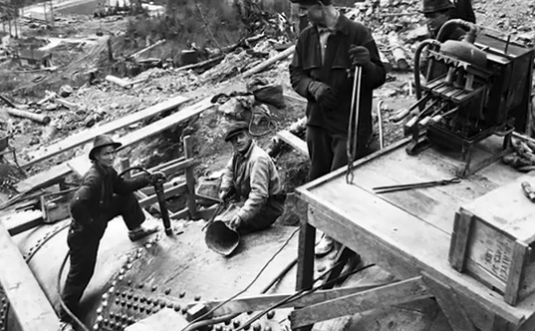
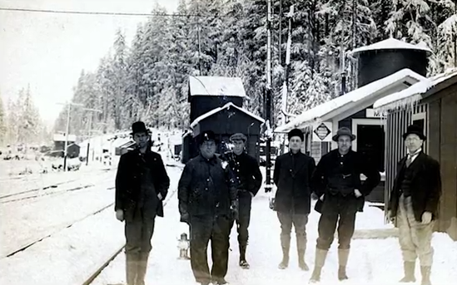
History of Moncton
In 1906, Moncton began as a railroad worker camp and a few years later Seattle City Light and Seattle Water workers also lived here.

Slide 39
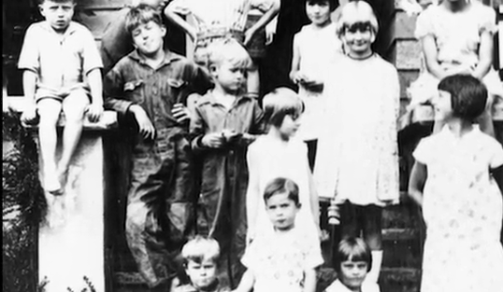
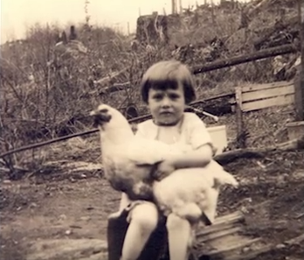
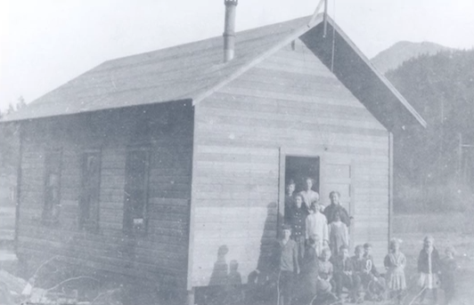
These workers brought their families. There were so many children in Moncton, that the town opened up a school.

Slide 40
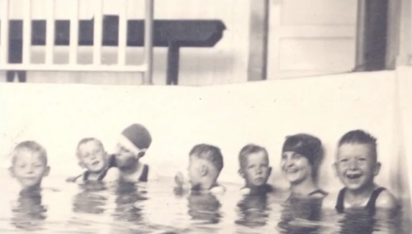
Moncton had a small indoor swimming pool, a hotel, and 200 people living and working in the town. In 1911, Moncton was renamed Cedar Falls. While these people were all living in Cedar Falls, Seattle began to build a new dam and power plant to control the water and make electricity.
Notes:
What does it mean when you rename something?

Slide 41
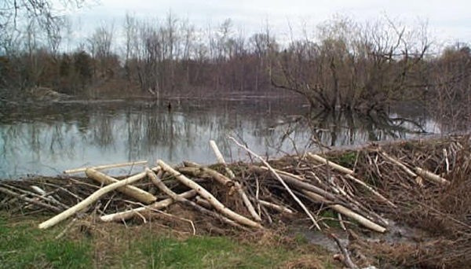
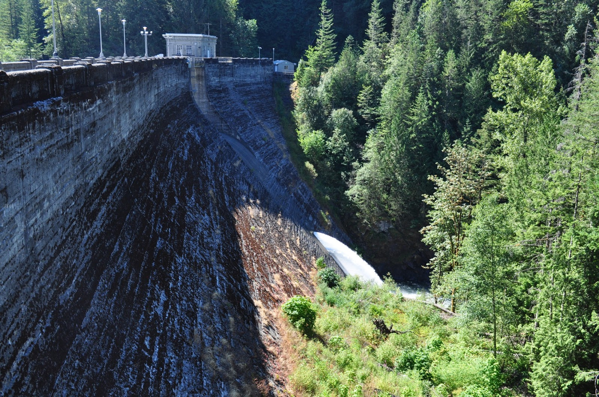
What is a dam?
A dam is a barrier like a big wall or fence to hold back water. People and animals build dams. Beavers build dams for protection and to block underwater noises. People build dams to control water to make electricity or saving the water for drinking.
Beaver Dam
Cedar River Masonry Dam

Slide 42
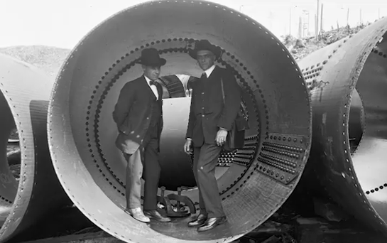
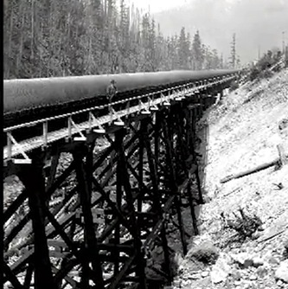
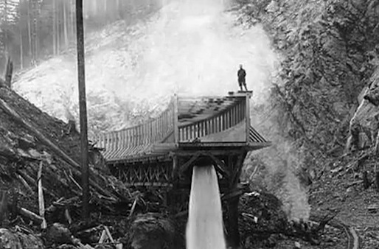
Making a dam takes a lot of careful planning. The water from the Cedar River is always rushing forward and downhill to the Pacific Ocean. When this dam was built, the engineers had to use their plans, math skills, scientific models, and problem solving skills to build the dam carefully.

Slide 43
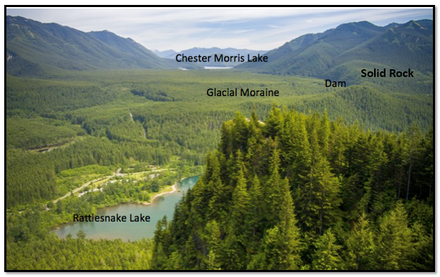
Disagreements about the Dam
Just after the City of Seattle started to build the dam there was a group of scientists and engineers that told the people working on the dam building project that there would be a problem with water leaking into the glacial moraine if they continued to build the dam. This group of scientists thought that since the dam was being built next to a glacial moraine that it would cause water to lead through the small rocks and sand very easily. But the City of Seattle ignored this warning and they kept building the dam anyway.

Slide 44
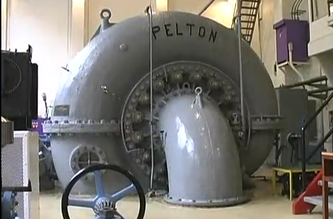
The Cedar River Masonry Dam was finished in November of 1914. There was also a hydroelectric power plant built that the water flows through to make electricity. In the top picture the land next to the dam is solid rock but on the other side of dam the hill is made of small rocks and sand.
Notes:
Hydropower plants capture the energy of falling water to generate electricity. A turbine converts the kinetic energy of falling water into mechanical energy. Then a generator converts the mechanical energy from the turbine into electrical energy.
http://www.wvic.com/content/how_hydropower_works.cfm
Dam. Raises the water level of the river to create falling water. Also controls the flow of water. The reservoir that is formed is, in effect, stored energy.
Turbine. The force of falling water pushing against the turbine's blades causes the turbine to spin. A water turbine is much like a windmill, except the energy is provided by falling water instead of wind. The turbine converts the kinetic energy of falling water into mechanical energy.
Generator. Connected to the turbine by shafts and possibly gears so when the turbine spins it causes the generator to spin also. Converts the mechanical energy from the turbine into electric energy. Generators in hydropower plants work just like the generators in other types of power plants.
Transmission lines. Conduct electricity from the hydropower plant to homes and business.

Slide 45
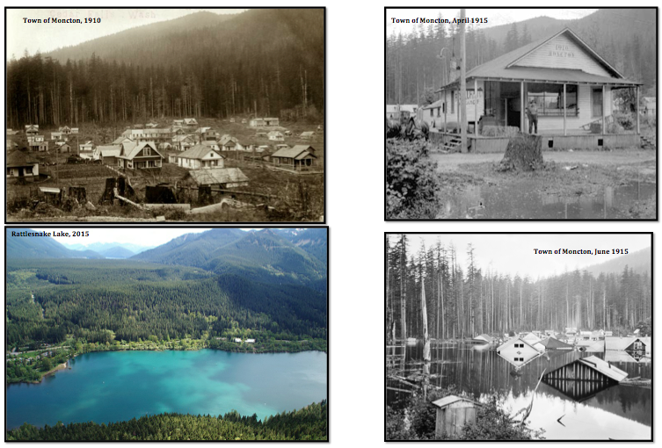
The Slow Flood
Notes:
Can you look at these pictures to determine and use evidence for explaining how the town flooded?

Slide 46
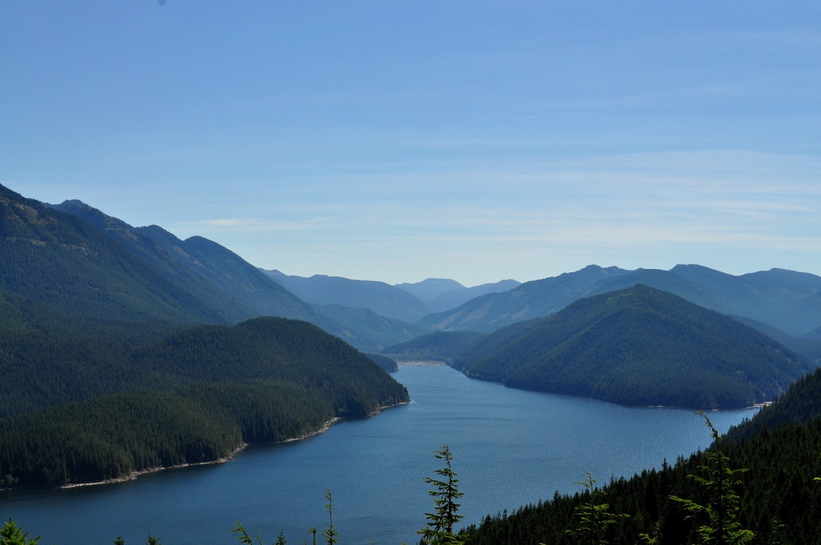
You are the Cedar River
Notes:
When you drink the tap water you are drinking water that came from a place shaped by glaciers during the ice age. Because you drink this water you are part of the Cedar River and the Cedar River is part of you. Can you think of one thing that you can do to help our water stay clean?

Slide 47
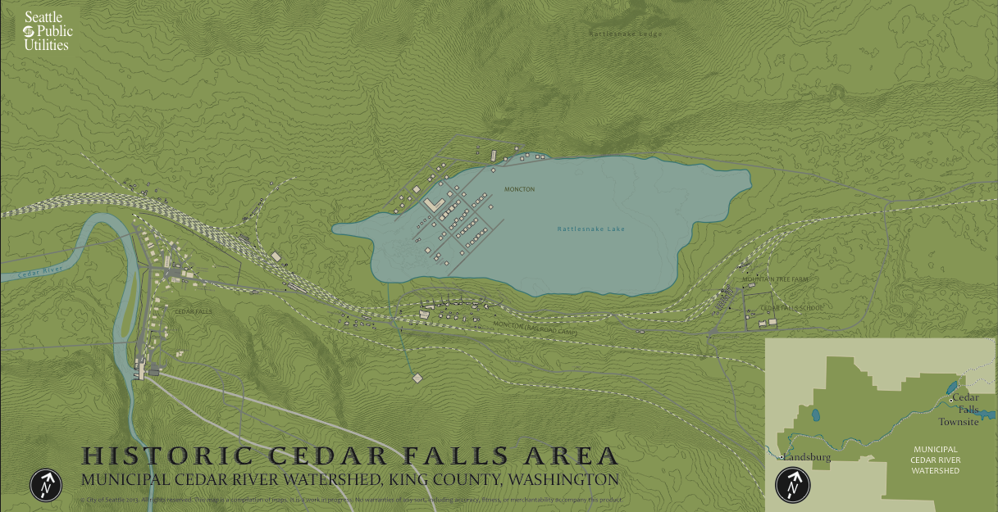
Rattlesnake lake
Notes:
This is a map of Rattlesnake Lake and the town of Moncton. After the town was built the name was changed to Cedar Falls. You might see the name Moncton or Cedar Falls on the map, they mean the same place. Do you see the little lines on the map, these are called contour lines (elevation) which show how steep or tall the land is. When the lines are close together it means that land is very steep.

Slide 48
What caused the flooding? Where did the water come from?
Notes:
Create a new list of ideas for students

Slide 50
MAPS
Notes:
Washington State Maps http://www.bentler.us/washington-state/maps/default.aspx

Slide 51
Cross-Section Map
Notes:
Tell students that they will be using a cross-section map. Relate this map to taking a slice of cake and seeing what is in the middle and being able to draw what is in the middle and top. Another image is to look at a cliff, which shows the very different kinds of Earth materials that were created long ago during different time periods.

Slide 52
Washington State Map
Notes:
Star represents roughly where Highline School District is located.

Slide 54
Notes:
Can you find the mountain ranges? What color are they

Slide 55
World Map

Slide 63
Photo and Map Credits
Seattle Municipal Archives
Museum of History and Industry, Seattle
Snoqualmie Valley Historical Society
Cedar River Watershed Education Center, Ralph Ness & Julie Stonefelt
University of Washington Digital Archive Collections
Seattle Post-Intelligencer
Smithsonian Institute

