Slide 1
Objective: To learn about energy transfer and cycling within marine ecosystems.
Do Now:
What are some organisms you would expect to find in Puget Sound? How might they be connected?

Slide 2
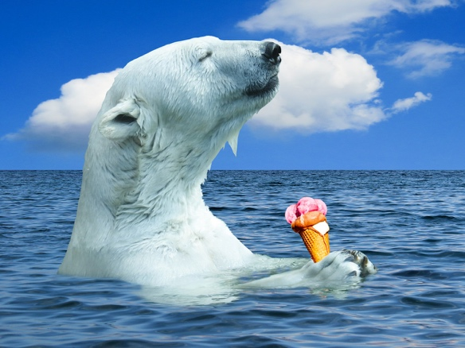
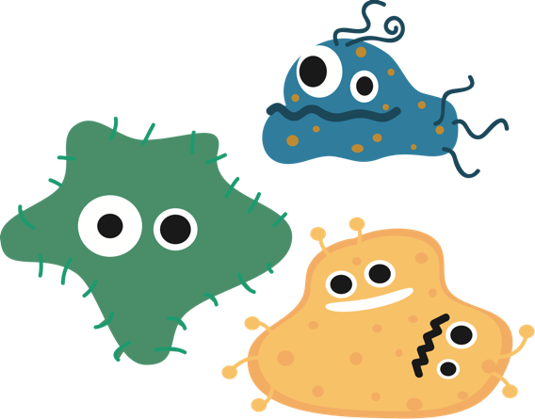
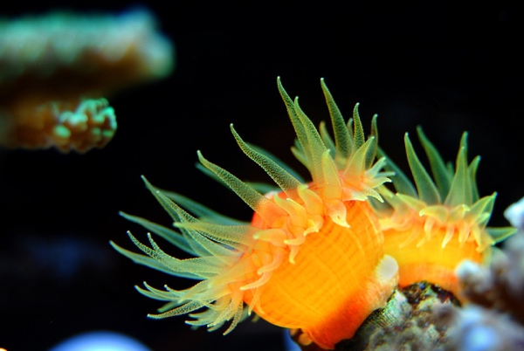
Every living thing needs energy to survive...
But where does this energy come from?
Notes:
We all know that living things need energy to survive, be it a tree, a polar bear, corals (which I study and also require unique amounts of energy), to microscopic bacteria, and ultimately humans. Today’s lesson will focus on where that energy comes from for a particular ecosystem. In thinking about that, where do you think some of these organisms get energy for growth? Hint - it’s not the ice cream cone for the polar bear. What about the tree?

Slide 3
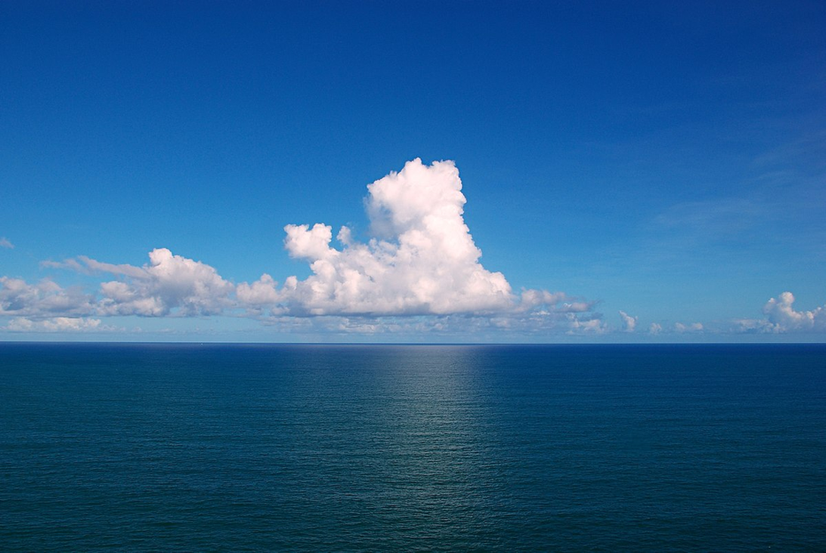
The sun surely plays an important role...
VS
?
Where does the sun’s energy go?
Terrestrial Ecosystems
Marine Ecosystems
Notes:
Trees and plants perform photosynthesis to make their own food and energy from sunlight, nutrients, and water. This process fuels the transfer of energy on land, as other organisms consume the plant material, and larger organisms consume those organisms. BUT! The story may get a bit complicated when looking at the ocean. We know that lots of stuff lives in the ocean, but where does the initial energy come from? What forms the base of the marine food pyramid?

Slide 4
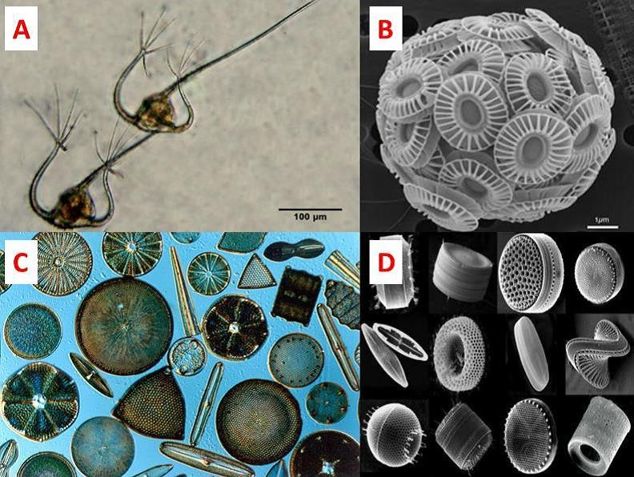
First stop → PHYTOPLANKTON!
Where does this energy go next?
Phytoplankton: A diverse group of photosynthetic organisms that form the base of aquatic food webs.
PC: OceanBites.org
Notes:
Tiny, often microscopic organisms called phytoplankton (a form of algae) take the energy from the sun and combine it with nutrients to produce sugars and energy for growth. These organisms are incredibly diverse (just like not all plants on land look the same), and form the base of the marine food pyramid.
Fun facts:
Phytoplankton come in many shapes and sizes. A shows two dinoflagellates, B shows a much smaller coccolithophore (which builds a shell from plates of CaCO3, a form of limestone or TUMS antacid), while C & D both show a variety of diatoms (which make shells from silica). 75 µm is the width of a human hair, for reference.
Together, these tiny organisms are responsible for ≥ 50% of our planet’s oxygen.

Slide 5
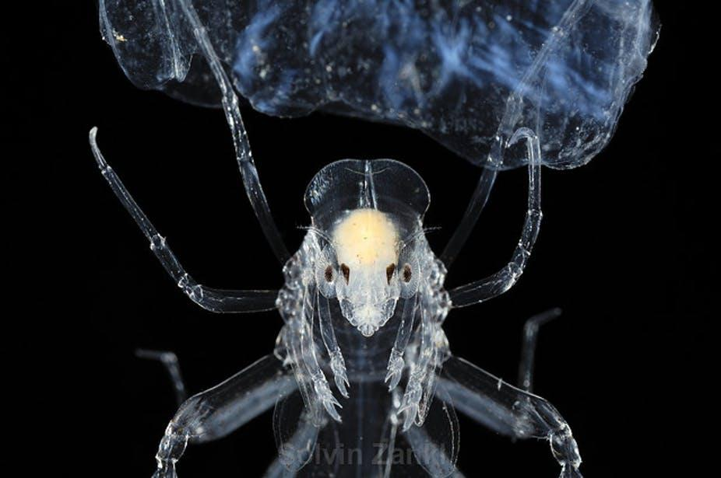
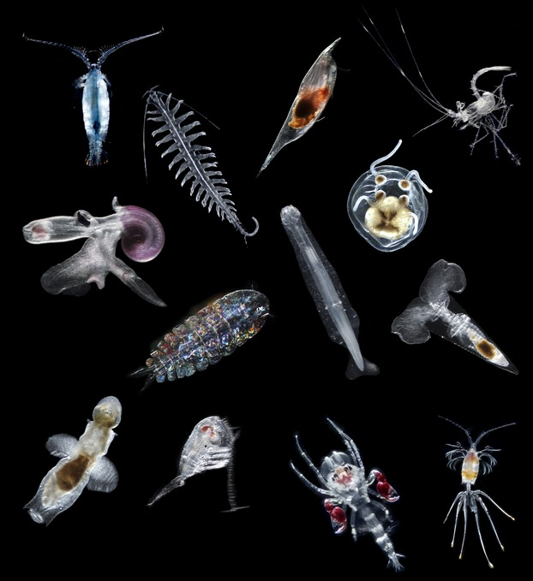
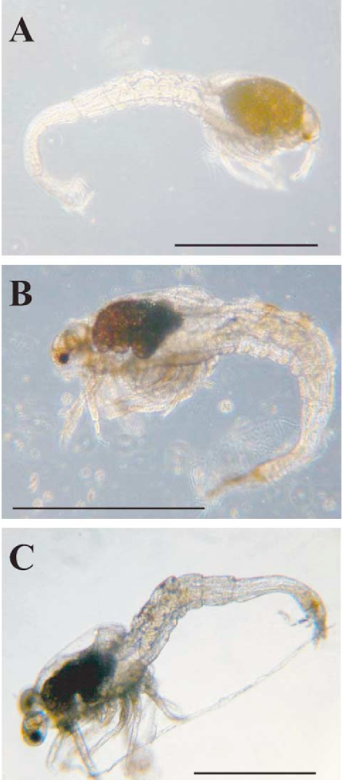
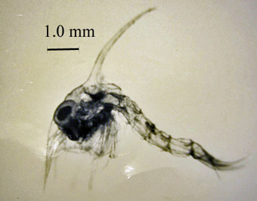
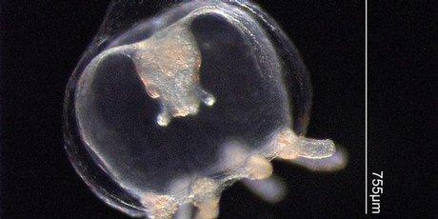
Next stop - ZOOPLANKTON
Where does this energy go next?
PC: Oregon Department of Fish & Wildlife
PC: Ocean Care Solutions
PC: Peijnenburg and Goetze (2013), Ecology and Evolution. 3:8
PC: Koyama et al. (2005), Marine Biotechnology. 7:4
Notes:
Zooplankton represent primary consumers and the first step of energy transfer between organisms in marine ecosystems!
Top Left: Dungeness Crab larvae
Bottom Left: Jellyfish larvae
Center: Diverse mix of holozooplankton
Left: Deep-sea shrimp larvae (1mm scale bars).
Let’s continue to track the flow of energy through the marine ecosystem using some of the organisms you all put in your schematics. We’ll also build this food pyramid as we go along.
Fun fact: Though small in the real world, you can imagine that some of these zooplankton would be incredibly frightening if they were “life-sized.” In fact, people have recently drawn attention to the fact that the alien from Alien looks a lot like organisms from the genus Phronima...art imitating life, perhaps?

